Slide 1
Master Wine Tour - JJ Cariou -
Digital marketing
Introduction: Some essential reminders (marketing, images…), state of mind, goals and organisation of the course
Part 1 Basics of web design (including seo)

Slide 2
Introduction
1 basics of web design
2 SEO
Introduction
Introduction

Slide 3
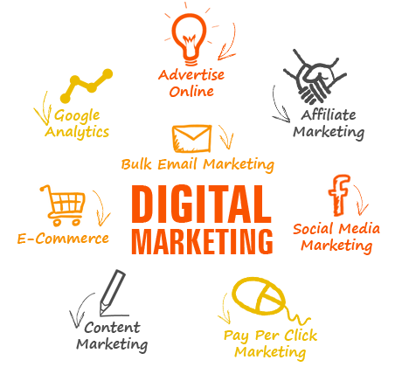
Introduction
Some essential reminders…
What is marketing ?
“the science and art of exploring, creating, and delivering value to satisfy the needs of a target market at a profit. Marketing identifies unfulfilled needs and desires. It defines, measures and quantifies the size of the identified market and the profit potential. It pinpoints which segments the company is capable of serving best and it designs and promotes the appropriate products and services.” (Philip Kotler)
What is digital marketing ?
Digital marketing is marketing on the internet.
For the most part digital marketing is about:
- communicating, with the public or with leads or with customers/clients/consumers through one of the following means: websites (own or partners or ads…), social network/social media, e-mail, mobile apps. E-communication= give and obtain information + encourage the public/consumers to exchange information about us through the internet.
- sales (e-commerce) thanks to . : websites, social network/social media, mobile apps

Slide 4
The market
Introduction
What we are going to do
and marketing
Distribution system (goods and/or services)
Demand analysis (+ e-reputation / on line reputation)
Products policy/ management, pricing
3
Market
Informations
Competition analysis
(+ e-reputation)
Customers/consumers
intermediaries
Goods and services
Produceurs/sellers
Money
Informations
Informations
Communication policy /management: (BtoC) advertising, OtoO com., (included:
Web, social media)
Informations
Communication policy /management:
(CtoC), buzz /viral marketing, community management
1
2

Slide 5
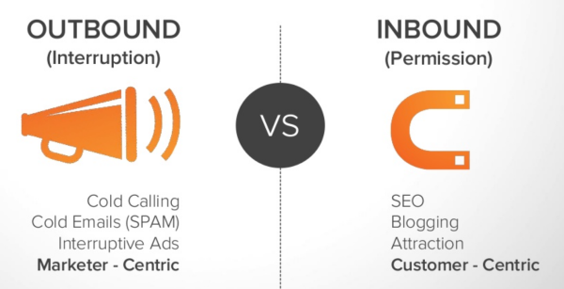
Introduction
Our state of mind: « Inbound marketing »
What is inbound marketing (vs outbound marketing) ?
Inbound marketing is an approach focused on attracting customers through content and interactions that are relevant and helpful — not interruptive/not intrusive. With inbound marketing, potential customers find you through channels like blogs, search engines, reviews and social media — unlike outbound marketing, which fights for their attention. By creating content designed to address the problems and needs of your ideal customers, inbound marketing attracts qualified prospects and builds trust and credibility for your business. (freely adapted from :https://www.hubspot.com/inbound-marketing )
Intrusive marketing
Massive ads
Permission marketing
No ads

Slide 6
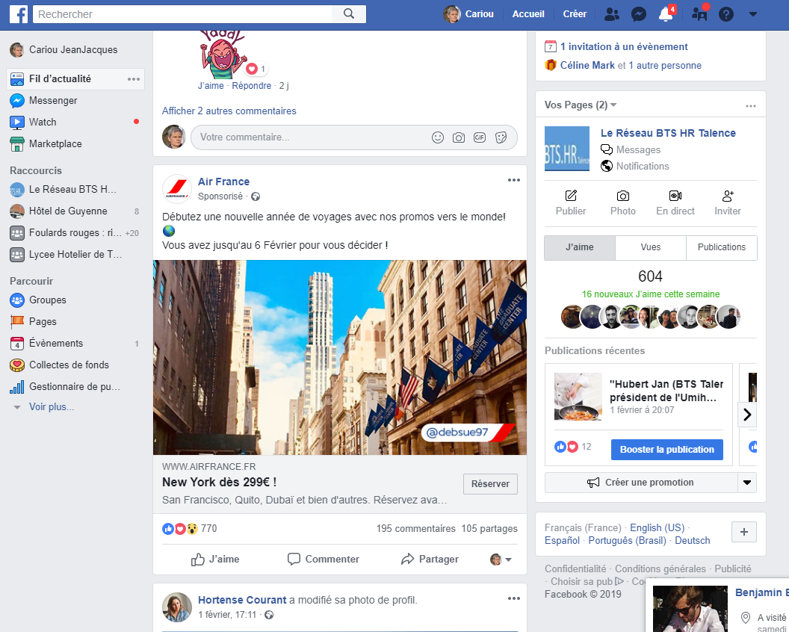
This post (from Air France):
Inbound ou outbound ?

Slide 7
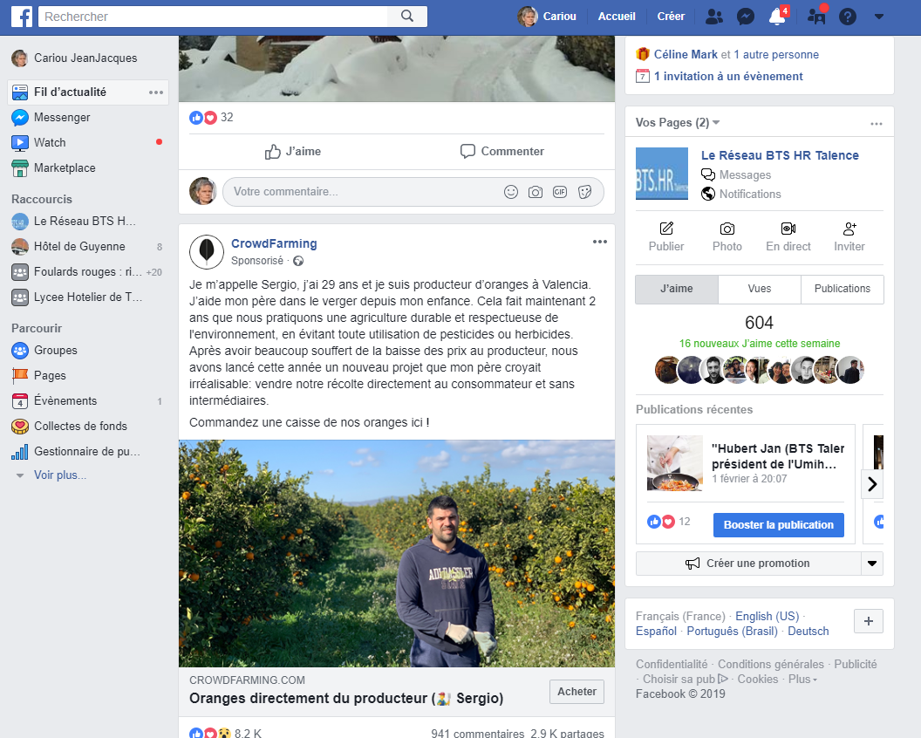
This post :
Inbound ou outbound ?

Slide 8
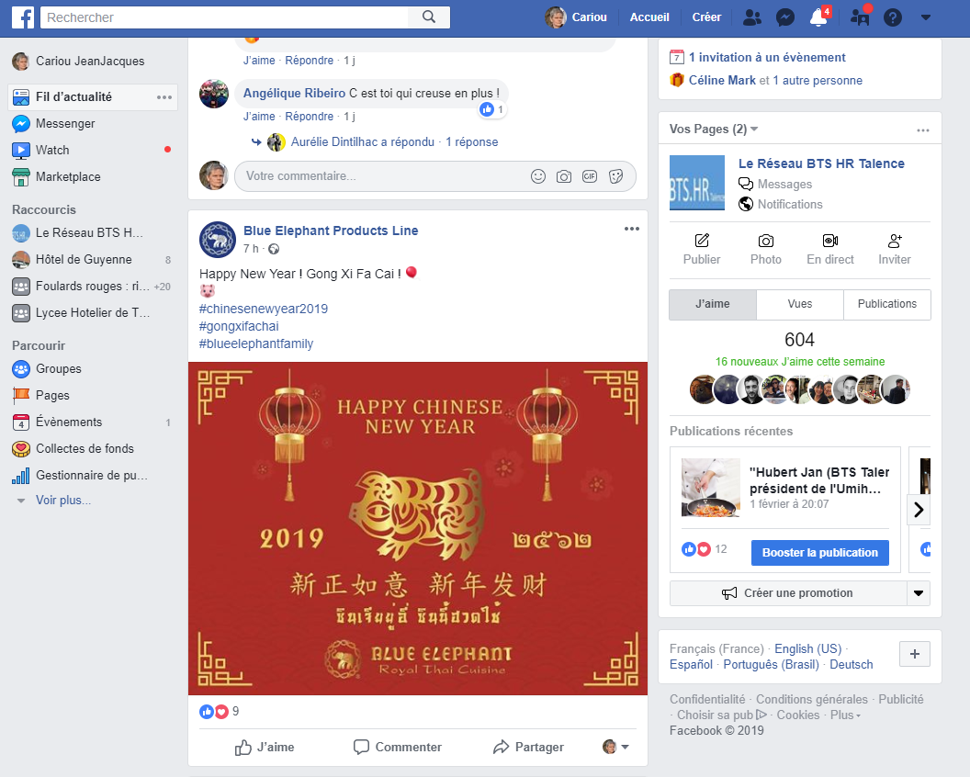
This post :
Inbound ou outbound ?

Slide 9
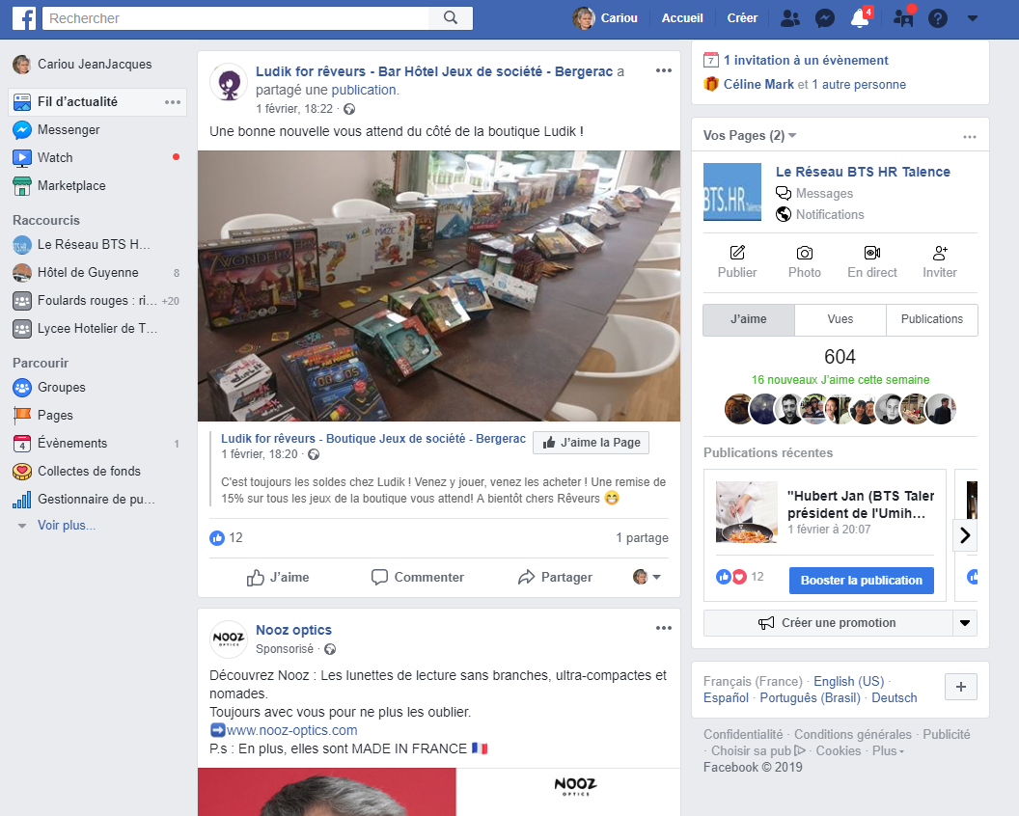
This post :
Inbound ou outbound ?

Slide 10
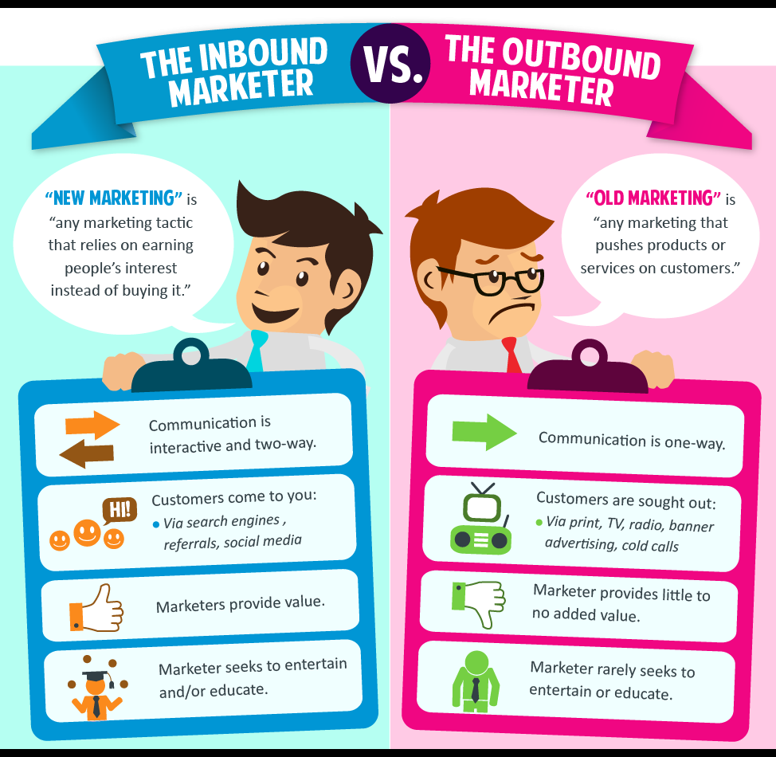
Introduction
earned audience
payed audience
http://charisestevens.com/5-inbound-marketing-strategies/

Slide 11

Introduction
I prefer widely inbound marketing to traditional marketing for several reasons:
First it is more effective marketing because over time the consumer has learned to protect himself from the traditional marketing. He is no longer permeable to the traditional ads. He has acquired a protection armor/a shield against all aggressive or intrusive commercial speeches/ads...
Moreover from an ethical point of view inbound marketing is more respectable.
To finish, it avoids saturation of the different media by the commercial discourse

Slide 12
Introduction
That's all for the theoretical part !
Let’s go for the workshop !

Slide 13
Agenda
(D1 = day 1 or step1, D2 = day 2…)
Introduction
Introduction + choice of theme + definition of objectives
D1
Web site design
D2
Optimization, SEO, SMO, KPI (Key Performance Indicators), analytics,
Dashboard
D3
D4/5
Social media (e-reputation and community management)
D6/7
E-mailing
(news letters…)
D8/9
E-commerce
D10
Presentation / defense
And at the end you will have a mark

Slide 14
Introduction
Day 1 (Step 1): create your own web site
(team of 2)

Slide 15
Introduction
Introduction
The website is often (not always) a central tool for the digital marketing of a company. The social networks of the company lead there, the newsletters also, the advertising campaigns (display) also.
In general, relatively long-term / stable information is placed on the website (except possibly for the “news” section), unlike “social media” (that include less sustainable, more volatile information and « news letters ».
There is also often a part for the sales (e-shop, booking system…)
In short, it's difficult to do without!
News letter
Social media
Website
Off line communication (flyer…)
On-line PR (public relation)
E-mailing

Slide 16

Introduction
Introduction :
A website is a set of pages linked together
To built a website you have to create the pages (files), link them together and then transfer them to a server where they will be available for the Internet users. The language mainly used is HTML (« HyperText Mark-Up Language »)
1) To create the pages there are two main solutions: HTML editor (Dreamweaver, BlueGriffon ...) or CMS (Wordpress, joomla …). We will very quickly explore HTML editor then spend more time on CMS (Contend Management System)
2) To put the pages on a server:
  It takes a web hosting on a server (web hosting company : 1 & 1, OVH for example ...)
  It takes an address on the server of this web hosting company (a domain name ...)
  It is necessary to transfer the pages on this server and for that a small adapted software (Filezilla for example). Occasionally we can also do it online for example with the website “net2ftp”.)
24/24 - 7/7 - 365/365
+ mirror copy…

Slide 17
Introduction
Hosting: How does that cost ?
(not a lot)
For a small company: 10 €/month (1&1)
For a big company, for big traffic: a lot more (thousands €/month)
Click here: ionos

Slide 18





Introduction
Traditionally, a "HTML editor" was used and HTML files were created (The best known of this software is Dreamweaver). These files are read with a web browser (browsers: firefox, internet explorer, google chrome ...)
It is also possible to create an simple html page with a text editor:
Open "Wordpad" and enter/type the following lines:
_________________________________________
<!DOCTYPE html>
<html>
<head>
<title>Bonjour MWT</title>
</head>
<body>
First name
This is my first page !
</body>
</html>
_________________________________________
Save the file with the name: test.html
Close wordpad
Find your file ... then doubleclick on it
What do you notice?
What is an internet browser ? (a software to read html files)
Web browsers
…

Slide 19

Introduction
You can save this file on a USB stick, external hard drive, google drive ....
You can also save it on a server that stays on 24 hours a day . And if this server is connected to a network (internet for example) you can access this file at any time of the day or night from any computer anywhere in the world connected to this network.
On the Internet it is enough to give the address of the file so that any user can read this file. For reasons of convenience the addresses are materialized by “domain names” ( type: 108.177.96.105 in the address bar….easy to memorise: 108.177.96.105 ?)
A domain name : How does that cost ?
(not a lot)
.com, .fr…. about 15 € / year

Slide 20




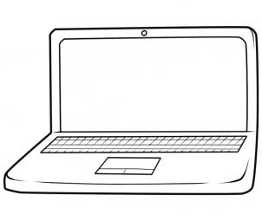

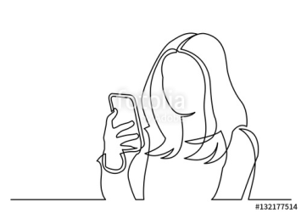
Introduction
What is a CMS ?
(wordpress, drupal, joomla, dotclear…)
it is a software design to create and maintain website
Website designer, redactors
Server
Internet users
Web designer
(full rights)
CMS
software
Content contributors
(limited rights)
Site visitors
Editors
(moderate rigths)

Slide 21
Introduction
Your tools for our workshop…
Here is your domain name :
www.wine1901.cariou.eu login: group01 code/password : Code001!
www.wine1902.cariou.eu login : group02 code/password : Code002!
and so on until the number 12 (…group12….Code012!)
You must not change the domain name (don’t try) and don’t change login and password (I use them to check your work)
You will use WordPress. You must choose a simple, responsive template (discover, try…but I recommend you choose “twenty nineteen”. If you choose another theme you may need to change it in a few weeks)
(To get the English version of WordPress it is necessary to proceed in the following way: “tableau de bord” →”reglage”→”general”→ bottom line “langue du site” → “English”)

Slide 22
Introduction
You must create and then write, update a website on the topic of your choice: the topic must by in relation with wine tourism in France.
Example:
- Wine tourism in Bordeaux
- Wine tourism for Israelites customers
- Family in the Languedoc vineyard
- Modern art in French vineyard
- Wine tourism ecological
- Wine tourism on horseback
- The discovery of Burgundy vineyard
- Modern architecture in the Bordeaux vineyard
- Wine tourism in the Médoc
- The secrets of the Aquitaine vineyard…………… ….. …
You must then complete the form “Presentation of your website project”

Slide 23
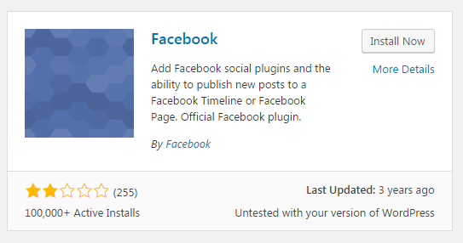
Introduction
Be careful when you install a new plugin:

Slide 24
Introduction
Basic tips:
The content of your website (WS) must be in coherence with the marketing strategy of your “company” (strategic objectives, marketing objectives, reference universe, axes of differentiation, objectives of communication, tone, editorial line, graphic charter ...)
Define objectives (measurable and achievable) for your WB: why a WS (what will the public do, what does he want to find ... put the user first: "customer centric" and not "student centric")? development of notoriety? Image of the company / products? Sales?
The content of your WB must be complementary to other communication media and in particular other digital media (Facebook, news-letter ...). The whole must be COHERENT and COMPLEMENTARY.
Define an overall structure that is simple to understand, practical (with internal links)
Especially when there are several editors it is necessary to establish rules of writing: for each page define keywords (you also write for the search engines), deliver quality information, relevant information (very relevant titles, impactful ), optimize the structure and simplicity, use a lot of visuals (photos and videos) +++ and hypertext links (external and internal)
Publish regularly/frequently (+ plan)

Slide 25
Images and video…
Introduction

Slide 26
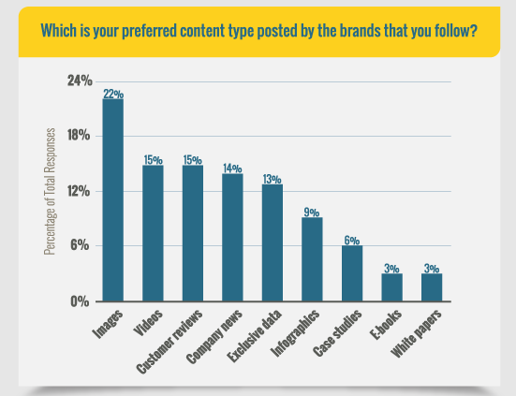
Introduction
Images and videos: Marketing aspects
- the images/video have a central place in marketing .... and especially in digital marketing (even more for the new generations)
- a photo/video captures the attention more easily than the texts
- studies show that an image is 40% more shared than a text and is "liked" 4 times more than any other content
http://www.adweek.com/digital/why-people-unfollow-brands-on-social-media-infographic/?utm_content=buffer507f6&utm_medium=social&utm_source=Webbiquity.com
I recommend you to use a lot of images and videos in your website and obviously on your social medias

Slide 27
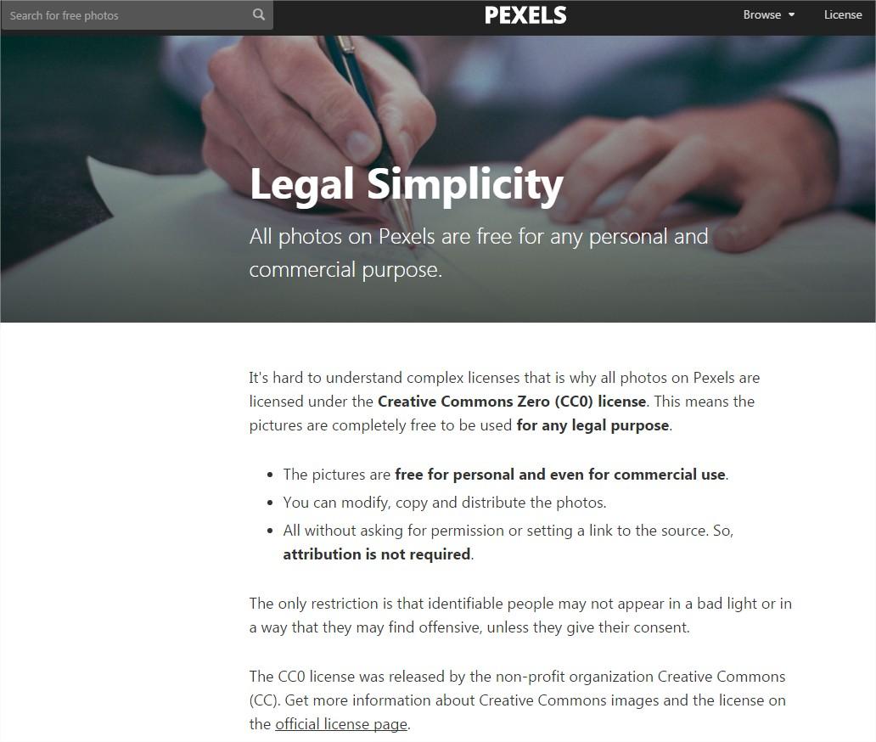
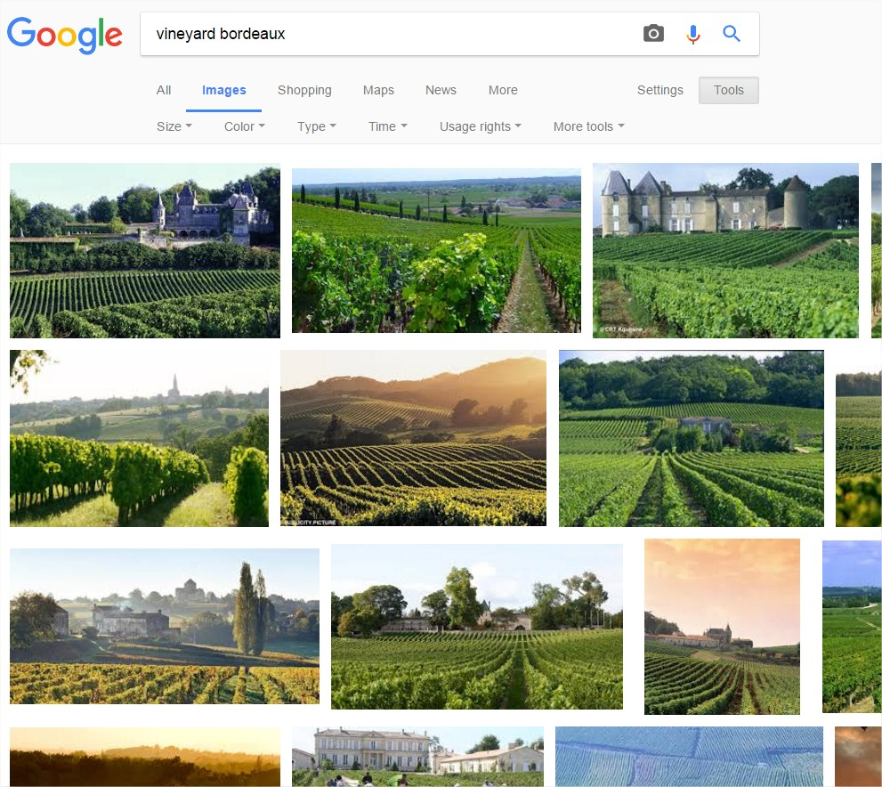
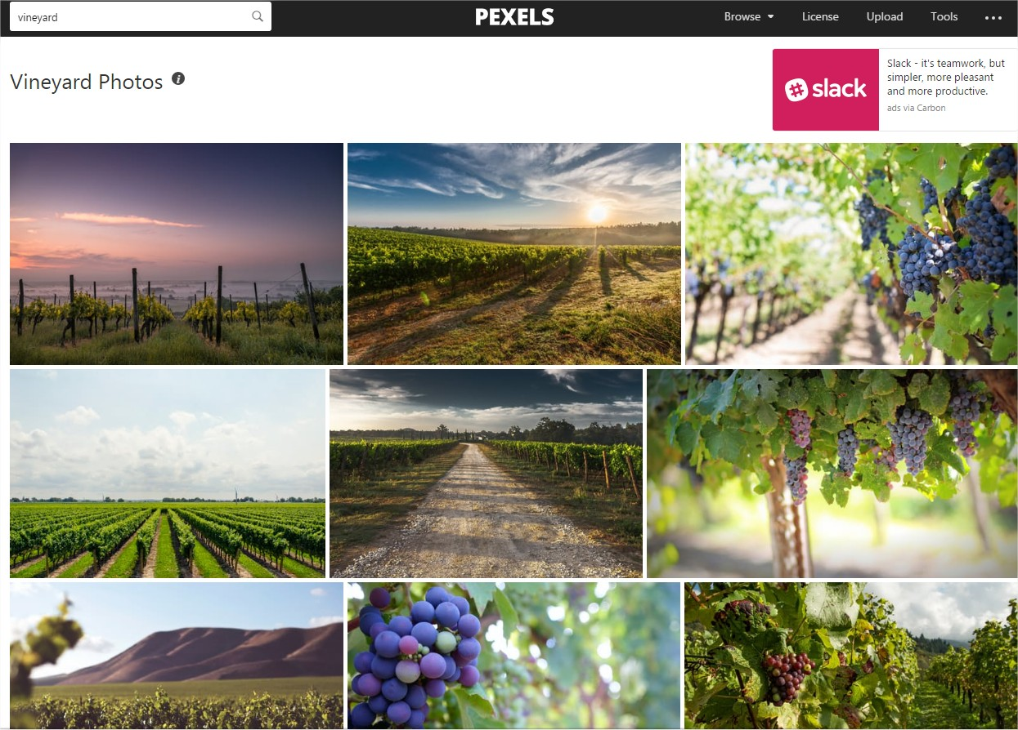
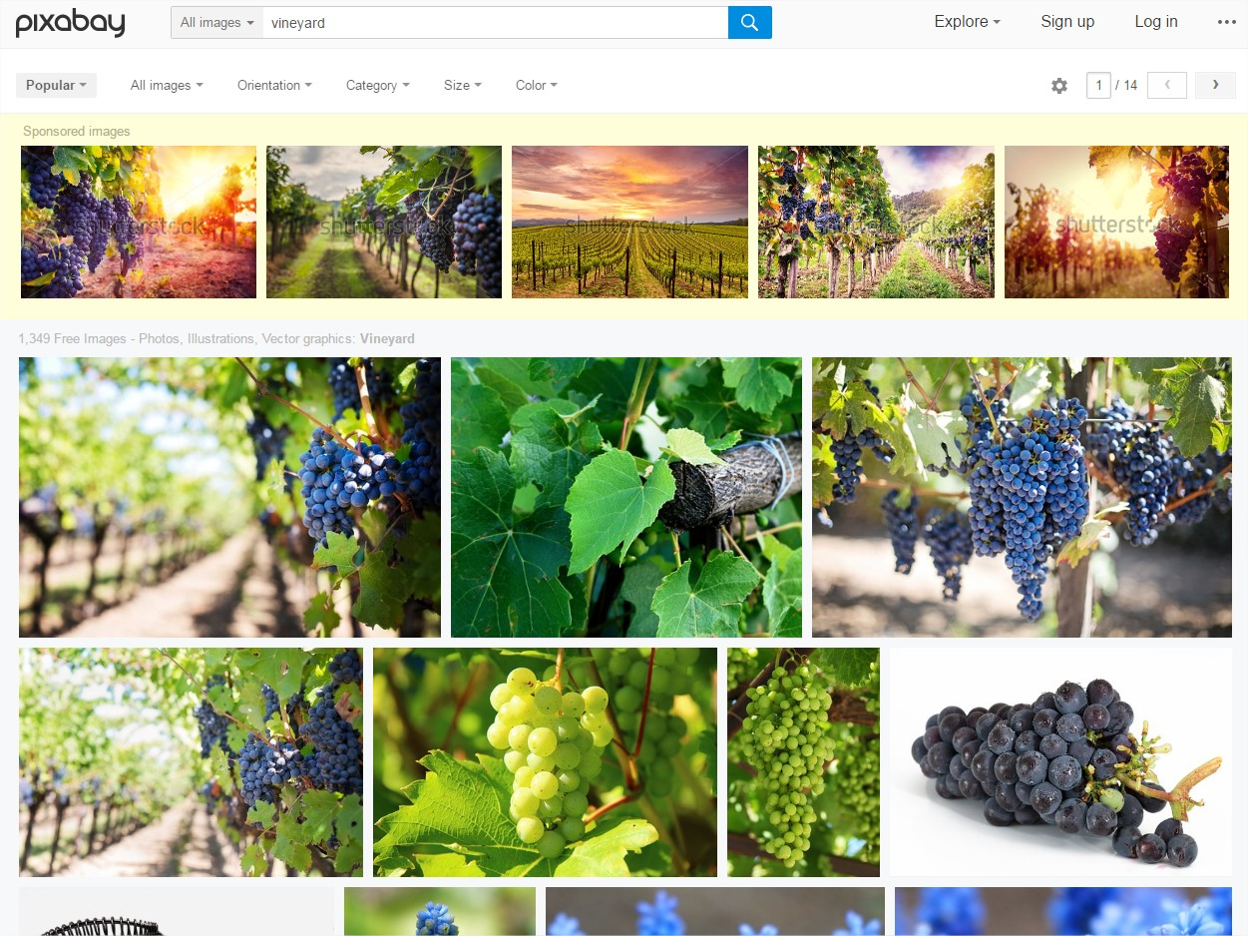
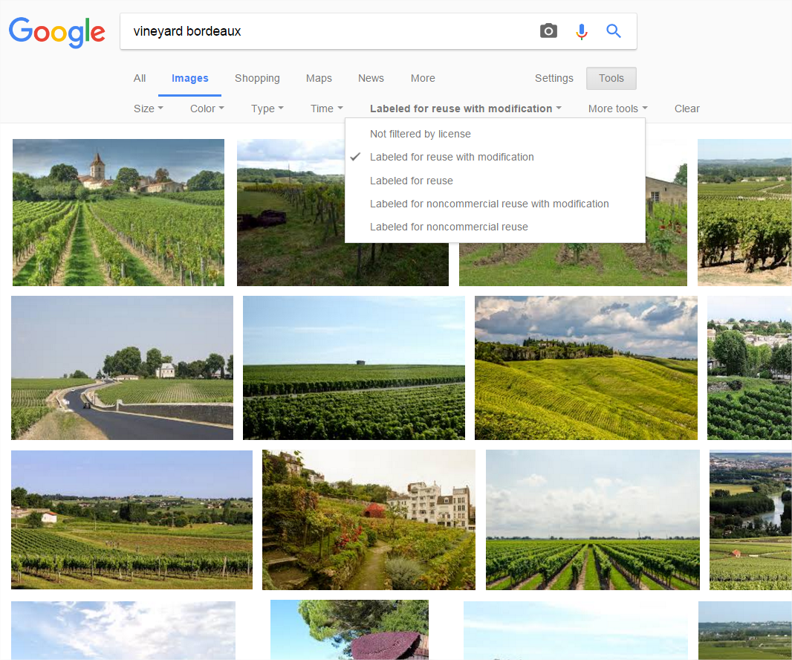
Images and videos:
legal aspects
Image rights (text, music…)
Available does not mean free of rights
I strongly advise against using images, video, music ... without having the copyright
Do not use “copy and paste” for texts from other websites (bad for your seo)
1 How to find « free-to-use » images (royalties free).
With search engine (e.g: google)
With specialized websites (e,g: pixabay, picjumbo, publicdomainpictures…°)
How to find « free-to-use » videos (royalties free).
Youtube: creative commons (cc)
(you do not have the right to broadcast youtube videos under standard license) Youtube… search…filter…creative commons

Slide 28
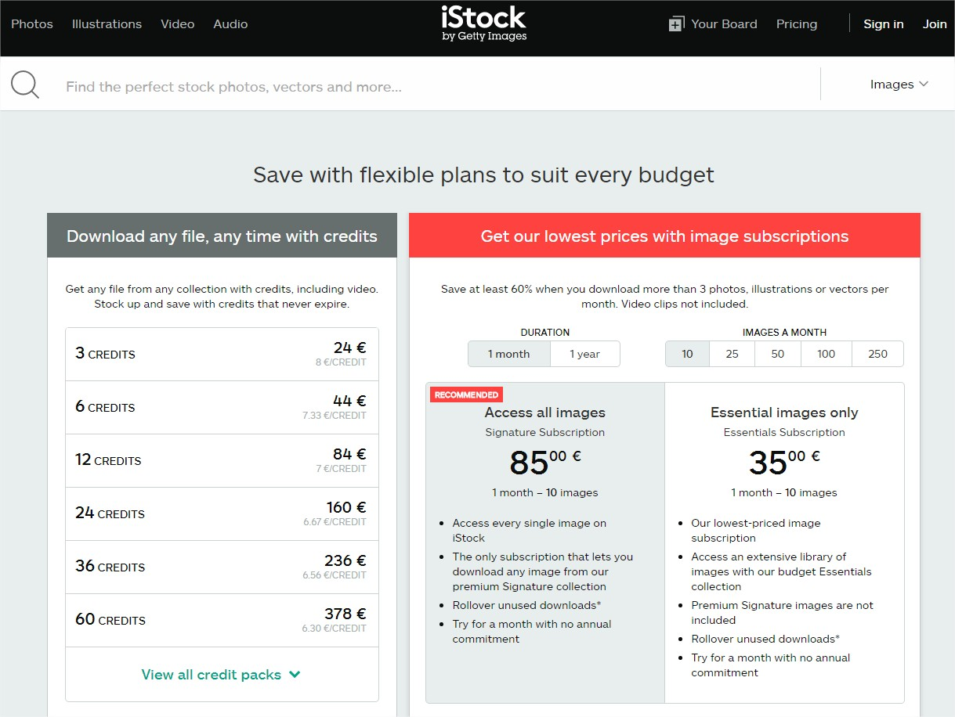
Introduction
Image rights
2 Getting permission for free: determine if it is needed, identify the owner and the rights needed, contact the owner (negociate the price…), get the permission agreement in writing)
3 Getting permission with fees: image banks (istock, gettyimages, shutterstock, fotolia/ adobestock…)
4 Take your own photos-video / hire a photographer: in France
-Photographing a landscape does not require any special authorization,
- All photos taken in public places may be published by the author or the copyright holders. To photograph some buildings it is necessary to obtain the permission of the architect/author…but this is not necessary if this building appears incidentally in the photo.
- It is possible to publish photos of people with their tacit or explicit/formal permission.
- It is permitted to publish the image of a group/crowd in a public place or street scene, without the need of permission from everyone photographed.
- It is permitted to publish images of public figures, “stars”… (but not in private contexte, not for commercial puposes)

Slide 29
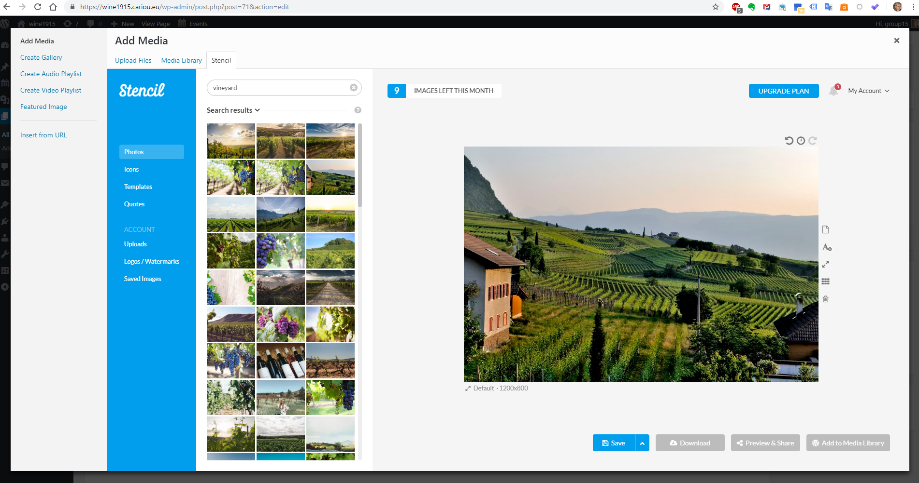
You also can « create » nice images with Stencil for WordPress (10 free images /month)

Slide 30
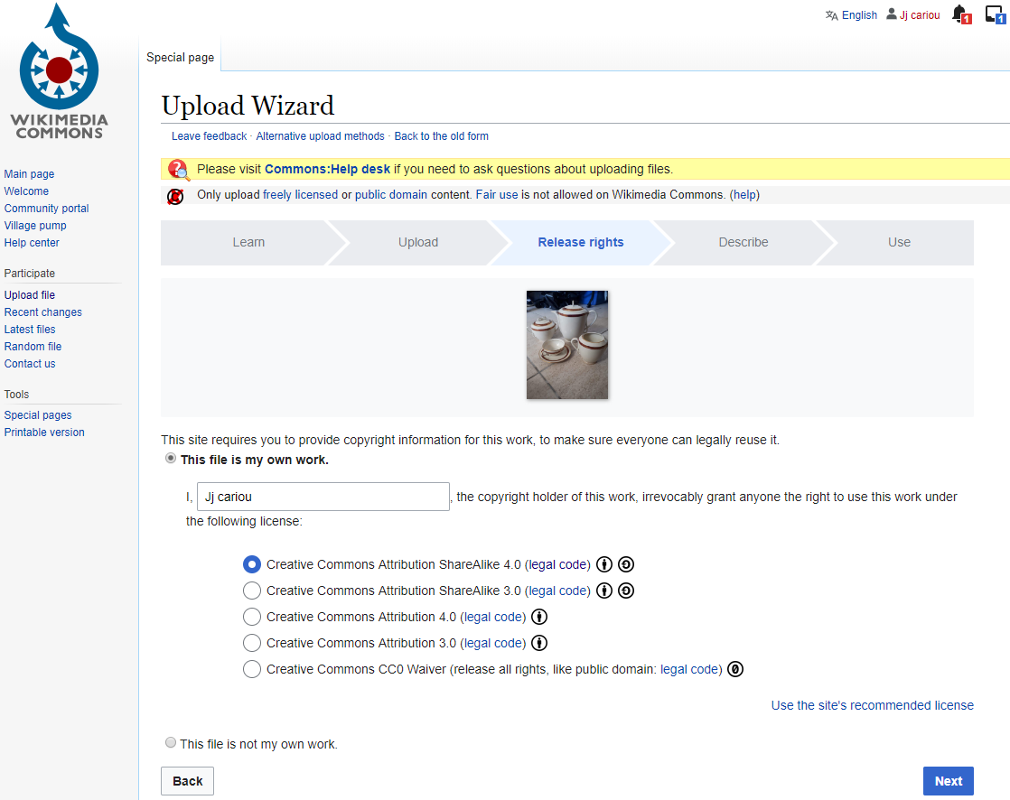
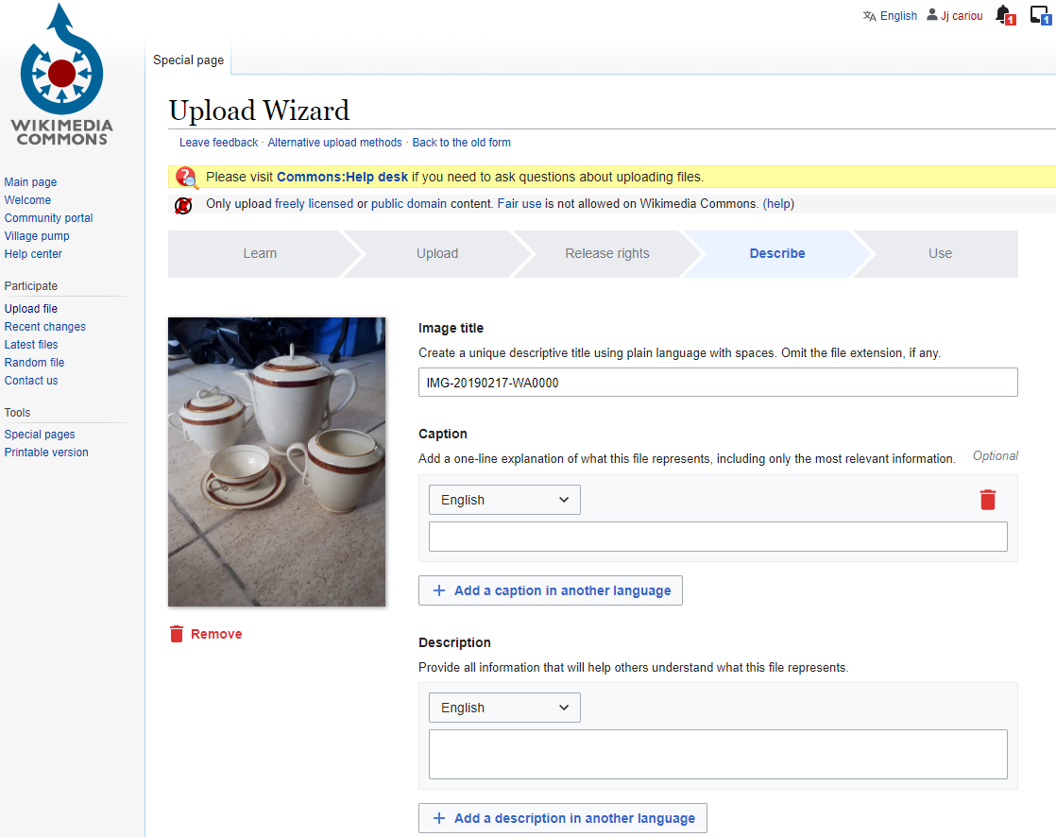
How to create « free-to-use » imagesor video (creative commons)
-Go to Wikimedia commons or flickr
-Upload your own photos (natural landscape, animals, plants, public figures, people photographed in public places, olds art, statues, buildings (usually ovre 150 years old.
-chose a licence (e.g: CC BY-SA = cretive commons, BY (author name) SA (share alike: free for copy, remix, transform..for any purpose, even commercially)
-describe it (title, caption, description, date)
- Publish it

Slide 31
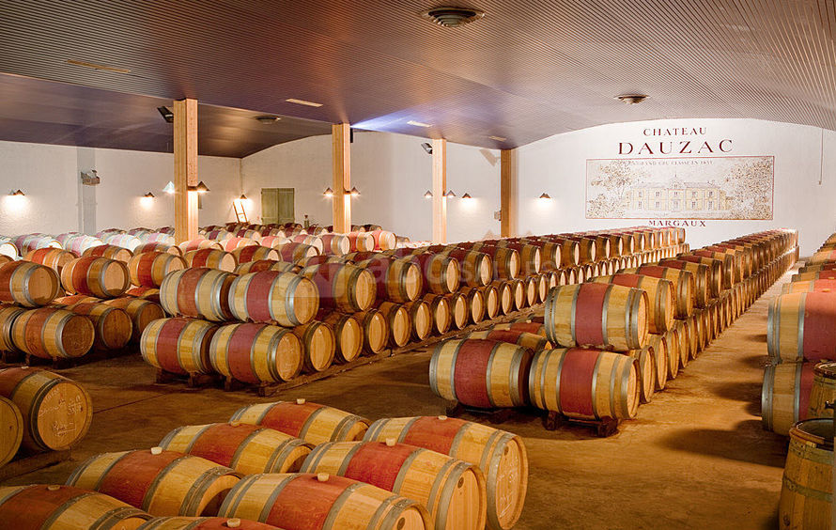
Images and videos: technical aspects
Introduction
Your photos must necessarily be uploaded to the server. If you delete the photo-file from the server, it will no longer appear in your pages
Optimize the size of the photos (with a photo-resizer or with your photo editor. Eg: SQUOOSHE ). It's essential for your SEO (if the photos are not optimized, the download times of your pages will be lengthened) + use the plugin: smush
Classify your photos in Word press (use the plugin: WP Media category management)
Describe your photo (+++seo): 1) give an explicit name (cellar-chateau-dauzac-margaux.jpeg is better than: dsc540568.jpg) and 2) use the « alt » tag (alt = alternative) and description it helps the search engine to undestand your photo « beautiful rows of colorful barrels in the cellar of "Chateau Dauzac" in Margaux near Bordeaux”: and 3) use a caption « A nice visit… ». See following slides
Don’t link your photo to it selsef ! (= bad seo). See following slides
A nice visit in the cellar of “Chateau Dauzac“ Margaux
- for videos you can proceed in two ways:
1 Upload your video on the server (but it takes up space on the server…and time to download your page)
2 Make a link from Youtube (you have to upload your video on Youtube or use a Youtube video (CC ?), but if the owner delete the video it will not appear on your website anymore (and the youtube/google server is quicker than yours)

Slide 32
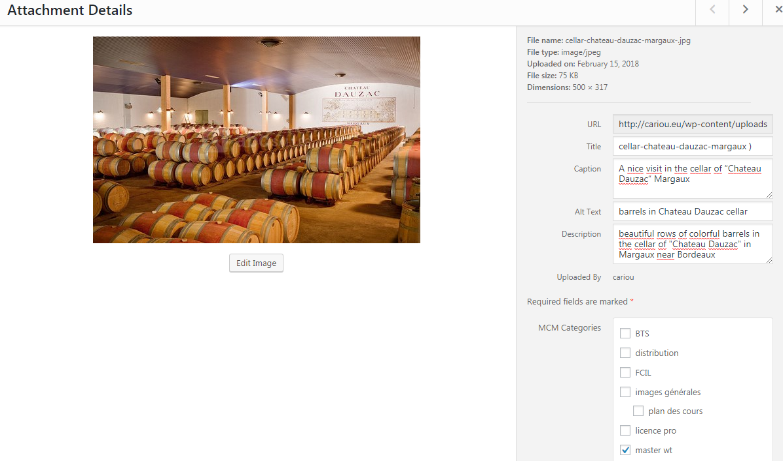
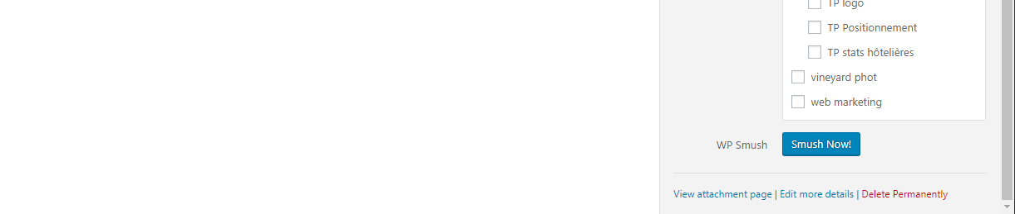
In wordpress

Slide 33
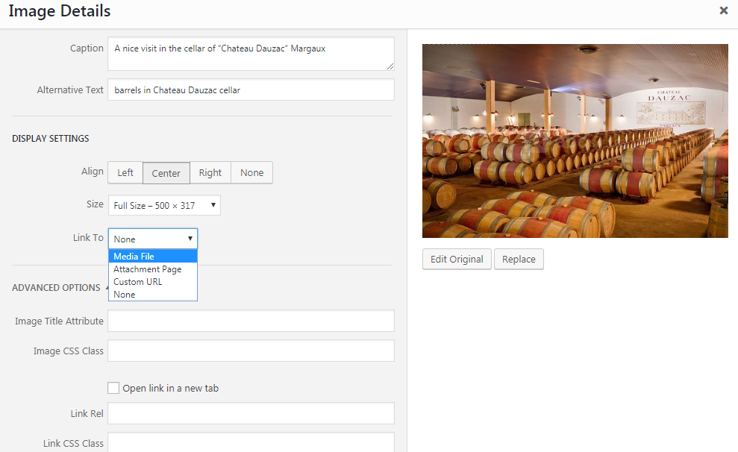
Introduction

Slide 34
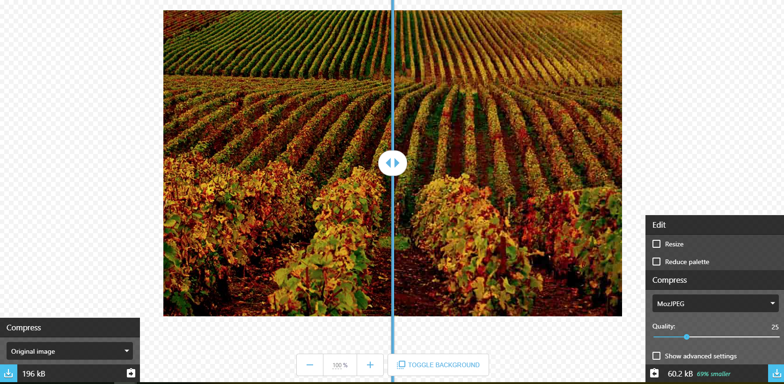
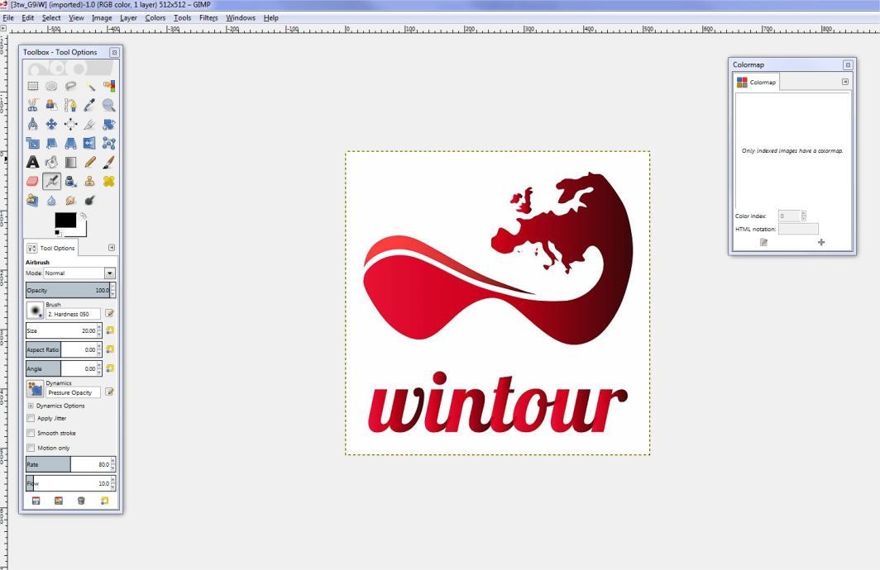
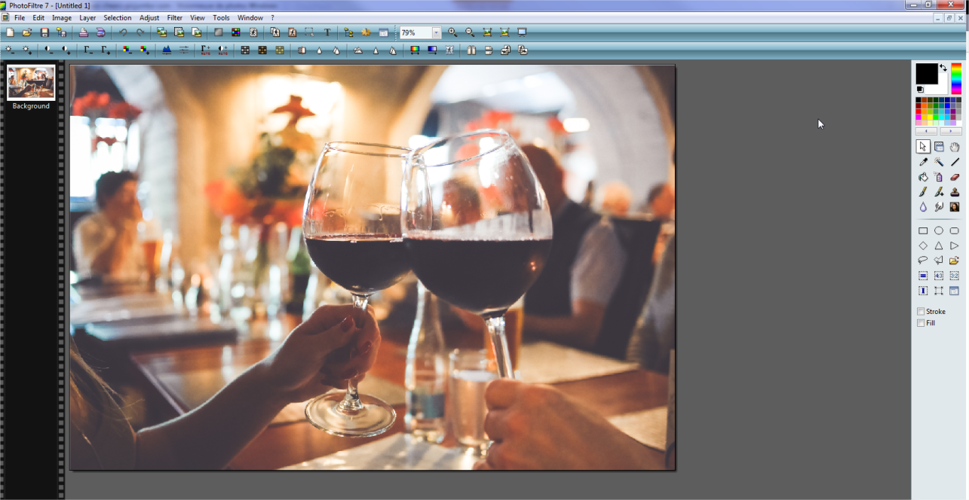
To edit images:
- GIMP :free, “a worthy rival to premium software as photoshop
or Photofiltre: free, easy to use
To quickly resize: SQUOOSH
…
Introduction
Squoosh
Photofiltre
GIMP

Slide 35
Introduction
Day 1 Step 1
The tools you need to know today | Ok ?
Discover WP | x
Choose a theme | x
Adapt/customize the template (static page…) | x
Write a page | x
Insert an image (+Image rights) | x
Edit an image with photofiltre | x
Insert a video (+ video right) | x
Create and modify menus | x
Create a contact page + Add a plugin: contact form7 | x
Add a plugin: WP smush | x
Insert widgets | x
Write a post
Create a news page (with featured image)
Advice for today and the next weeks: Don’t use « Elementor
page builder » (not compatible with our e-commerce solution

Slide 36
Part 1 Web design basics
Introduction
1 basics of web design
2 SEO
Web design basics

Slide 37
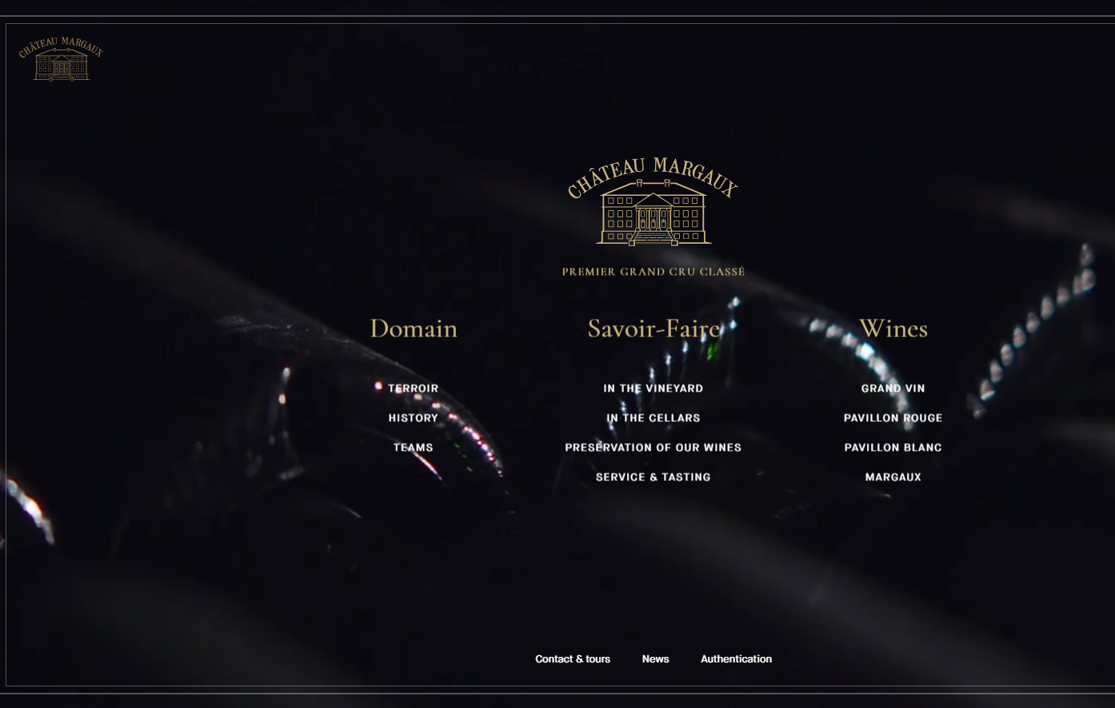
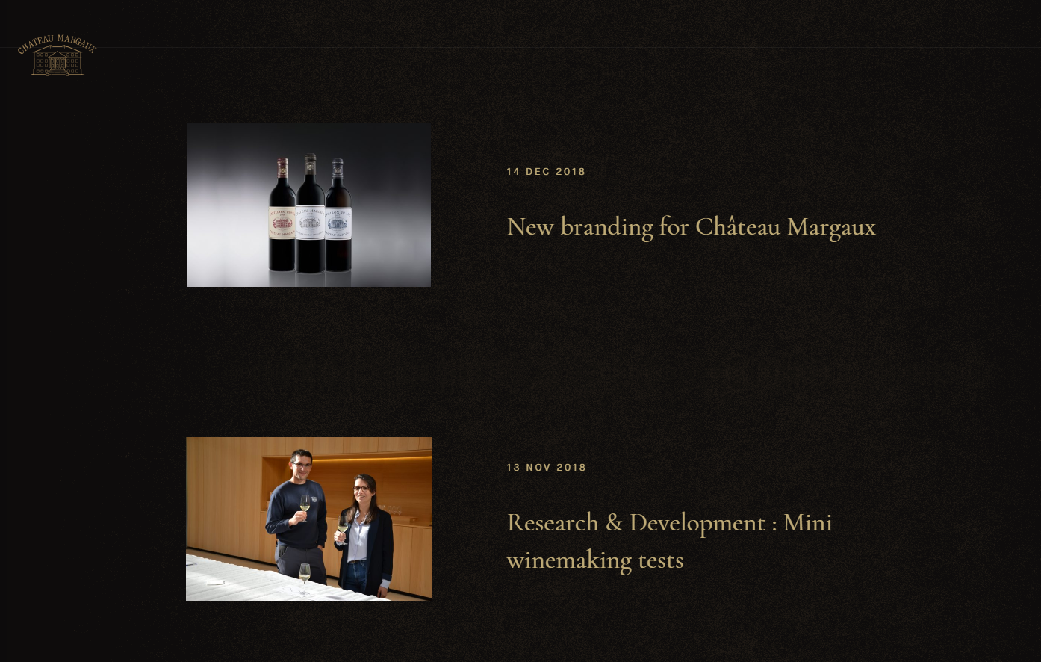

With Wordpress
- Pages ≠ posts
To create/edit pages or posts, you have two ways:
gutenberg editor: create pages with blocks
classic editor: wysiwyg (you can install the plugin « classic editor »)
A page (home page)
A page (the « news page »)
A post

Slide 38
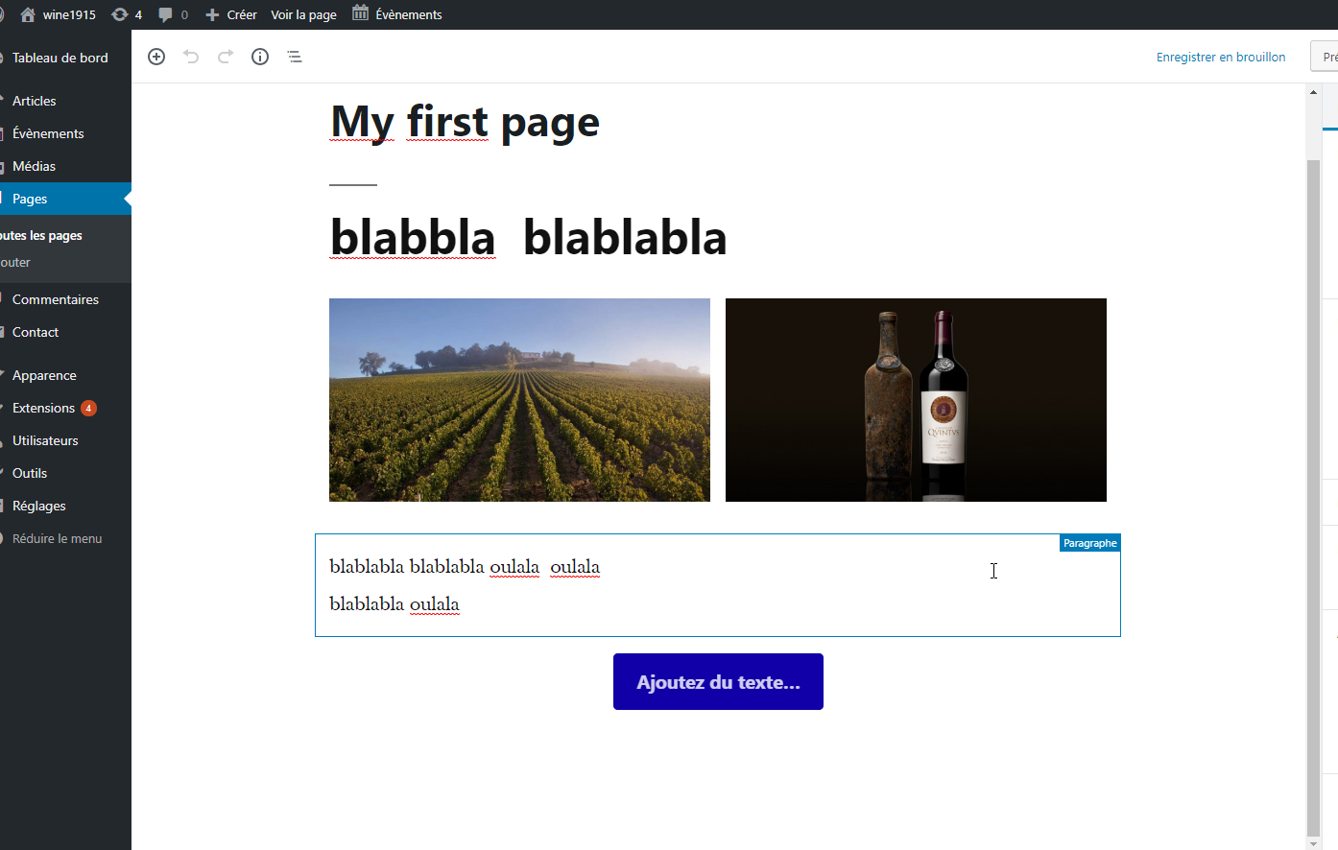
gutenberg editor: create pages with blocks

Slide 39
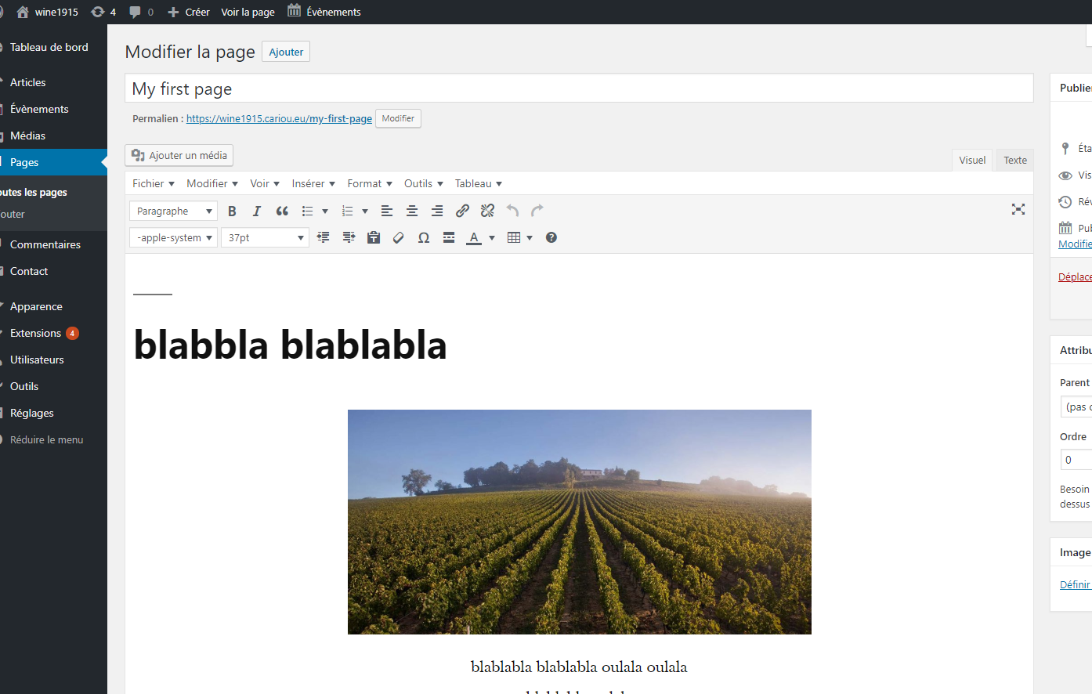
classic editor: a little bit old fashion !

Slide 40
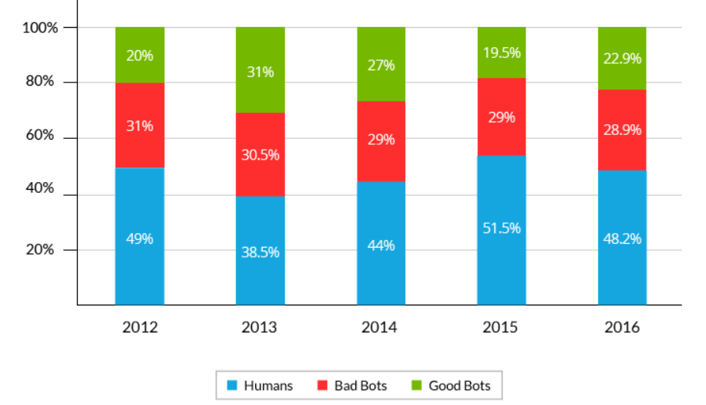
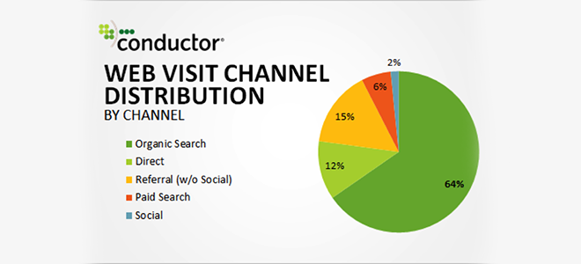
The web site is read by…:
Our clients
…sofwares (robots = bots or spiders or crawlers) for their own purposes
(e.g : hackers bots)
…bots to advise humans beings (e.g : search engine bots)
…human beings thanks to advices/help of bots
(e.g : human who use google seach engine)
…human beings without advices/help of bots
(e.g: human who type the adress of the web site in their browser)
Global traffic on the Internet
Bad bots (which operate in the shadow/illegal purpose, owner unknowed):
Impersonators (more than 80% of bad bot attacks): masking themselves as legitimate visitors so as to circumvent security solutions. These attackers proclaim themselves as either good bots or humans. They are responsible of the DDoS attacks (For example: asking it to load the home page 50,000 times a second.) A DDoS (Distributed Denial Of Service) perpetrator needs to send out many thousands of bots to take down a website. It’s why the traffic of this kind of bot is so large. Ex: Nitol (more than 1% of the wordwide web traffic),
Spammers (inject spam into forum, discussion, email…)
Hacker tools (data theft, malware injection…)
Good bots (legal purpose, with official owner):
- Feed fetchers (bots that ferry website content to mobile and application web wich they then display to users) : facebook mobile app, android framework bot…
- Search engine bots (bots that collect information for search engine algorithms wich is then used to make ranking decisions): googlebot, yandex bot…
- Commercial crawlers (Spiders used for authorized data extractions, usually on behalf of digital marketing tools): ahrefsbot, alexabot…
- - Monitoring bots (bots that monitor website availability an dth eproper functioning of various online features): wordpresspingback…
Conductor (SEO company) studied 30 large websites across six industries to evaluate the sources of their inbound web traffic over a one-year period. They analyzed over 310 million visits
https://www.conductor.com/blog/2014/07/organic-search-actually-responsible-64-web-traffic/
https://www.incapsula.com/blog/bot-traffic-report-2016.html
Based on : 16.7+ billion visits to 100,000 randomly-selected domains

Slide 41
So the site must be designed for:
Web design basics
Bots
They advise, help or influence my targets
Des êtres humains
C’est mon audience, ce sont mes clients, ma cible
They can read texts (very quickly in any language) without subtlety.
They are bad at interpreting the images and very bad at the videos
they have an almost limitless capacity for concentration and memorization
They are not free, they do what they were programmed for
They have no emotion
…
They (we) can read texts (slowly and only in one language, sometimes two or three) with subtlety.
They (we) can interpret images, videos (they love it)
They (we) have a very limited ability to focus and memorize
They (we) are free ... they can choose to stay on my site or to leave ...
They (we) have emotions ... it's important for them
…

Slide 42
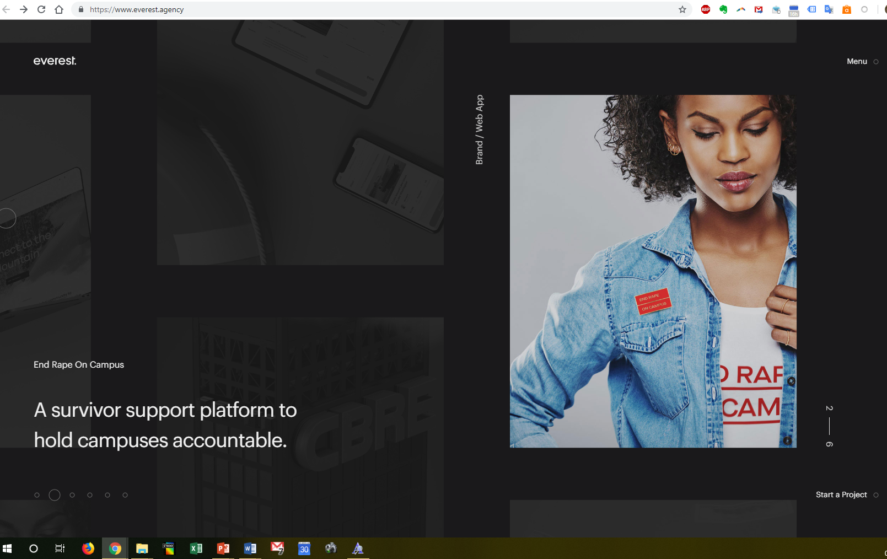
Web design basics
Good for emotion…
But bad for bots
click

Slide 43
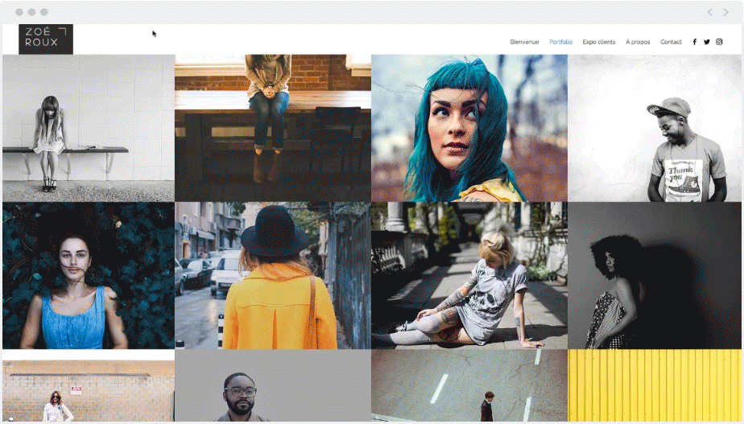
Web design basics
What interest for a rob?

Slide 44
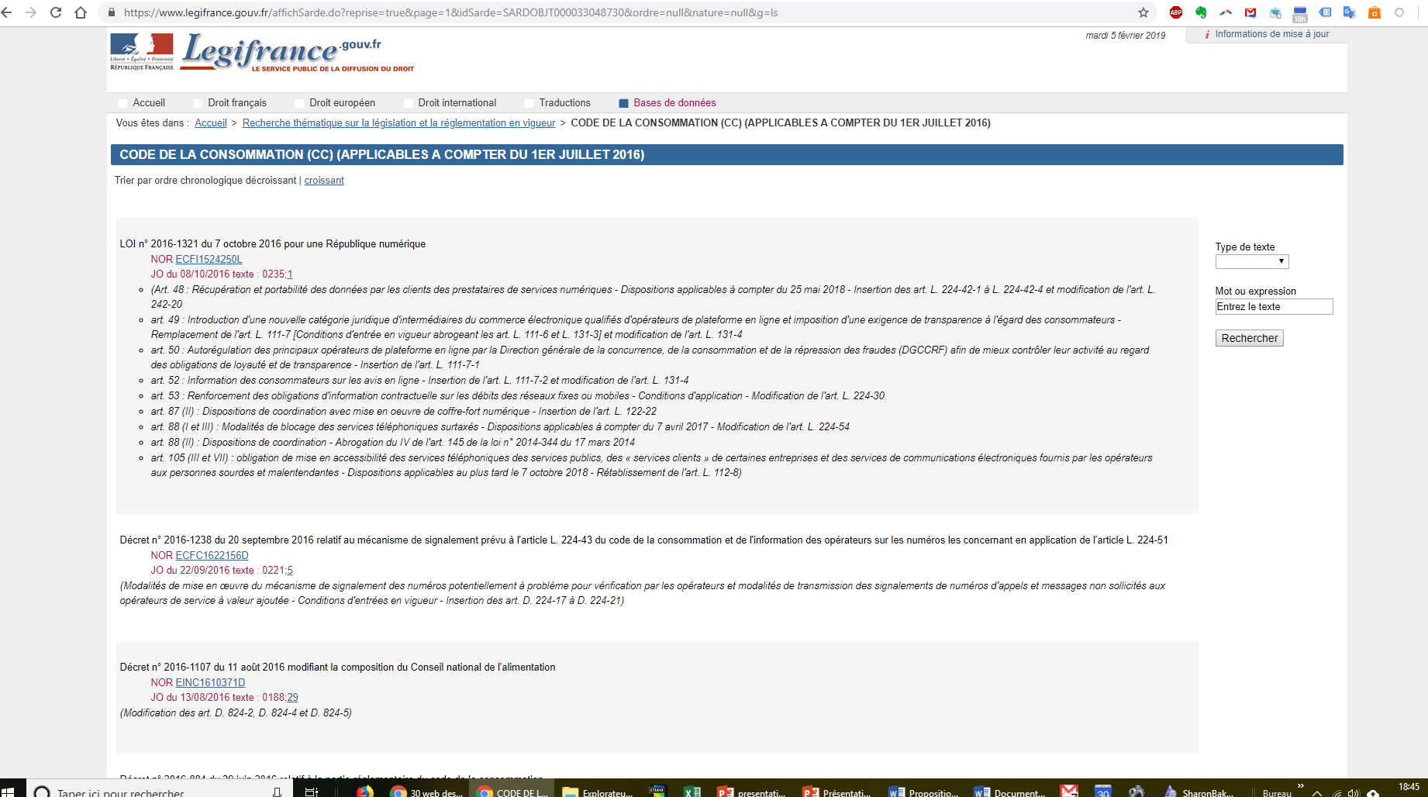
Web design basics
Any emotions ?
(but good for bots)

Slide 45
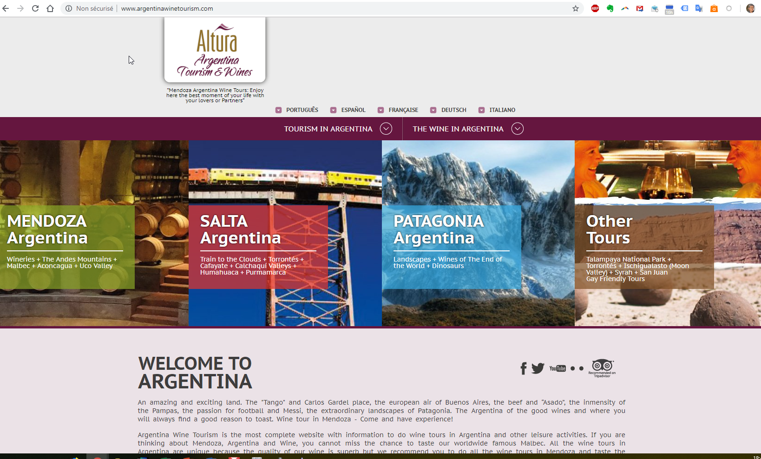
Web design basics
You have to design your
web site for human and
bots (specially search
engines bots and AI…)

Slide 46
The website must be design for:
Web design basics
Bots
They advise, help, influence my targets
Human beings
It's my real audience, it's my clients, my target
I have to:
protect myself from bad bots
be loved by the good bots
I need to create a functional website
and emotional
3
1
2
The site must also respect the regulatory framework (in Europe: GRPD)

Slide 47
I need to create a functional website
and emotional (for human beings)
Web design basics
1
Functional:
Fast to download (watch the photos!) because people don’t like to wait
Easy to consult on any type of device (responsive or "mobile first"), police sans serif, contrasts
A website structure easy to understand, easily accessible information (limit the number of clicks), simple and fast navigation (e, g: long scrolling with anchoring menu e.g. : link the logo with the homepage ...)
Not too much volume per page: mix photos videos and texts
Write naturally using a simple but rich vocabulary
Structure the texts: a nice title (only one H1/page), an introduction (a catchy summary), a title/paragraph (H2), possibly one or more sub-paragraphs (H3) and even sub-subclauses (H4)
Emotional:
The tone: avoid neutrality, show the authenticity, humanity, personality (sensitivity, humor, curiosity, values, personalization ...)
Give personality: prefer "us" rather than "About", give anecdotes rather than a list of facts, faces / character on the screen
Be honest
Stimulating emotions: surprise / novelty
Aesthetics: colors, images, fonts ...
Image +++
Video +++
Choice of colors with care:
bright = joy / life / cheap
dark = elegance, power, sadness ...
- Take care of readability: contrast, size, font without serif , don’t use too many different fonts
- Look after the footer: this is the last point of view ...

Slide 48
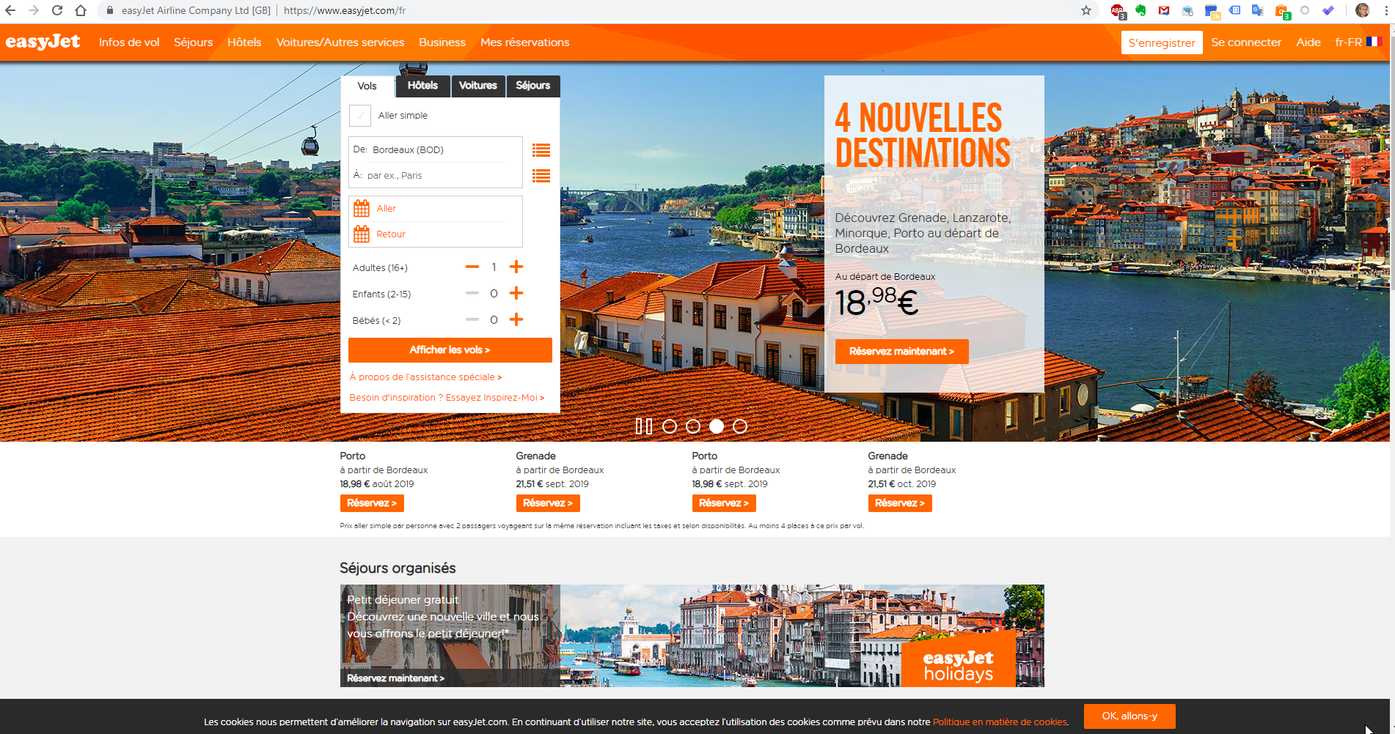
Bright colors = cheap

Slide 49
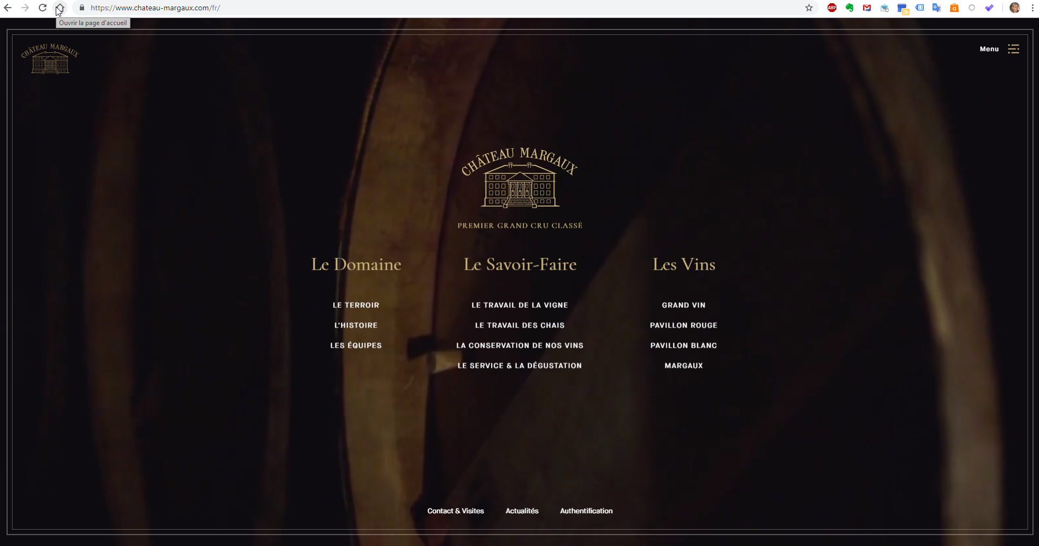
Dark colors = elegance, serious…(sadness ?)

Slide 50
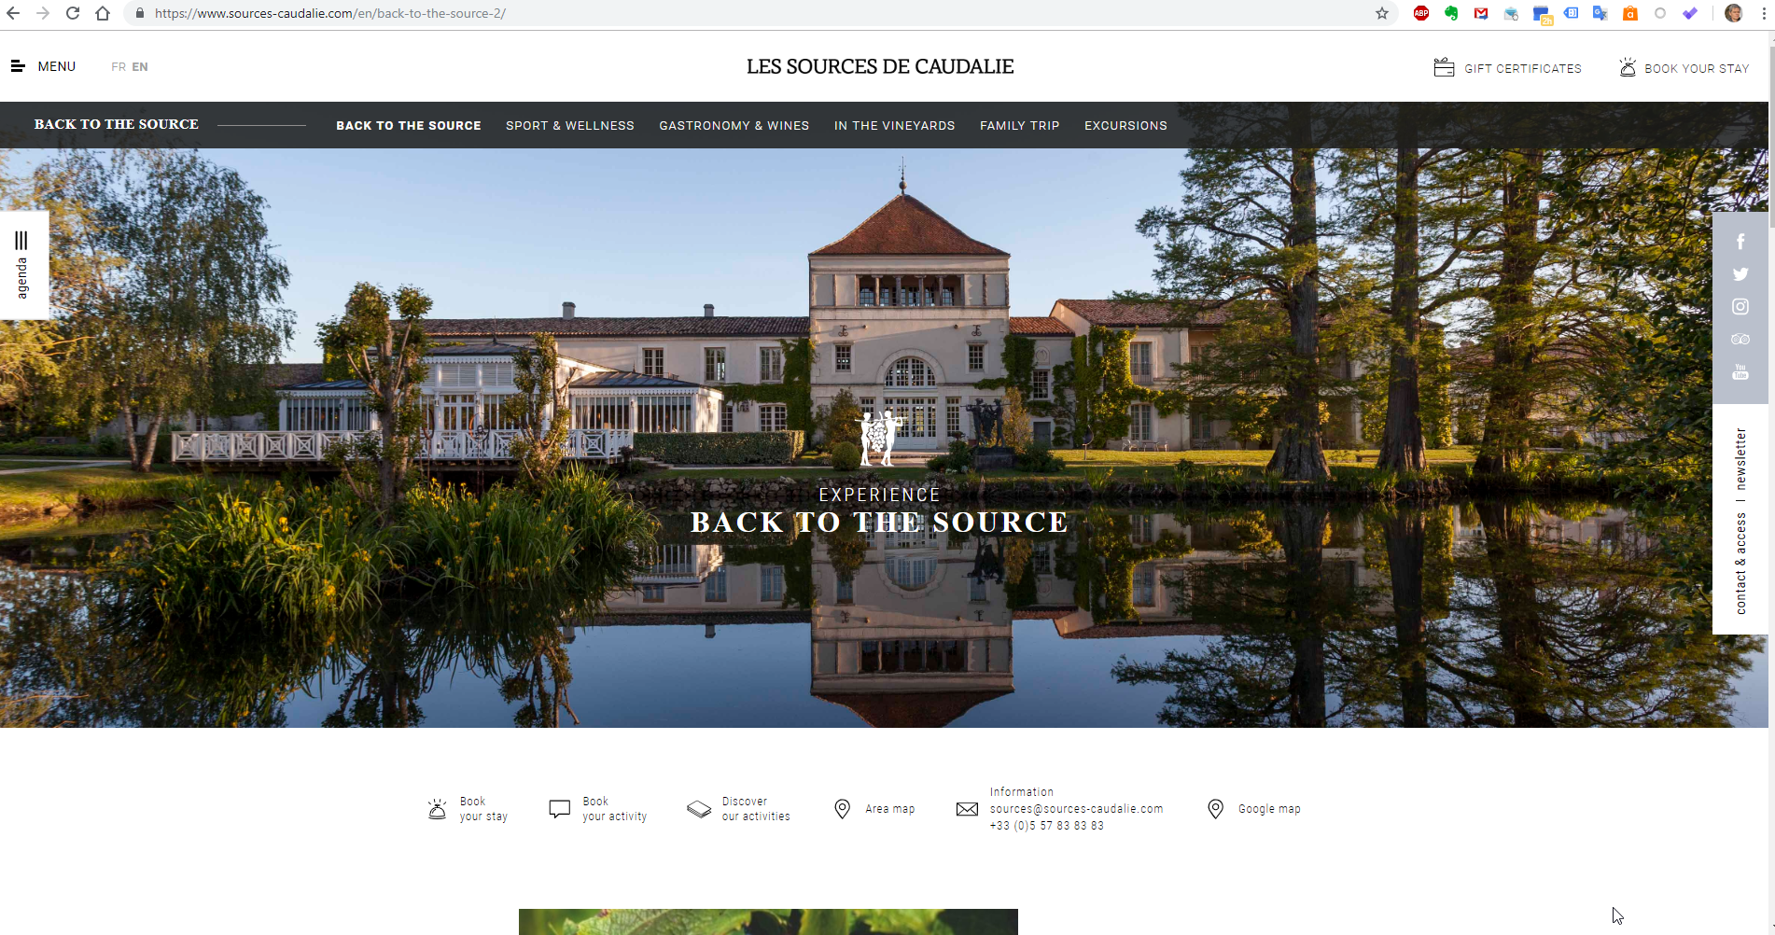

Slide 51
The site must also respect the regulatory framework (in Europe : GDPR, General Data Protection Regulation)
Web design basics
2
General principles
Legitimacy, honesty and transparency : You must indicate the type of data collected as well as the reason why you collect it in your privacy policy in order to remain transparent with the data subjects.
Limitation of treatment: You may only collect personal data for specific purposes, clearly state their purpose, and only retain the data for a period of time necessary to achieve that purpose.
Data minimization: You only need to process the personal data you need to achieve the original purpose.
Accuracy : "All reasonable measures must be taken to ensure that personal data that are inaccurate, having regard to the purposes for which they are processed, are erased or rectified without delay. "
Storage limitation: you must delete the personal data when they are no longer needed for processing. you must provide for a maximum retention period and a (automatic) destruction process.
Integrity and confidentiality: personal data must be 'processed in such a way as to ensure appropriate security of personal data, including protection against unauthorized or unlawful processing and against loss, destruction or accidental damage, appropriate technical or organizational measures. "
You can use a specific plugin, e.g. : GDPR for wordpress

Slide 52
I have to:
protect myself from bad bots
be loved by the good bots
Web design basics
3
Protect my website from bad bots:
- Secure the computer you are working on (anti virus ...)
-Secure your site: secure password (complex + different profiles depending on the users (do not give the right to administer to anyone!) + Limit repeated attempts (eg for WP: login lockdown)
- Make backups (example with WP: UpdraftPlus)
- Caution with tamplates and plugins
- Regular update of wordpress (and plugins)
- Go to https
- Add an antispam for the blog (ex for WP: Antispam Bee)
- Add an antivirus (e.g .: wordfence)
Note on viruses:
blackhat seo: the virus inserts hidden links in the site (to dubious websites whose credibility increases through these links) ... such links can be very bad for your own SEO
Data theft: for example the personal data of your customers
Ransom hackers demand ransom to restore access to your website
attract and convince ( seduce ?) good bots :
SEO
(search engine optimization)
see following slides

Slide 53
SEO the art of getting a good ranking in the search engines
Introduction
1 basics of web design
2 SEO
Web design basics

Slide 54
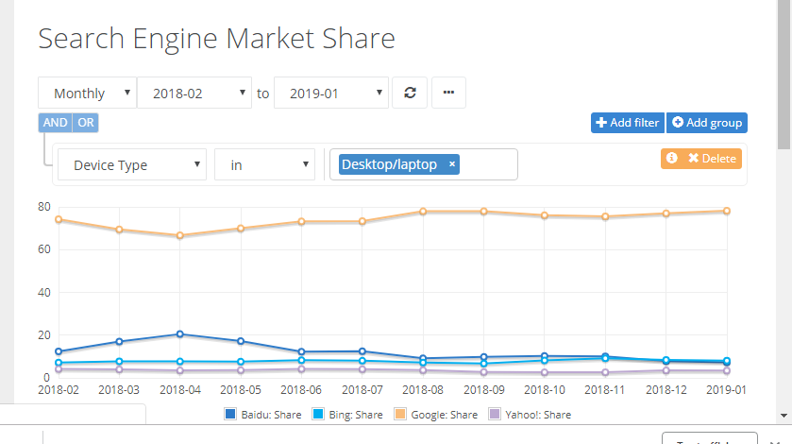
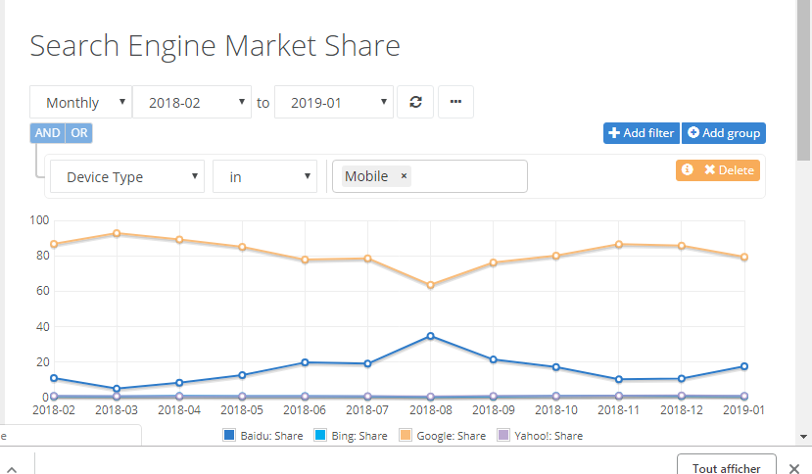
Search engine market share wordwide (https://netmarketshare.com)
Web design basics

Slide 55
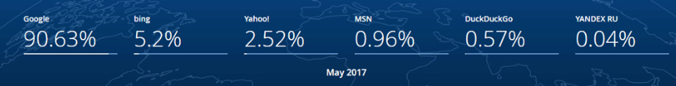
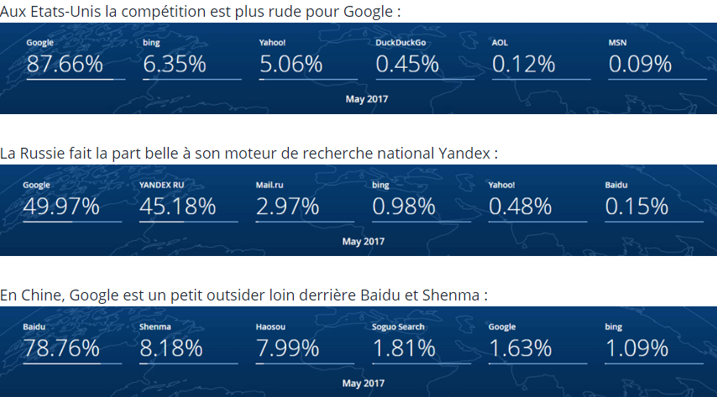
France
Aux Etats Unis la compétition est à peine plus rude pour Google…
USA
Russia
China
Where your customers come from ? Which customers do you want to attract? (try to search with Baidu)

Slide 56
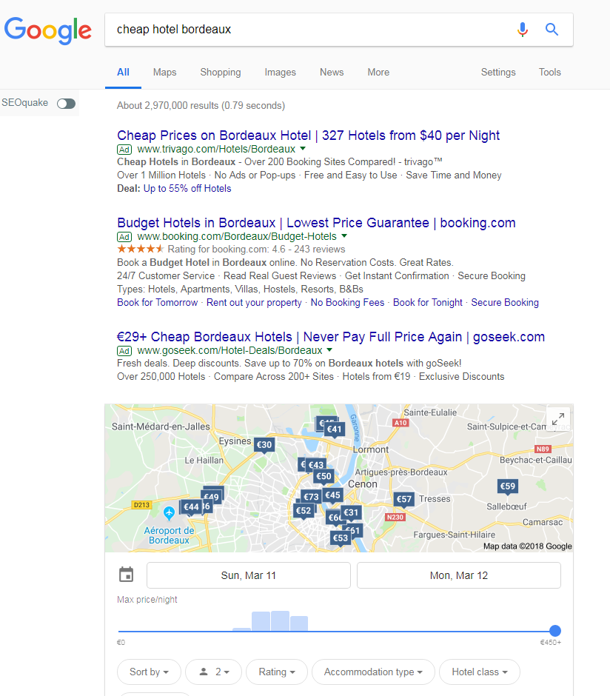
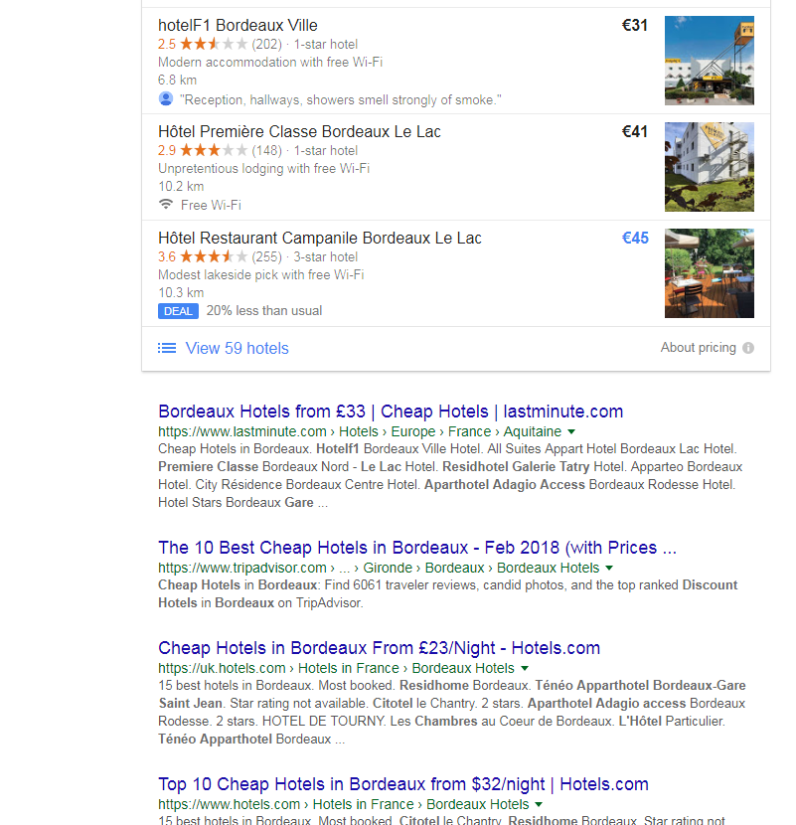
SEO (search engine optimization)
SEA
Search engine optimization (SEO) is the process of affecting the visibility of a website or a web page in a web search engine's unpaid results—often referred to as "natural", "organic", or "earned" results
Google maps
local informations
SEO is a part of SEM (seach engine marketing, wich include SEO and SEA)
SEO

Slide 57
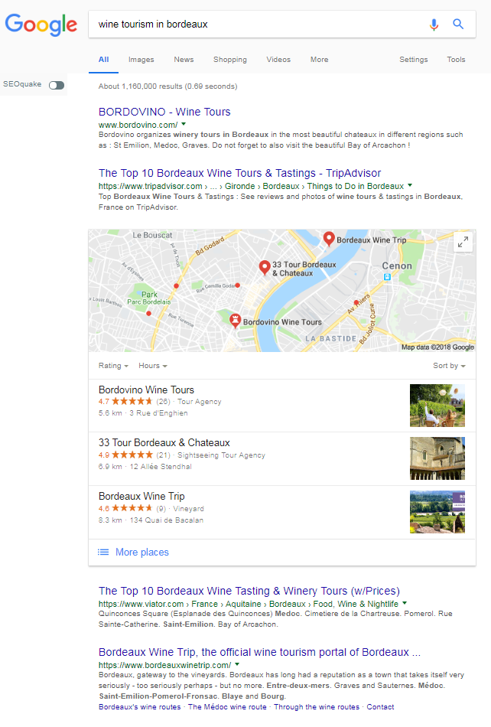

Slide 58
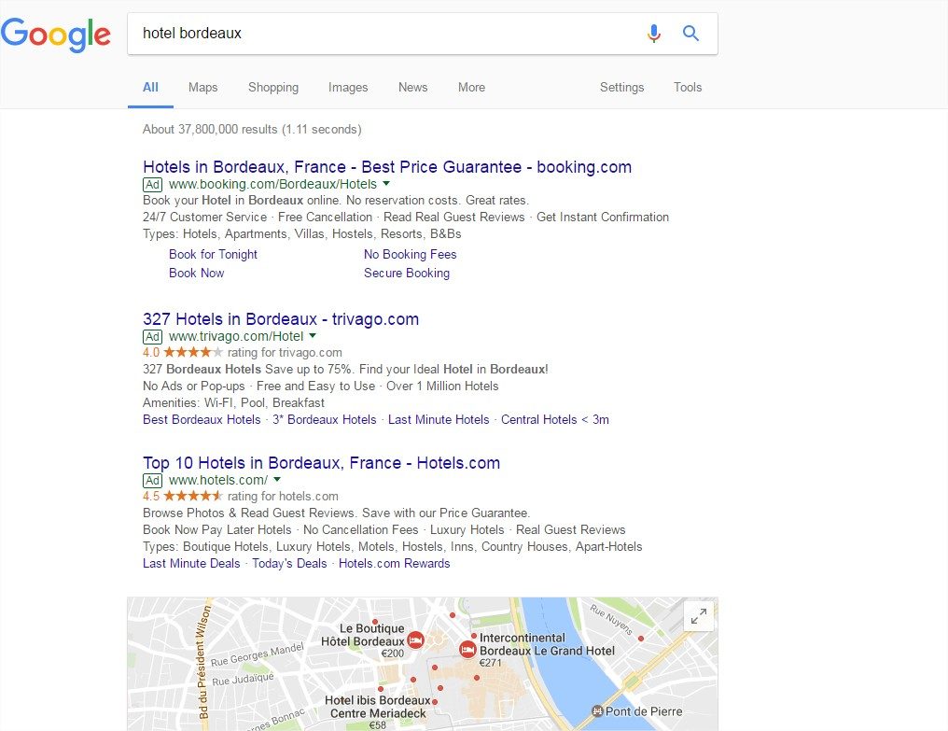
SERP
(search engine response page)
SEA:
search engine adverstisement
(usually 3 or 4 links /page)

Slide 59
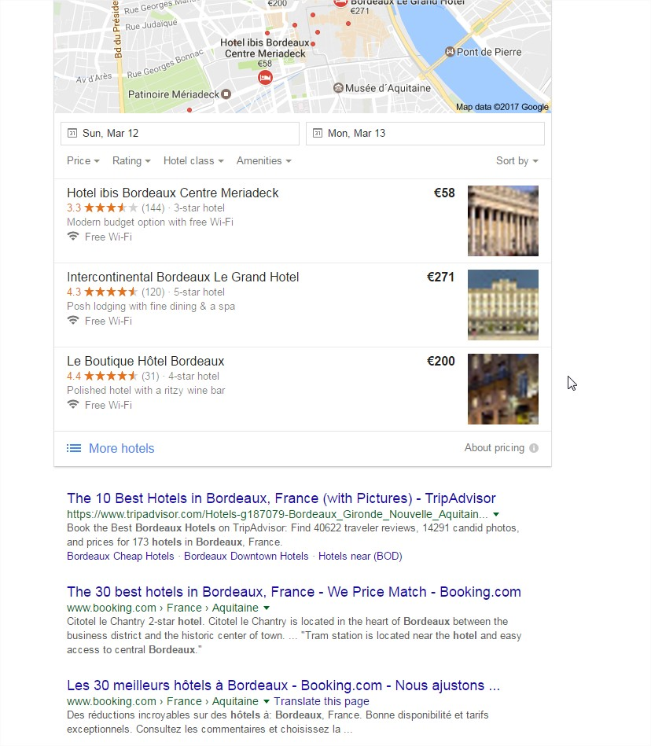
Google maps + Google my business
Local information
SEO
(usually 10 links/page)

Slide 60
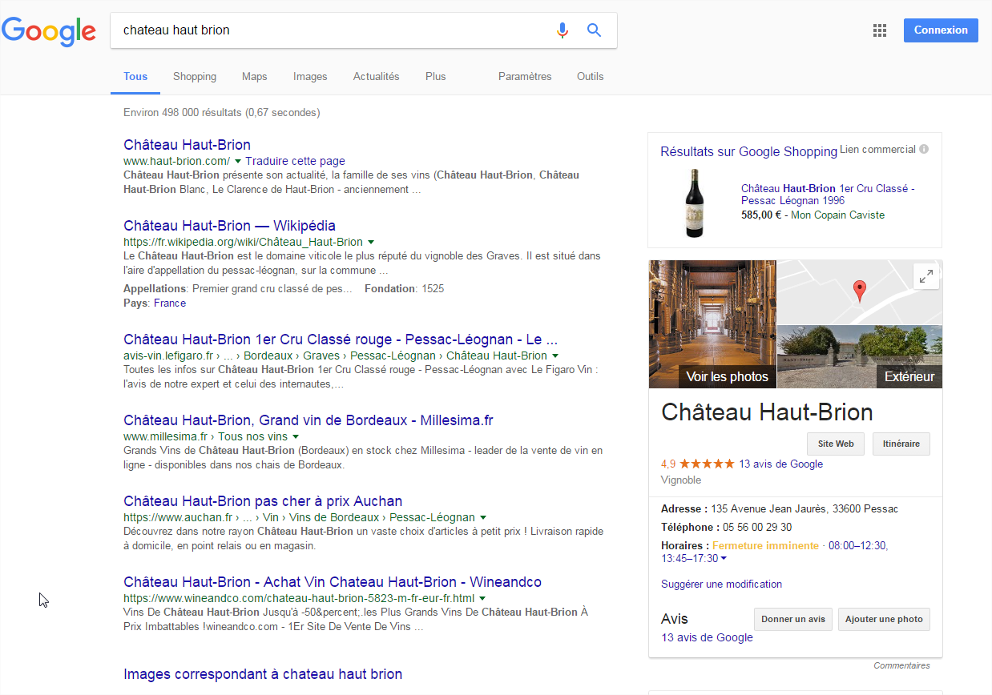
Google shopping
Google my business

Slide 61

Google
Knowledge graph

Slide 62

Google news

Slide 63

How to develop a good SEO ?
How to get a good ranking in SERP?

Slide 64




On Google Maps / local informations
The golden triangle of SERPs
(thanks to eye-tracking technologies)
Paid ranking
(paid search
engine results)
On mobile
Natural ranking
(organic search
engine resultats)

Slide 65

Web design basics

Slide 66
Web design basics
How does a search engine work ?
1 It's a secret!
If the search engines reveal exactly how they work, then webmasters may succeed in influencing the results
2 We have some ideas:
- The search engines constantly crawl the web (robots, crawlers, or spiders who "read“ from links to links, permanently, the entire web)
- The engine indexes these pages: keep them in memory, analyze them, qualify them.
- The search engine processes the requests of Internet users, classifies the answers according to a logic of relevance (the detail is kept secret but the search engines broadcast "good practices" to respect): Google best practices here
The Google algorithms include (non-exhaustive list): the content of the website + the structure (tags !) and internal links of the website + the location of the user + Optimization for mobile ("responsive" or "mobile first") + the accessibility of the server (hence the interest of having a good hosting) + backlinks (++the presence on social networks : links from social networks ) + the loading time (the heavy pages are badly referenced ... beware of the images!) …
Test your loading time: https://www.thinkwithgoogle.com/intl/en-gb/feature/testmysite
Read it !

Slide 67
Web design basics
There are two ways to get a good SEO
SEO on-page
How to organize your web site ? It must be designed to be easy to understand by Internet users but also by search engines.
How to optimize the content of pages to get a good ranking (check with Yoast SEO)
You write the pages of your website thinking of two targets:
Internet users
Search engine bot/crawlers
SEO off-page
The search engines and probably also the Internet explores closely the reputation and the authority of your website. To do this, they study very precisely the incoming links/inbound links (backlinks).
You should try to get many backlinks but also high quality backlinks: relevance of the link, location of the link in the site of origin…
Good: you get a link from every tourist office web site of the region on their home page with the text: “best wintetourism attraction”
Bad: you get a link from the web site of a friend (It sells gas vacuum cleaners)
It is virtually impossible to understand exactly how search engine indexing works. (Why ?)
However it is necessary to consider that the objective of the search engines and to provide the most relevant information possible to Internet users. For search engines is an essential objective because without this the Internet users risk to turn away from them
It is very prudent to follow the instructions of the search engines (“white hat”). It is dangerous, pretentious and illusory to want to deceive them (“black hat”: keyword stuffing, farm links…)

Slide 68
Web design basics
Let’s go with Yoast Seo on your web site

Slide 69
Web design basics
Now you have to work on your web site… and use my advises (slides « Web desing basics »)
You must Write at least 3 pages (+ 1 « news page ») and two posts on your web site (and get green points with Yoast SEO on your pages and posts)
- Try to get some backlinks from partners or other websites (…. For example from other teams in the class)

Slide 70
Web design basics
End of part 1

