Slide 1
Web Analytics (with GA: google analytics) Search console (and site map) Dashboard (and KPI’s)
2 Web analytics, search console, dashboard
3 Online reputation management (ORM)
4 Social media optimization
5- e-commerce
6 e-mailing / news letters

Slide 2
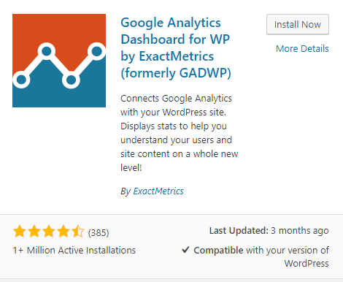
a) Analytics
Google Analytics:
- connect with your google account (you nedd a google account)
- Let’s go on your web site and add a new plugin:
- « Google Analytics Dashboard for WP »
Add your web site on your account on : https://www.google.com/analytics/ (Nominate your team member as administrator)
Discover the features offered + Explore “classic” dashboards + Build your own dashboard
At home watch the videos:
- (30 minutes) https://www.youtube.com/watch?v=WC3ONXJn9FQ
- and (17 minutes): https://www.youtube.com/watch?v=braJCJhfwQU

Slide 3
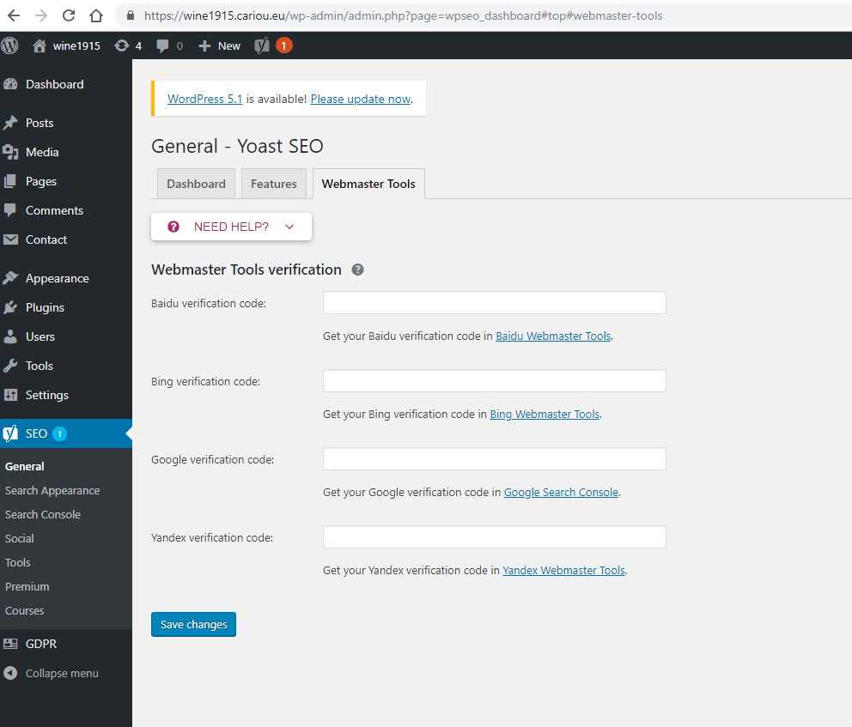
We’ll work in a Google context but…
Web design basics
For BING/YAHOO and/or YANDEX and/or BAIDU
With Yoast in « dashboard » and « webmaster tools » you can connect with BING Webmaster , « Yandex Webmaster Tools »,
Note that Bing and Yahoo have a partnership agrement: Yahoo site explorer is in Bing Webmaster tools. they use the same technologies and share the same algorithms
For BAIDU
It is essential to use a native person to transcribe your content, otherwise they will be incomprehensible to locals.
The use of Simplified Chinese is also recommended as it is favored by Baidu over traditional Chinese.
Mobile optimization is therefore crucial and, of course, taken into account in the engine algorithm. Design = Responsible or Mobile first. Use MIP: mobile instant pages by Baïdu and not AMP (accelerated mobile pages by Google)
Use HTTPS and Baidu Webmaster Tools (you need to create a Baidu account and login to Baidu webmastool moreless as you did for Google search engine)
And, of course:
Have a good contend (not a lot of ads)
A lot of back links
Nice HTML tags (title, description…)

Slide 4
b) Search console
Google Search Console
Connect to your google account
Connect to « Google search console » (type un search engine) : add a property…verify…alternate methods…html tag… copy
Connect to word press…dashboard…Yoast…dashboard…webmasters tools …paste (from Search console)
Return to search console: verify (ok ?)
Declare your website to google / Send a site map to search console… wordpress…dashboard…YoastSEO…XMLSitemaps ⁽¹⁾…General… « you can find your xml sitemap here : click »… copy the adress (http://winetourX.cariou.eu/sitemap_index.xml) …go to search console…crawl…sitemaps…add/test sitemaps… paste the adress…test then submit
Discover the features offered
(you can add yandex and bing/yahoo with a similar process)
(1) In Yoast: If you don’t see « Xml Sitemaps: Yoast…dashboard… Features… Advanced settings pages « Enable »

Slide 5
c) GDPR
Your website places cookies* on your visitors' computers (eg google analytics)…your website places cookies on the computers of your visitors (for example google analytics), it collects location data, an IP address, the type of computer / mobile ... in the sense of the European law they are data personal. So you have to be in compliance with the European “General Data Protection Regulation », GDPR
*An HTTP cookie (also called web cookie, Internet cookie, browser cookie, or simply cookie) is a small piece of data sent from a website and stored on the user's computer by the user's web browser while the user is browsing. Cookies were designed to be a reliable mechanism for websites to remember stateful information (such as items added in the shopping cart in an online store) or to record the user's browsing activity (including clicking particular buttons, logging in, or recording which pages were visited in the past).

Slide 6
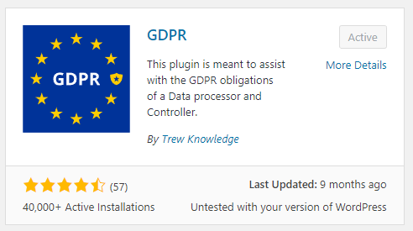
The principles of the GDPR are focused on the privacy rights of every person when it comes to collecting and processing their data:
The Principles of Lawfulness, Fairness, and Transparency: These dictate that the personal data needs to be processed in a way that is lawful to the subject.
The Principle of Purpose Limitation: The data processors can only use the data for the objectives they’ve explicitly described and justified.
The Principle of Data Minimization: The information that is required has to be relevant for its purpose and limited to what is necessary.
The Principle of Trueness, Accuracy: If some of the data is inaccurate, it should be removed or rectified.
The Principle of Storage Limitation: Data is kept in a form which permits identification of persons for no longer than is necessary for the purposes for which the personal data is processed.
The Principle of Integrity and Confidentiality: This principle stands for taking all required measures to ensure all the personal data is protected.
Create un small « Privacy Policy » page. Download here
Set the banner
I want you to install and use this plugin:

Slide 7
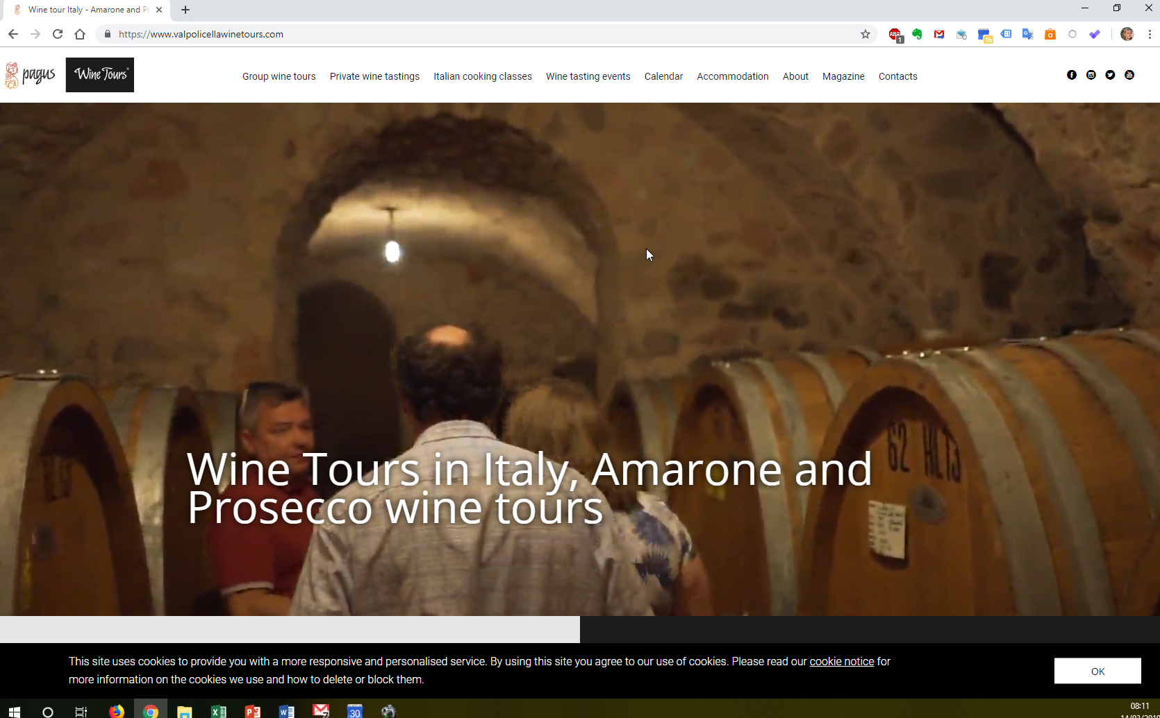
Copy and paste (and adapt) the cookies policy: here

Slide 8
d) Sitemap
You must create and declare your sitemap to the search engine (eg google). This is essential for the recent website and also for the bulky website.
A sitemap is made to help robots understand your website and thus improve indexing (and ultimately improve your site position in the answer pages).

Slide 9
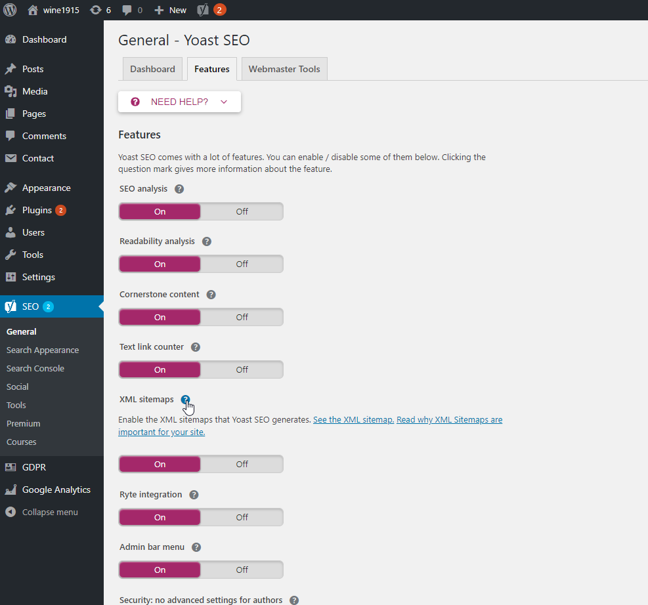

Slide 10
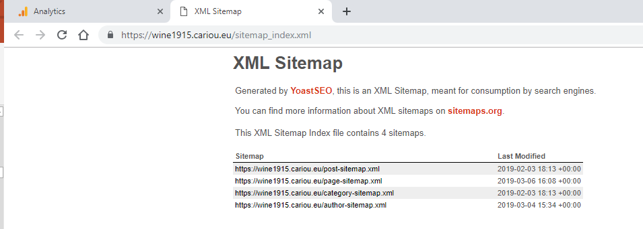
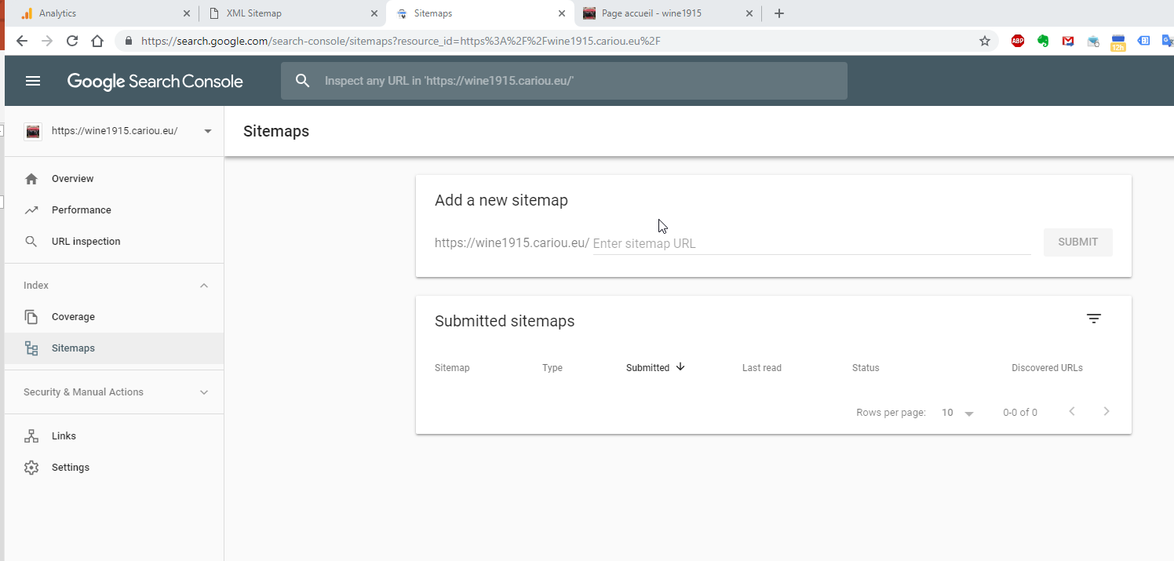
Copy the adress
Paste it in google
search console

Slide 11
e) Dashboard and KPI’s
Have a look to this website https://your.googlemerchandisestore.com/
Then access the datas of this website (demo account), your google analytics account must be open:
https://support.google.com/analytics/answer/6367342#access
Analyse the analytics…

Slide 12
You must create a weekly dashboard (with Google sheet) for your website
- You should choose the most relevant indicators to evaluate the performance of your website (KPI)
https://blog.crazyegg.com/2013/01/22/best-website-kpi/
https://en.onpage.org/blog/google-analytics-these-are-the-10-most-important-kpis-for-your-website

Slide 13
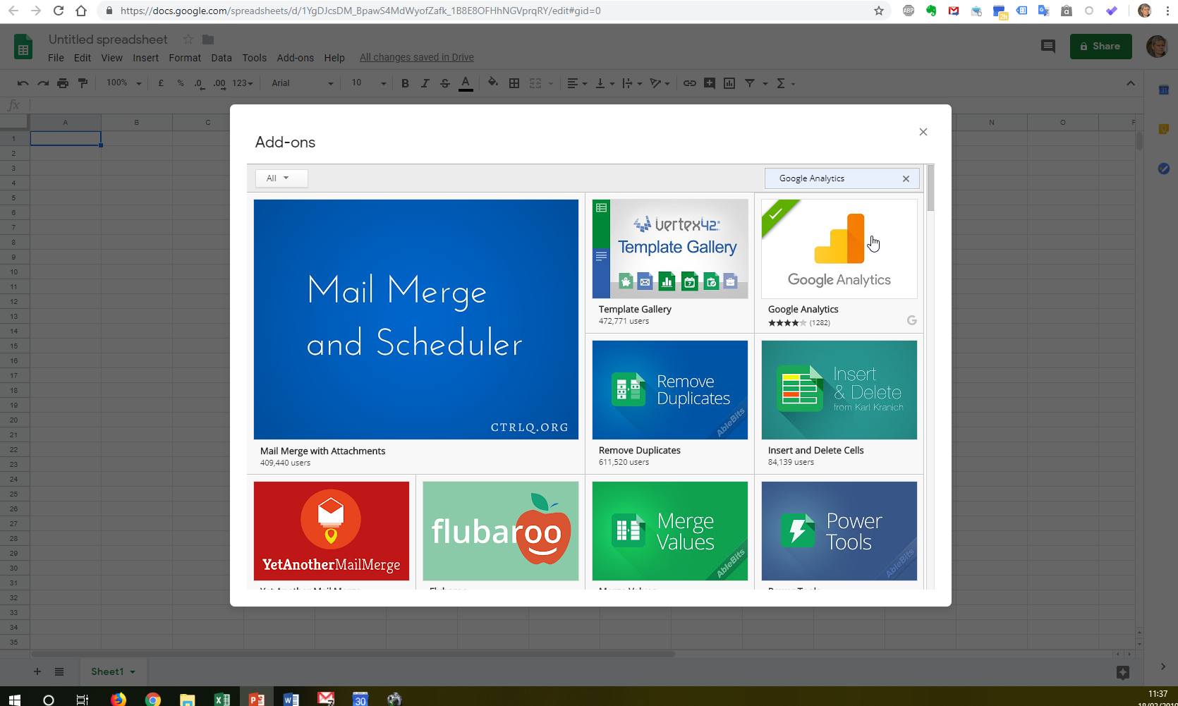
Open a new google sheet
Install the « Google analytics » add on

Slide 14
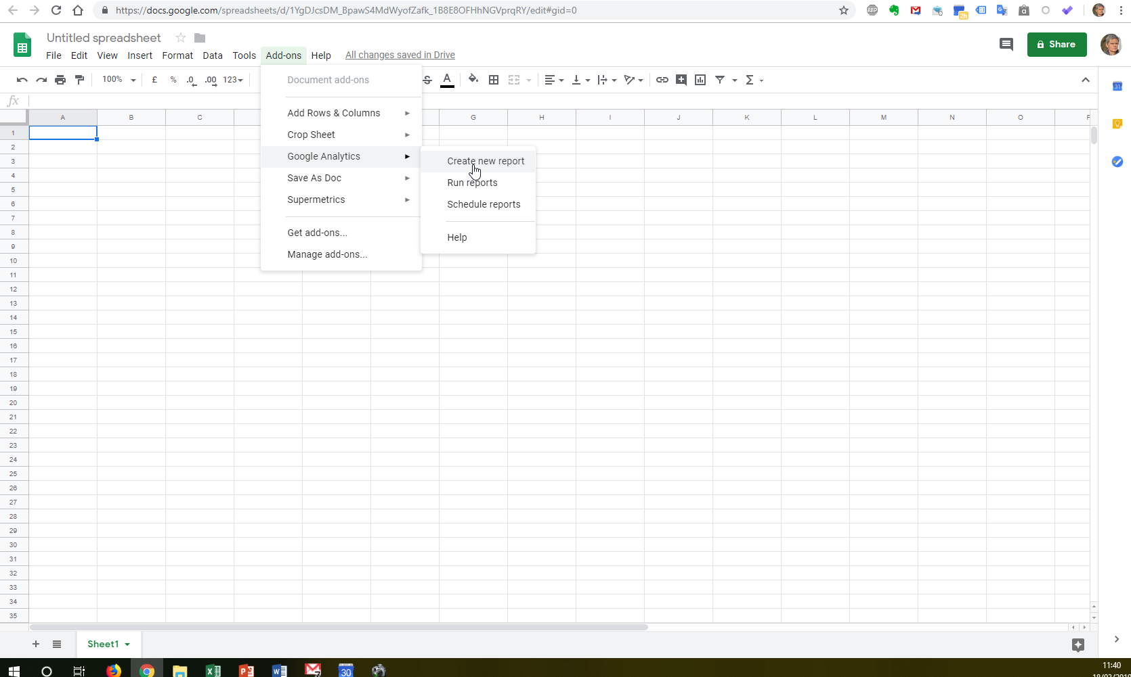
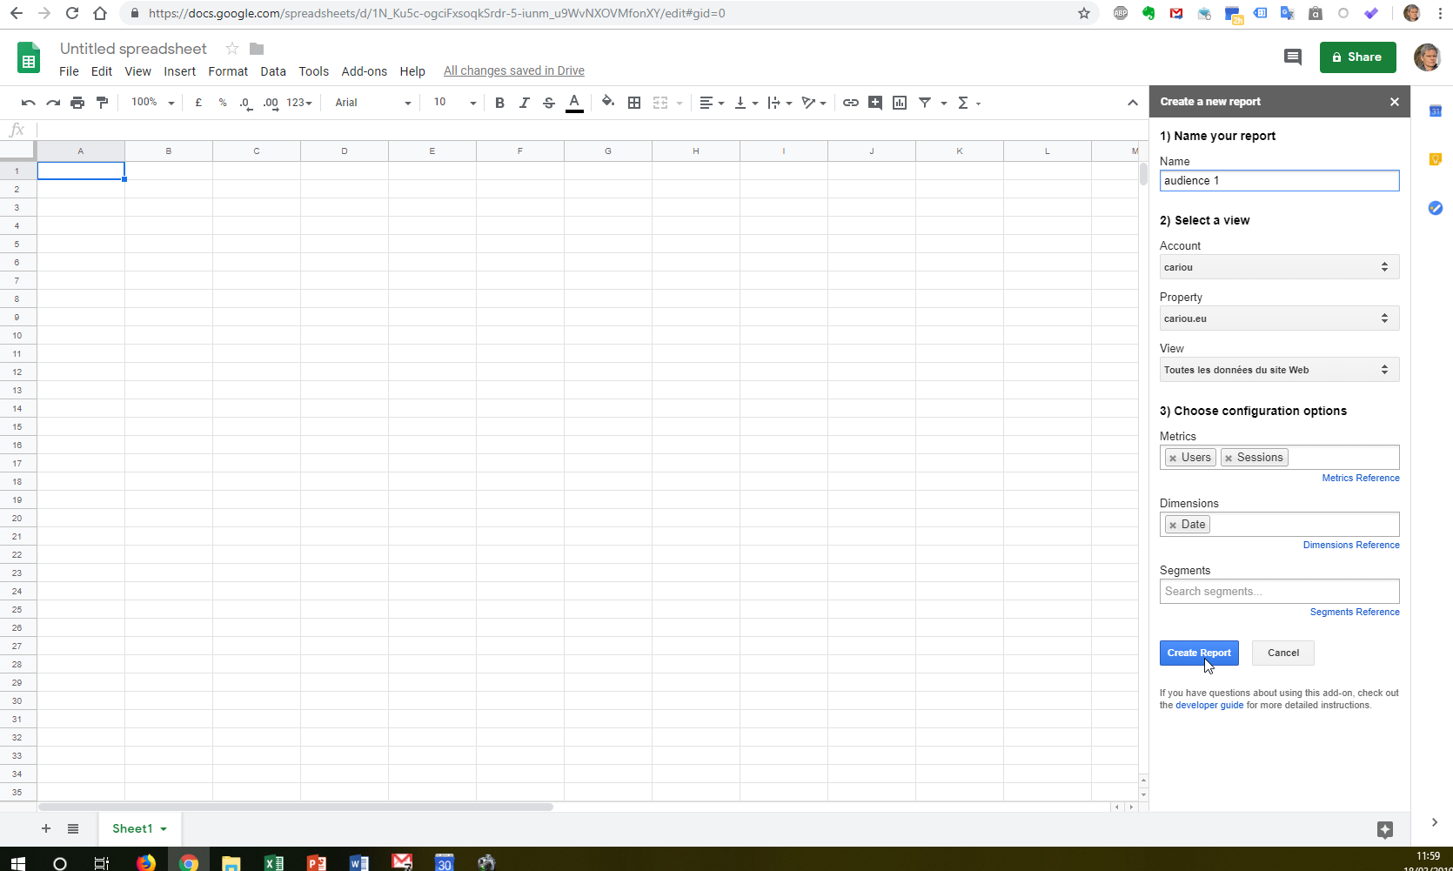
Create a new report
Your first report:
(if you don’t have some datas on your own website, use your « demo account » )

Slide 15
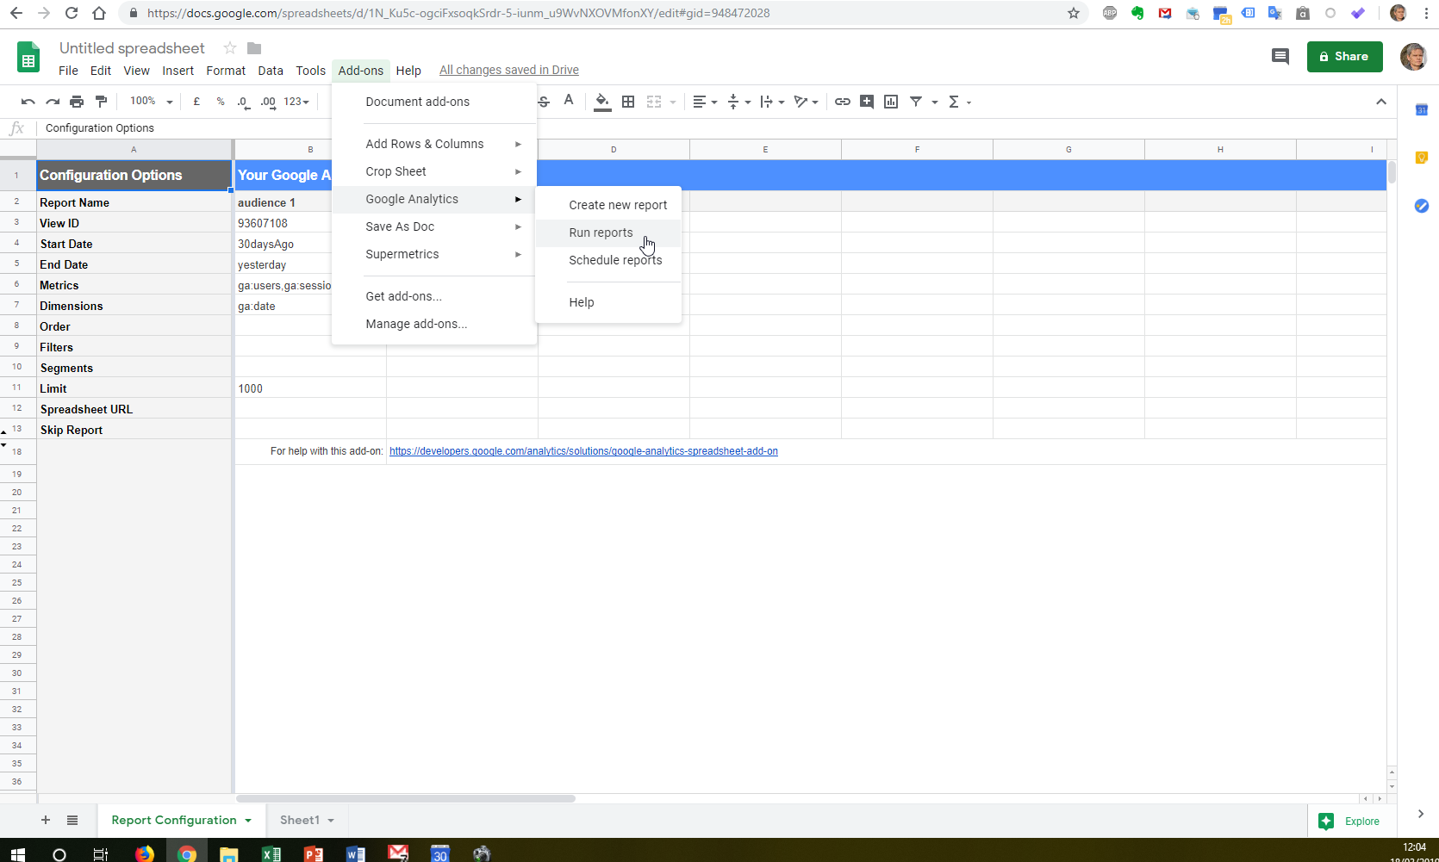
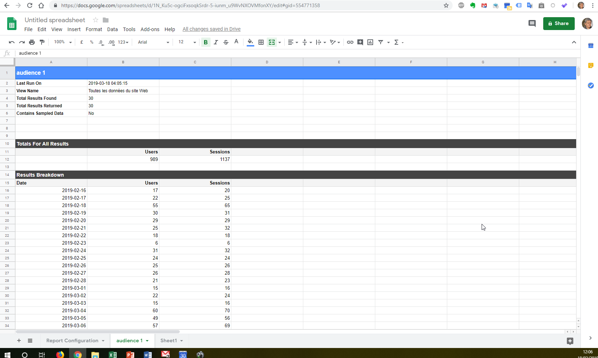
Get the data : (from google analytics)
Run reports
Now you can create/manage your own KPI’s
Create custom graphics…
Clic here to discover every dimension et metrics available

Slide 16
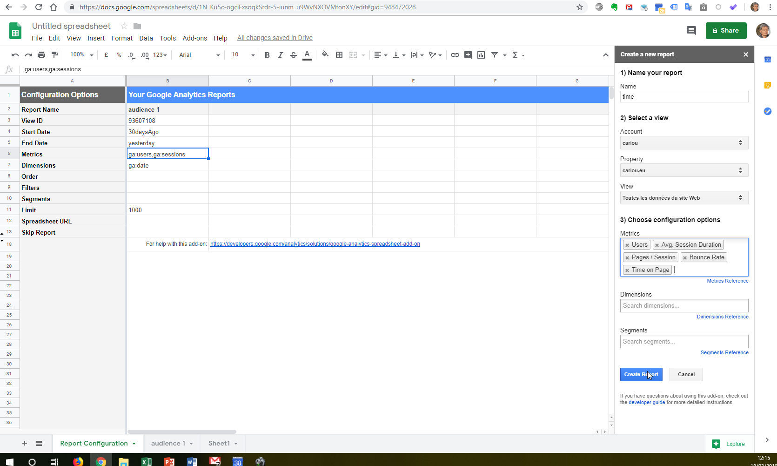
To add new data (new columns)

Slide 17
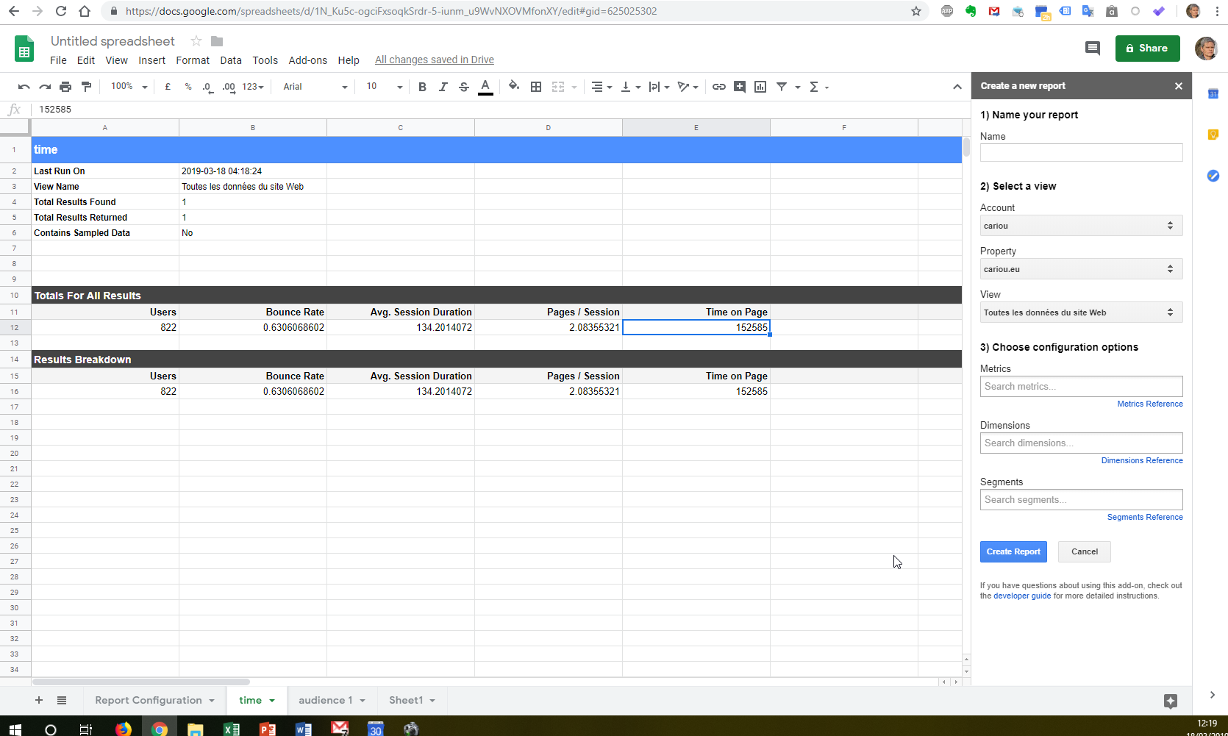

Slide 18
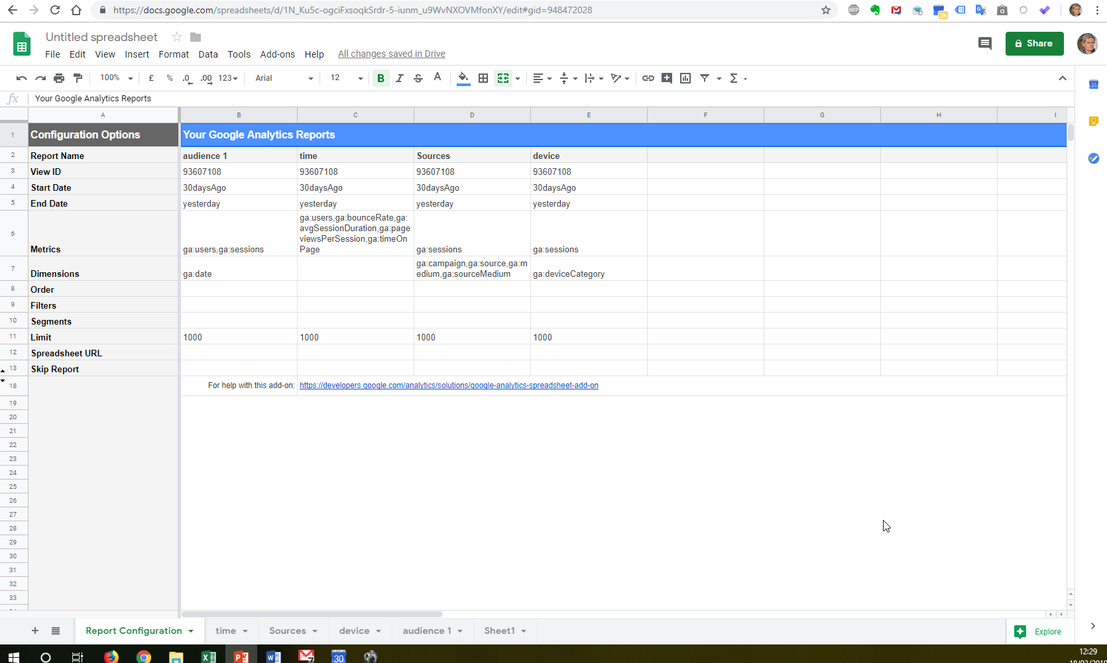
You can (you must)
Add different data (include : manual data and data from others sources)

Slide 19
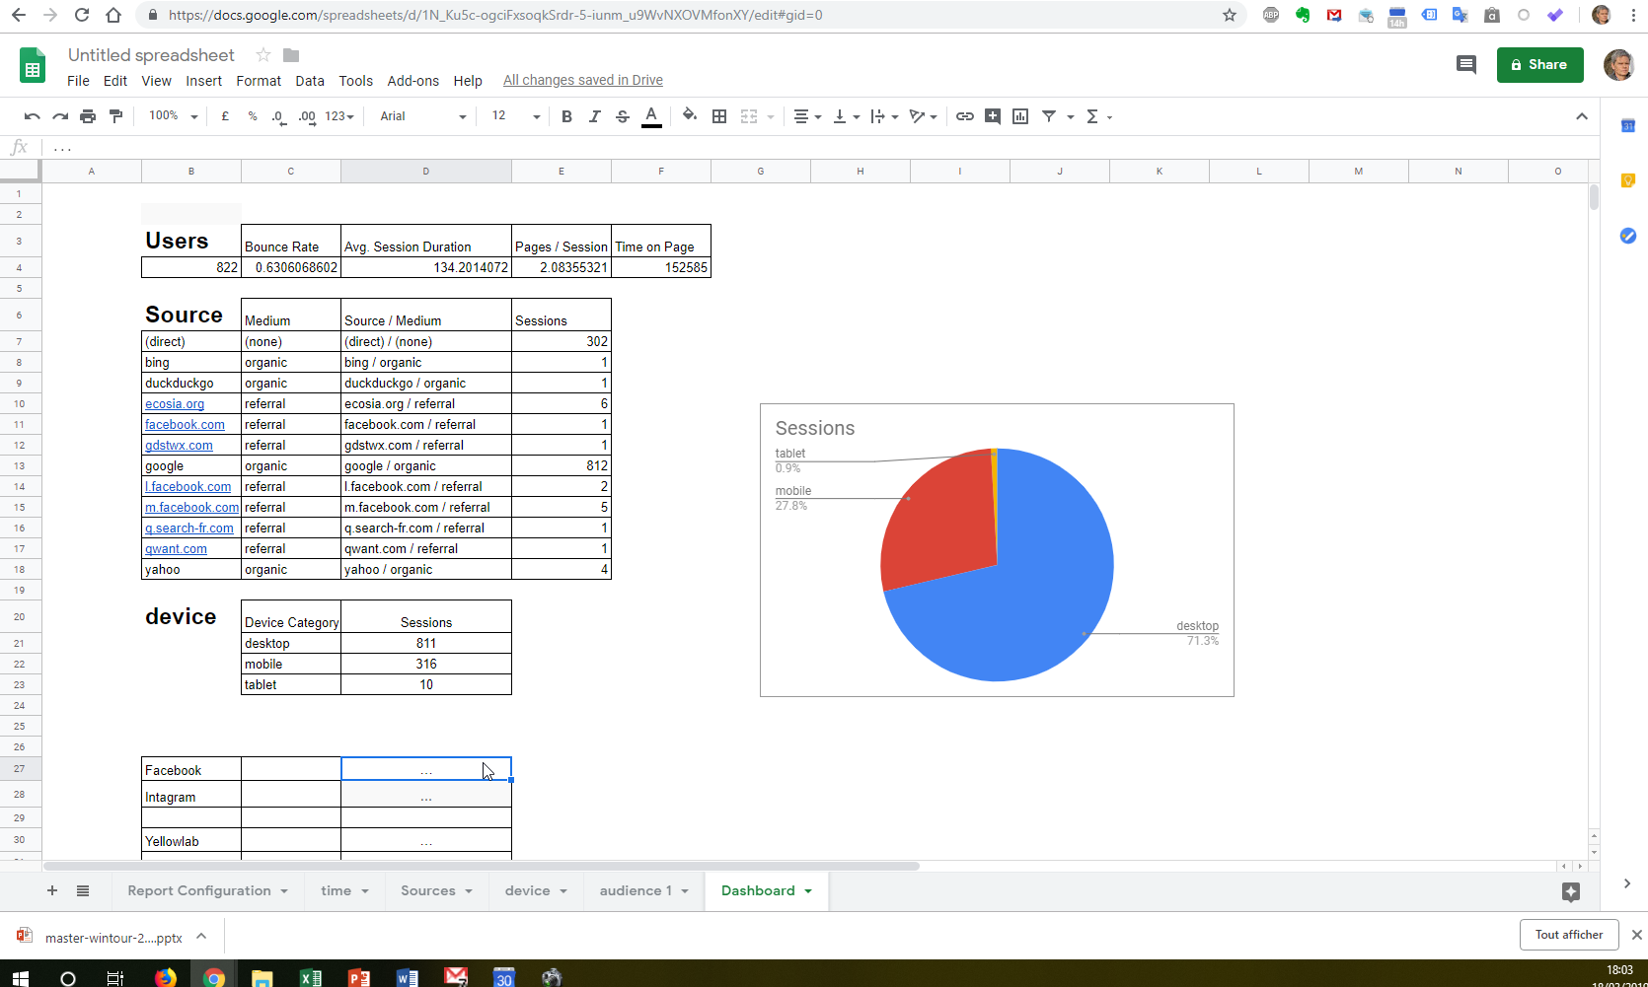
Create a new page
With google analytics data
And others sources

Slide 20
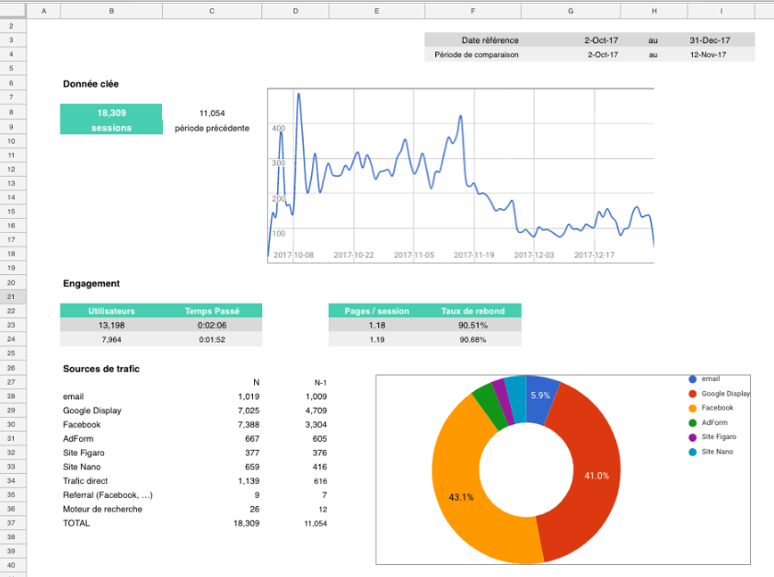

Slide 21
Every week you must:
1 ) Check your analytics (google analytics…and later: social media analytics, mailchimp…) and post them in a nice googlesheet (your dashboard with nice graphs)
2) Check your ranking with different keywords in several search engines (and post the results in your nice dashboard)
3) Check your website (and try to improve it) with:
- Google search console
- Pagespeed insights or GT metrix or Uptrends or Yellowlab
Pagelocity
4) Update and improve your dashboard (on google sheet)

Slide 22
Day 4/5
The tools you need to know today | Ok ?
Insert an image (+Image rights) | X
Edit an image with photofiltre | X
Insert a video | X
Classify images | X
Create a « contact page » | X
Add a plugin (contact form7 , WP smush, WP Media category management) | X
Insert widgets (search) | X
Write a post | X
Create a “news” page (with featured image)+ widget “recent post” | X
SEO (with « YOAST SEO ») | X
Analytics (with « Google analytics dashboard for WP ») + search console + different tools | X

Slide 23
Day 4/5
The tools you need to know today | Ok ?
Check your ranking in Google (search engine), bing, Yahoo, (Yandex…?)
Check your analytics (google analytics and search console)
Write new pages / post in your web site
SEO (with « YOAST SEO »)
Analytics (google analytics / goolge search engine): you must begin your dashboard , use : « Supermetrics » (in google sheet) « Google Data Studio » (dataviz) or « Excel »…)
Online reputation management (and ad this plugin « kk Star Ratings » on your WS)
Your guideline for social media (Facebook and Twitter and/or instagram)
Basics of SMO
Manage your social medias with Hootsuite (you must create an account)
Update your dashboard (web and social media)
To discover Supermetrics : https://support.supermetrics.com/support/home
To discover Google DATA STUDIO https://www.youtube.com/watch?v=R0rV4ZS-ruQ

Slide 24
I want you to use « supermetrics for google sheet »… but the free version is only for 14 days
… so you have to wait 14 days before the last day (« public defense » of your work ) to install Supermetrics’ add-on on googlesheet

Slide 25
End of Day 4/5
The tools you need to know today | Ok ?
Check your ranking in Google (search engine), bing, Yahoo, (Yandex…?) | X
Check your analytics (google analytics and search console) | X
Write new pages / post in your web site | X
SEO (with « YOAST SEO ») | X
Analytics (google analytics / goolge search engine): you must begin your dashboard , use : « Supermetrics » (in google sheet) « Google Data Studio » (dataviz) or « Excel »…) | X
Online reputation management (and ad the plugin « kk Star Ratings » on your WS and customize it)
Your guideline for social media (Facebook and Twitter and/or instagram)
Basics of SMO
Manage your social medias with Hootsuite (you must create an account)
Update your dashboard (web and social media)
To discover Supermetrics : https://support.supermetrics.com/support/home
To discover Google DATA STUDIO https://www.youtube.com/watch?v=R0rV4ZS-ruQ

Slide 26
2 Web analytics, search console, dashboard
3 Online reputation management (ORM)
4 Social media optimization
5- e-commerce
6 e-mailing / news letters
Online reputation management (ORM)
/ Guest Feedback platform or web reputation, reputation managment or e-reputation
Google alert (not for social media)
Mention
Webmii
Owler…
Trust you, Medallia, Review pro…
Tripadvisor (jj@cariou.gmail.com XXXXXXXX )
Booking…

Slide 27
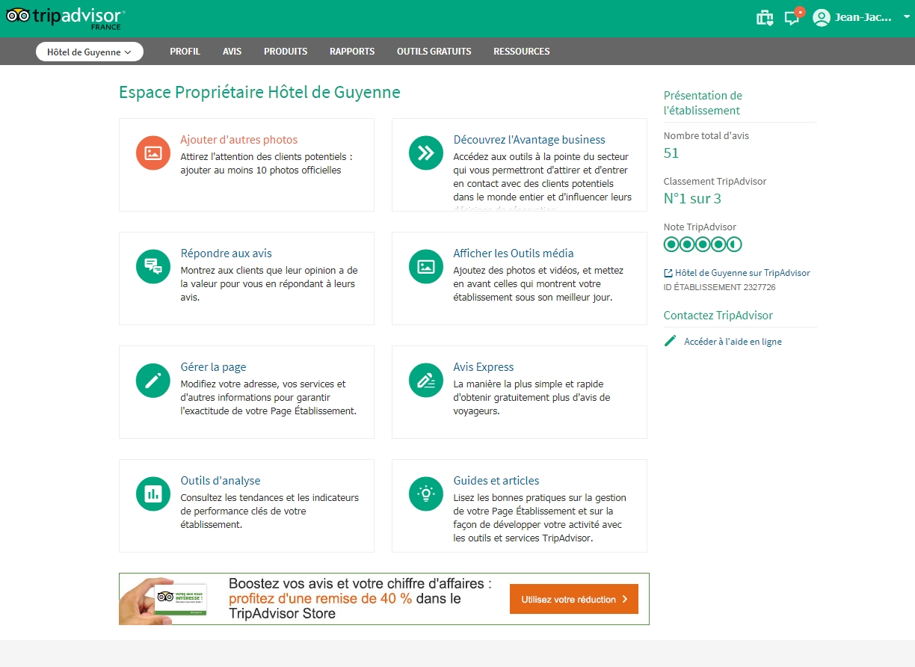

Slide 28
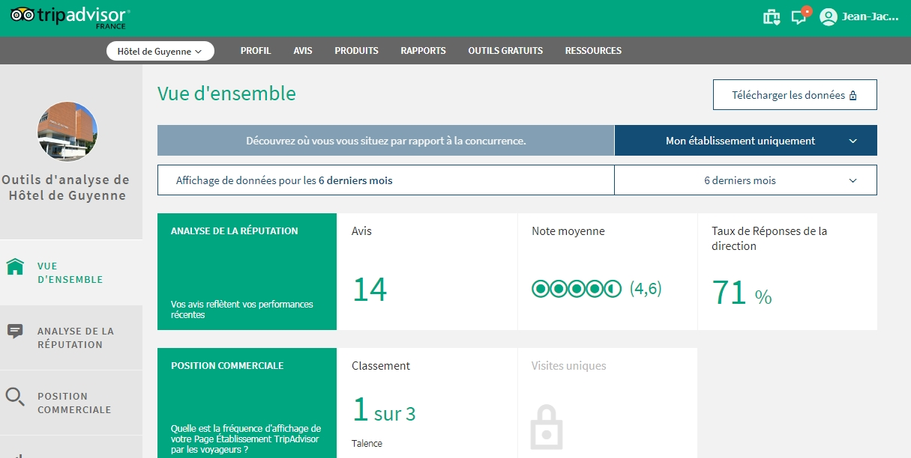
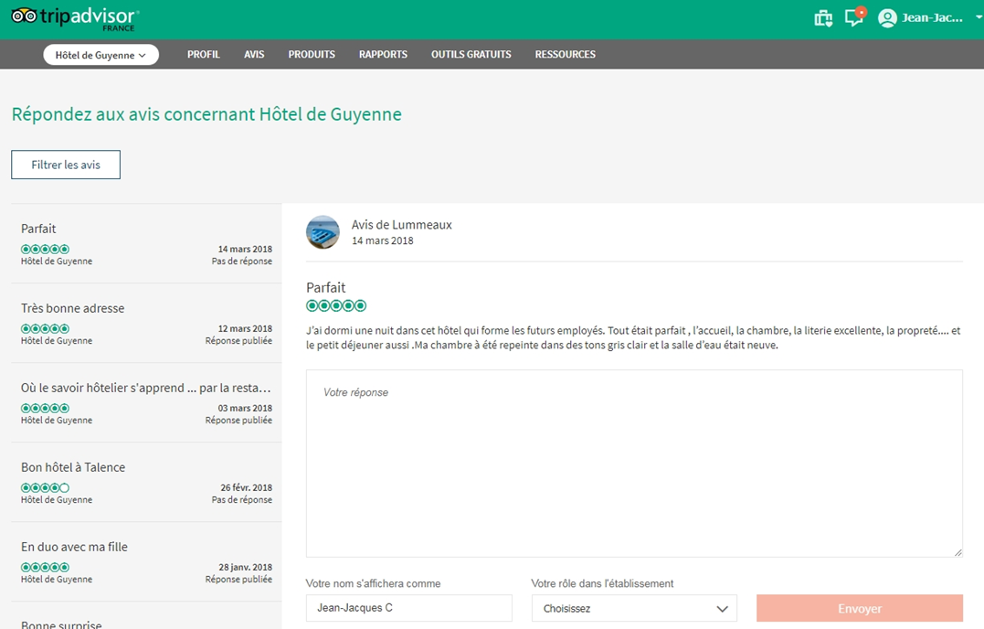

Slide 29
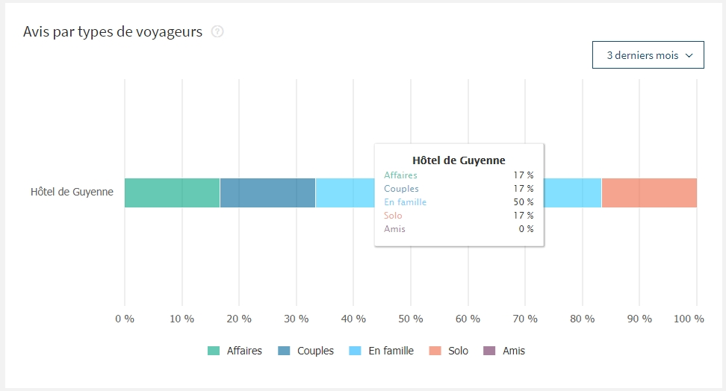
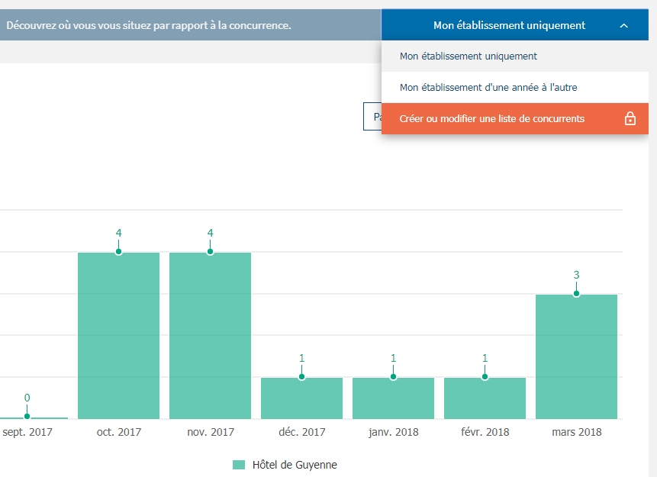

Slide 30
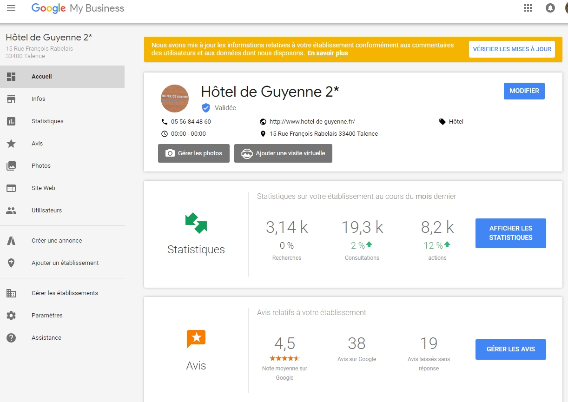

Slide 31
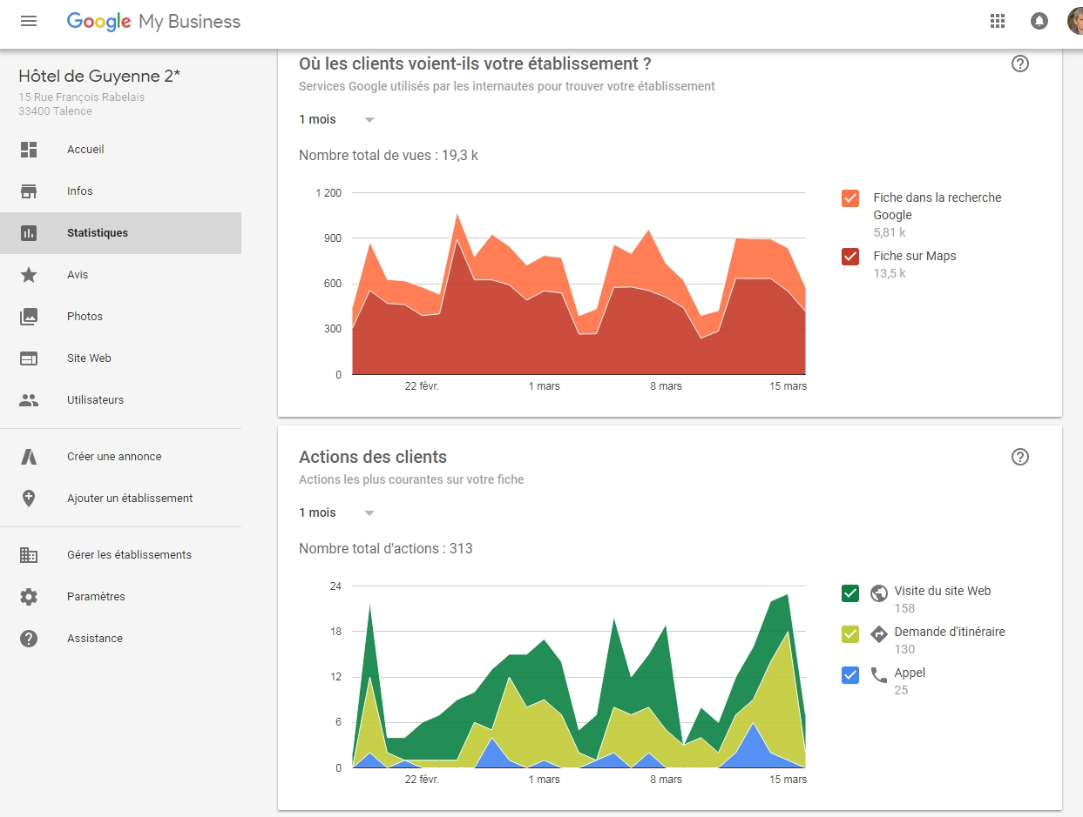

Slide 32
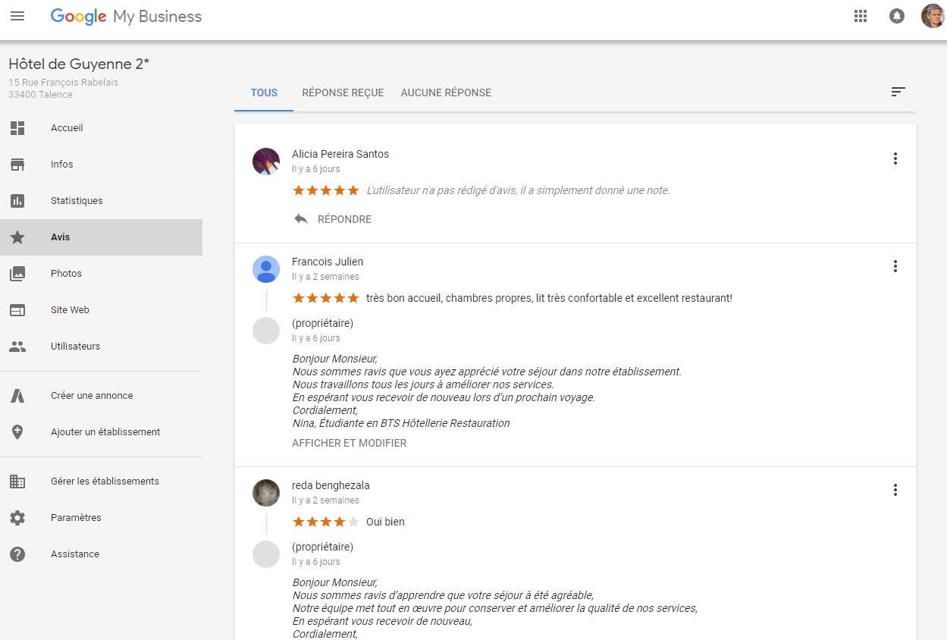

Slide 33
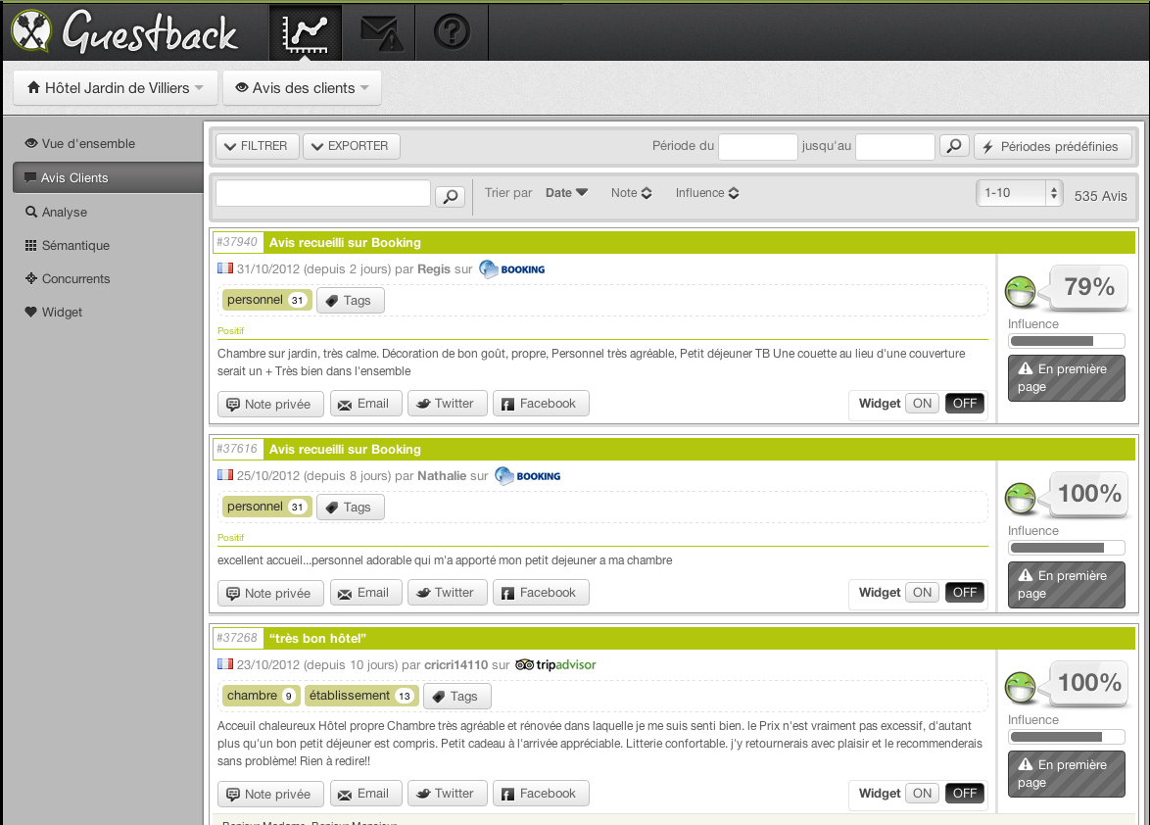
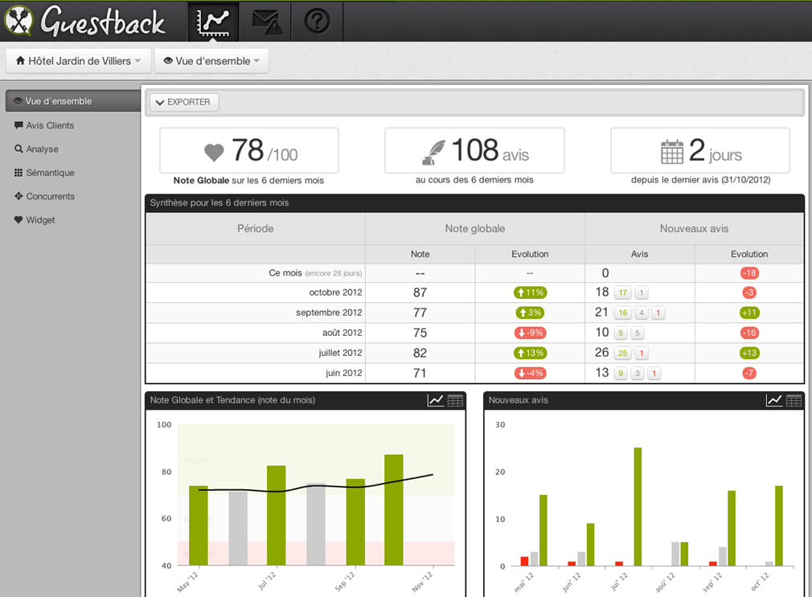

Slide 34
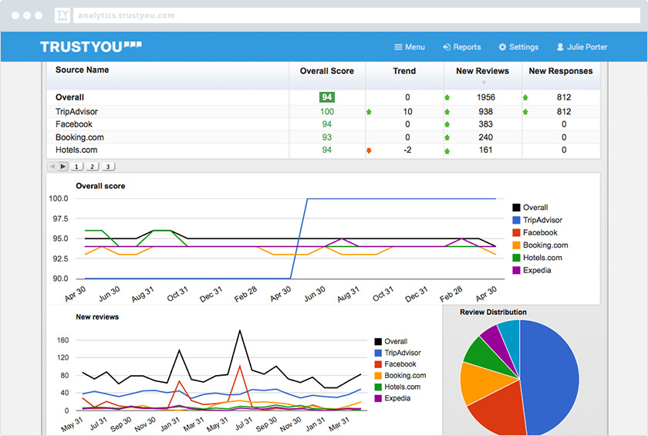
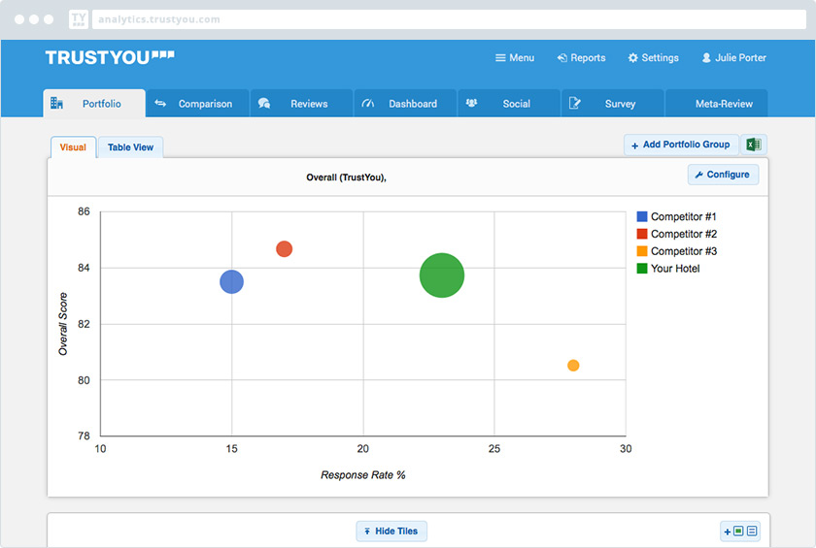
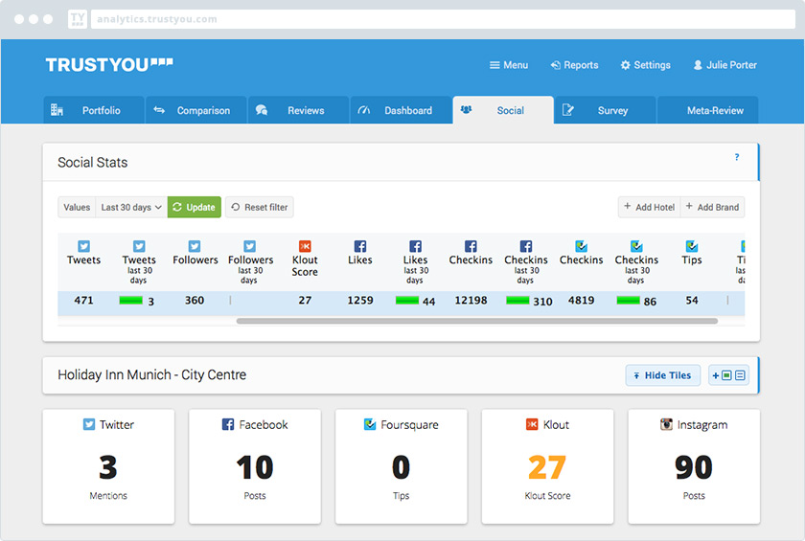

Slide 35
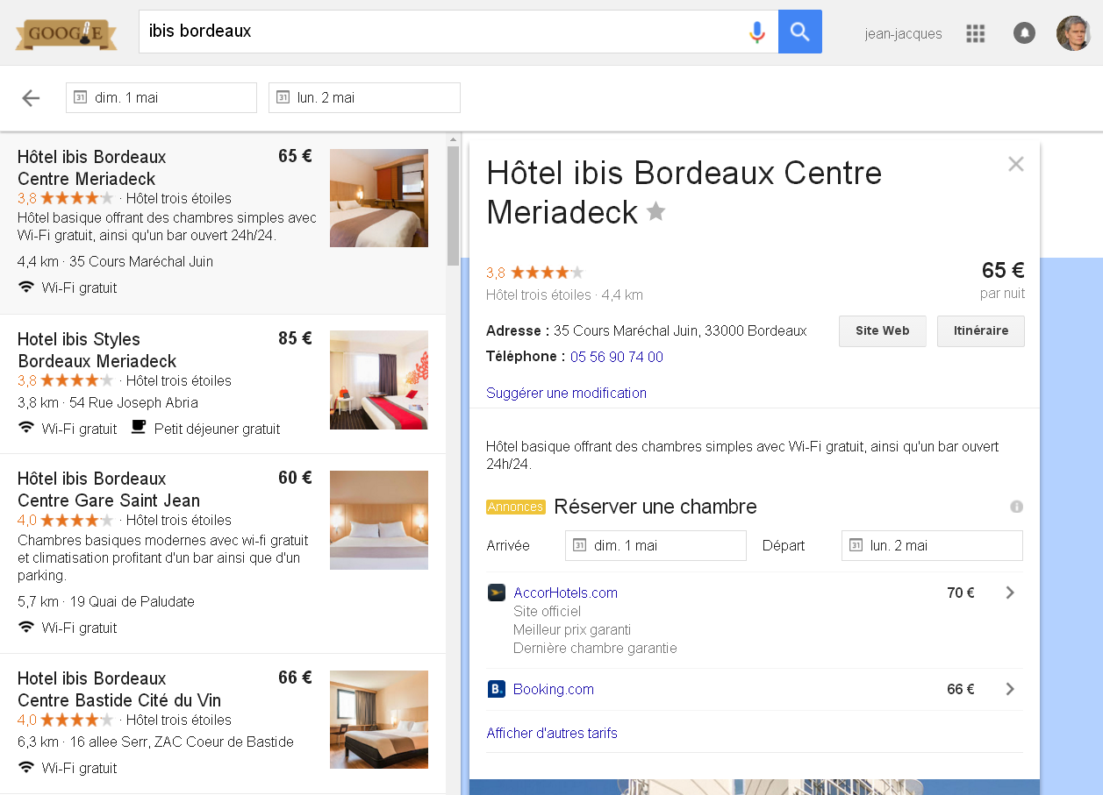
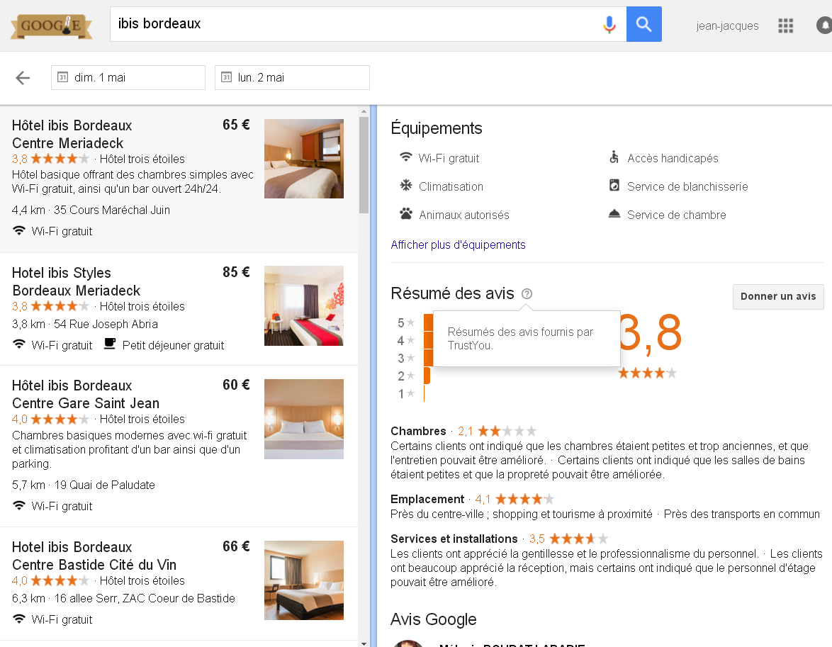
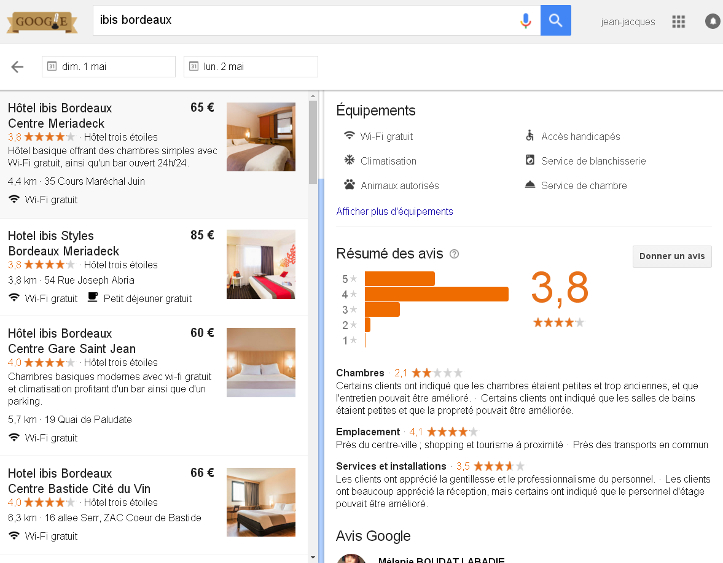
Trust You allows you to collect and dispatch to Google, Kayak… your own website…)

Slide 36
2 Web analytics, search console, dashboard
3 Online reputation management (ORM)
4 Social media optimization
5- e-commerce
6 e-mailing / news letters
SMO
Only Facebook and then you’ll choose one or two others social medias

Slide 37
Your guideline / SMO:
1 Community Focus: The target audience for your social media community building
2 Goal: The overall mission and purpose of your social media activity….in link with your communication stategy (web site…)
3 Values: The values that you wish to express and present through social media
4 Tone: The style of communication
5 Posting Frequency: How often you will create and reply to social media posts
6 Services and Resources: The specific services and resources you wish highlight/amplify through social media
Click here to complete the FORM

Slide 38
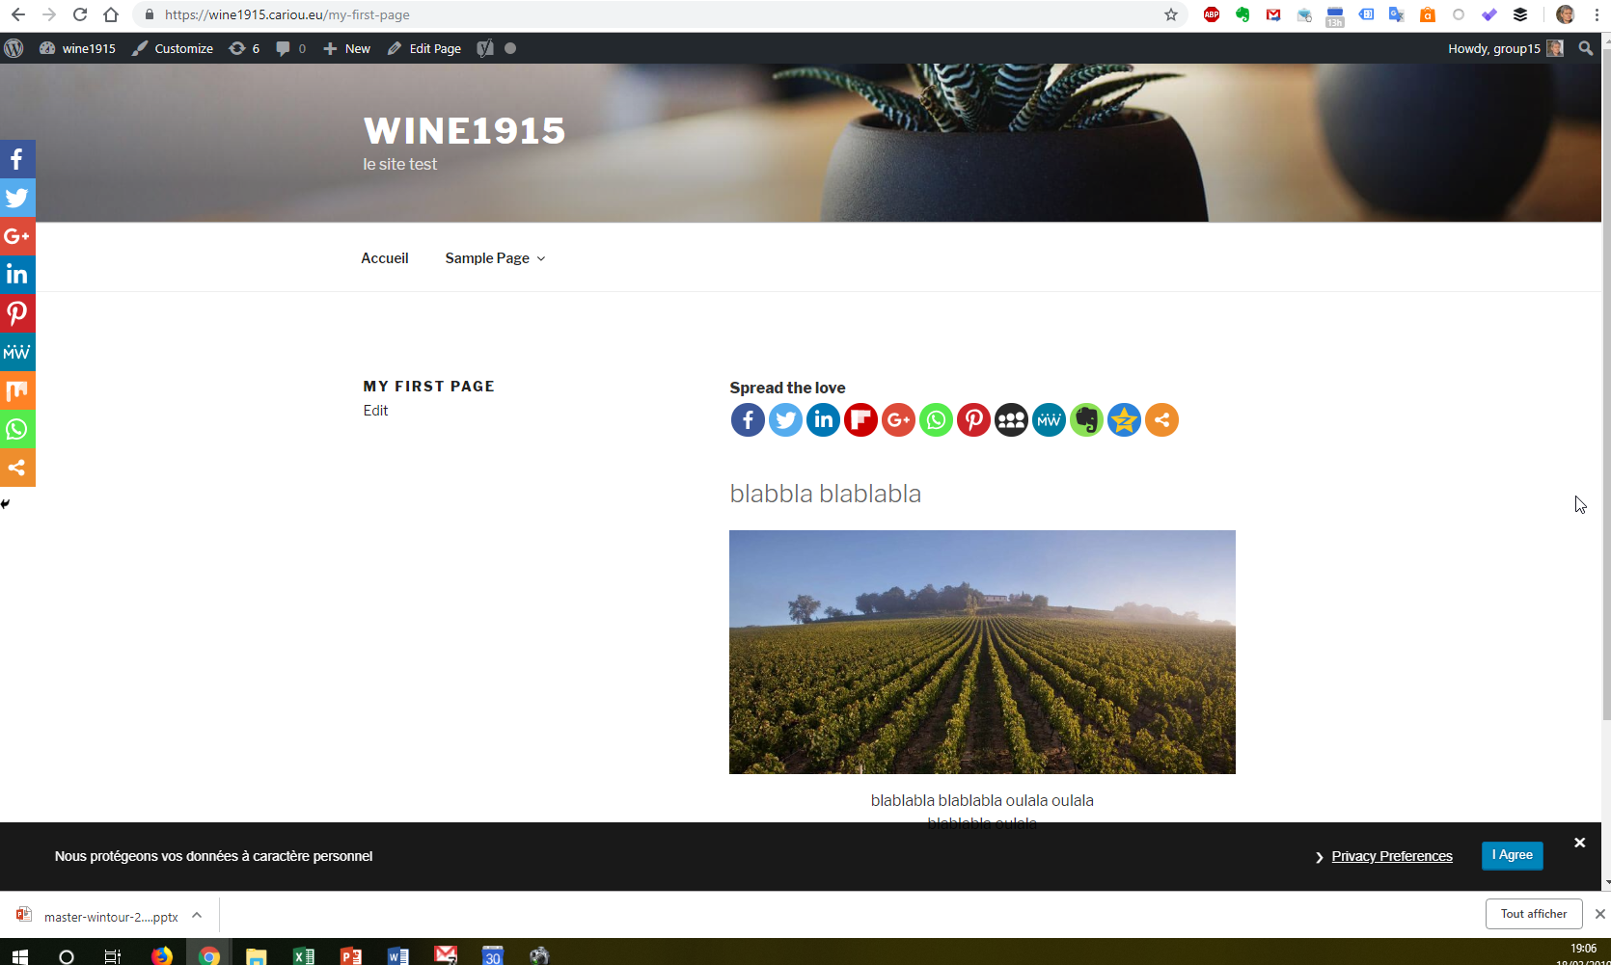
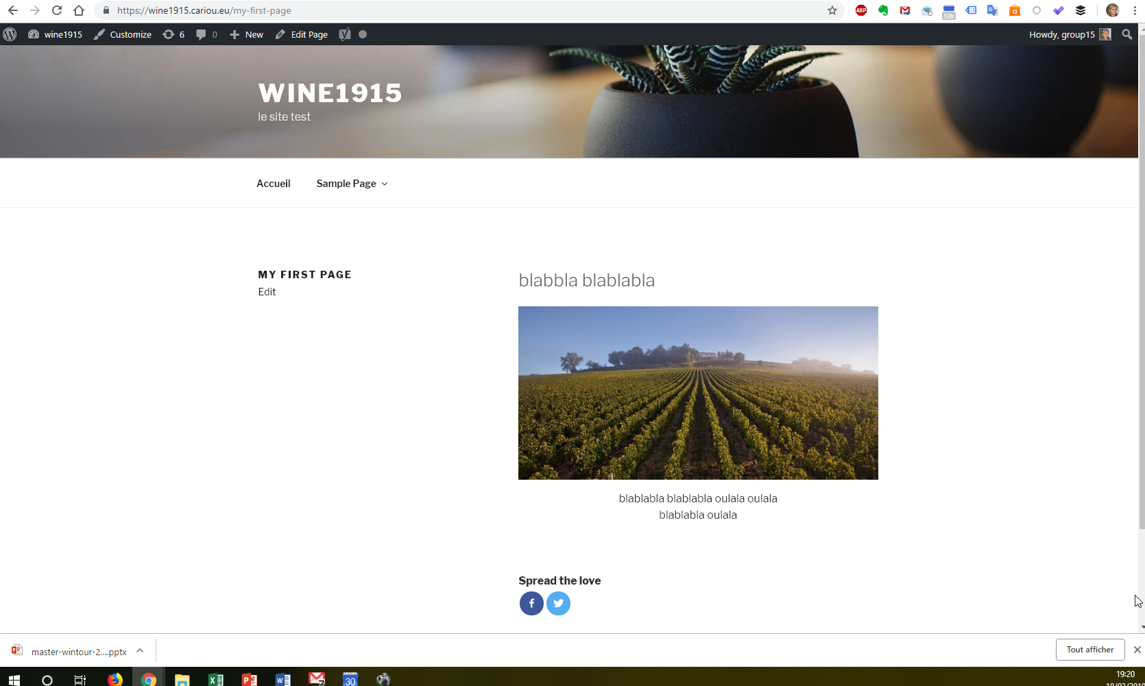
Create a facebook page about your topic
Create a twitter profile (business : https://business.twitter.com/ ) or Instagram
(Nominate your team member as administrator)
Create links from facebook/twitter/intagram to you web site
Create links from your web site to facebook/twitter/instagram:
Add plugin about facebook/twitter/instagram on your web site: Sassy Social Share (or Social warfare or and/or Shareaholic and/or WP Social Sharing and/or
Sharify Social Share Buttons and/or Custom Share Buttons with Floating Sidbear…)
(I recommend “share” buttons and not “like”. Put them at the beginning and/or end of your post on wordpress. Avoid official button
Avoid to transform your web site in a “Christmas tree” : limit the number of buttons)

Slide 39
To compare with competitors, use (e,g):
LikeAlyzer: http://likealyzer.com/
And/or Fanpage Karma : http://www.fanpagekarma.com/
And/or Klear: https://klear.com/
And/or Quintly : https://www.quintly.com/

Slide 40
Social media
DO’S AND DONT’S
Place logo every where you can: web site, business cards… | Ignore statistics tool (insight/facebook, analytics…)
Improve your picture design… to publish attractive post | Let your custumer / followers… comments unanswered
Write attrative, positive, VIRAL /snowball posts Choose topics and tone that your community will like to share + title (stirring up curiosity, practice humor…) + hook (start with something amazing/original,,,from the firsts words) + relate/personalized (use « We » and « I »…) + emphasize/highlight/exaggerate. More about that? Read: « Jab, Jab, Jab, Right Hook: How to Tell Your Story in a Noisy Social World” old book (2013)…but usefull. | Use unrelated hastags, links…
Best time to post: 8/10am, 12-2 pm, 4-6 pm….worst: 10 pm-8 am. Best days: Thusday, Friday, Saturday, Sunday…worst: tuesday | Let your fans without post during long time
Plan your post in advance | Be affraid to use fewwer words than usual
Use hyperlinks, video (+++), pictures, #, @...in your post. They will be more engaging | Don’t feed the troll ! / do not boost bad buzz !
Ask fo feedback from your fans/followers | Live to post !
Thank and reward your fans, folowwers… (respond, follow them, tips, goodies…)
Keep it cool…

Slide 41
Bad Buzz
Musician Dave Carroll said his guitar was broken while in United Airlines' custody….
Carroll says that his fruitless negotiations with the airline lasted about nine months. Then he wrote a song and created a music video about his experience “United breaks guitars” : more than 16 billions views (…and United breaks guitar 2 and 3)

Slide 42
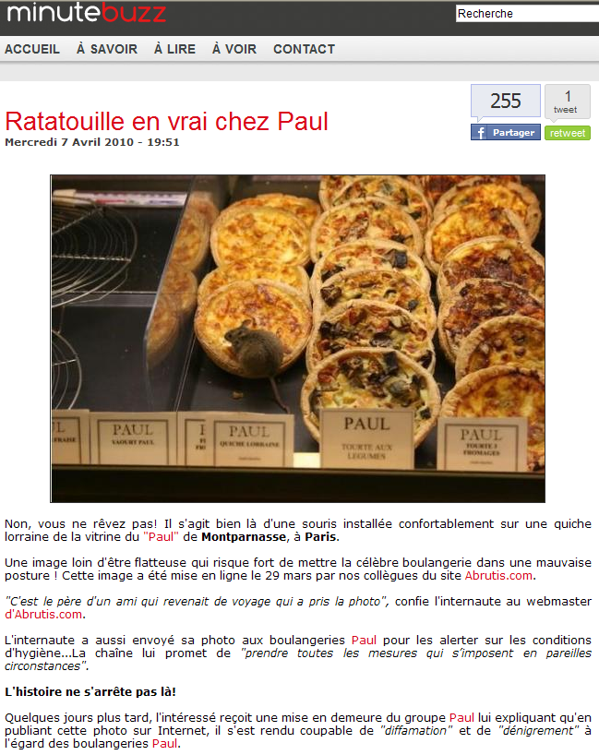

Slide 43
Watch the video (here) and began to post

Slide 44
You need to complete your dashboard by adding social media indicators (with Google Sheet or data studio or Excel)
- One or two a pages in A4 format (web site analytics, social media analytics/insight and later newsletters analytics

Slide 45
Several groups did not fill in the form to declare the subject of their website and their names
When the course ends today you must (1/2):
have a nice web site: 5 wonderfull pages minimum and more if possible + 3 nice posts and a page “news”. Images must have been optimized with “Photofiltre”. Each page must be optimized for the SEO with Yoast (readability and SEO/Keyword). Get SEO “off page” on your web site.
Have send the form about “Your guideline / SMO ”
have a Facebook page on the same topic, 3 nice posts minimum…and a little community (students of the group ?)…read the slide: DO’S and DONT’S
have a Twitter (or other social media) account on the same topic, 3 nice posts/twits minimum…and a little community (students of the group ?)… read the slide: DO’S and DONT’S
you need to have two-way links/button between your FB/Twitter and your WordPress site ( + like buttons, share buttons…on your WP posts) … read the slide: DO’S and DONT’S
Bonus: use IFTTT to share WP posts to FB or Twitter to FB page or FB to Twitter… Explore the software IFTTT !

Slide 46
When the course ends today you must (2/2):
- have connected your website with Google Analytics (You must verify that Google Analytics is working correctly in relation to your website)
- have connected your website with Google Search console. You must also have sent your site map to Google Search console.
- You should explore the possibilities of Google Analytics as well as statistics of facebook and Twitter/other social media (if you use it)
- You need to define your first KPIs for your WordPress site your Facebook page and your Twitter account
- You need to create a dashboard in one page maximum. I want you to use Supermetrics in Google sheet (“add-ons” + “Get add-ons” + search: “supermetrics”) or Google Data Studio

Slide 47
End of Day 6
The tools you need to know today | Ok ?
Check your ranking in Google (search engine), bing, Yahoo, (Yandex…?) | X
Check your analytics (google analytics and search console) | X
Write new pages / post in your web site | X
SEO (with « YOAST SEO ») | X
Analytics (google analytics / goolge search engine): you must begin your dashboard , use : « Supermetrics » (in google sheet) « Google Data Studio » (dataviz) or « Excel »…) | X
Online reputation management (and ad the plugin « kk Star Ratings » on your WS and customize it) | X
Your guideline for social media (Facebook and Twitter and/or instagram) | X
Basics of SMO
Manage your social medias with Hootsuite (you must create an account) | ?? (free 1 month)
Update your dashboard (web and social media) | X
Or Buffer ?
To discover Supermetrics : https://support.supermetrics.com/support/home
To discover Google DATA STUDIO https://www.youtube.com/watch?v=R0rV4ZS-ruQ

Slide 48
Day 6
The tools you need to know today | Ok ?
Analytics (consolidation)
Dashboard (consolidation)
Manage your social medias with Hootsuite (you must create an account)
Newsletters

Slide 49
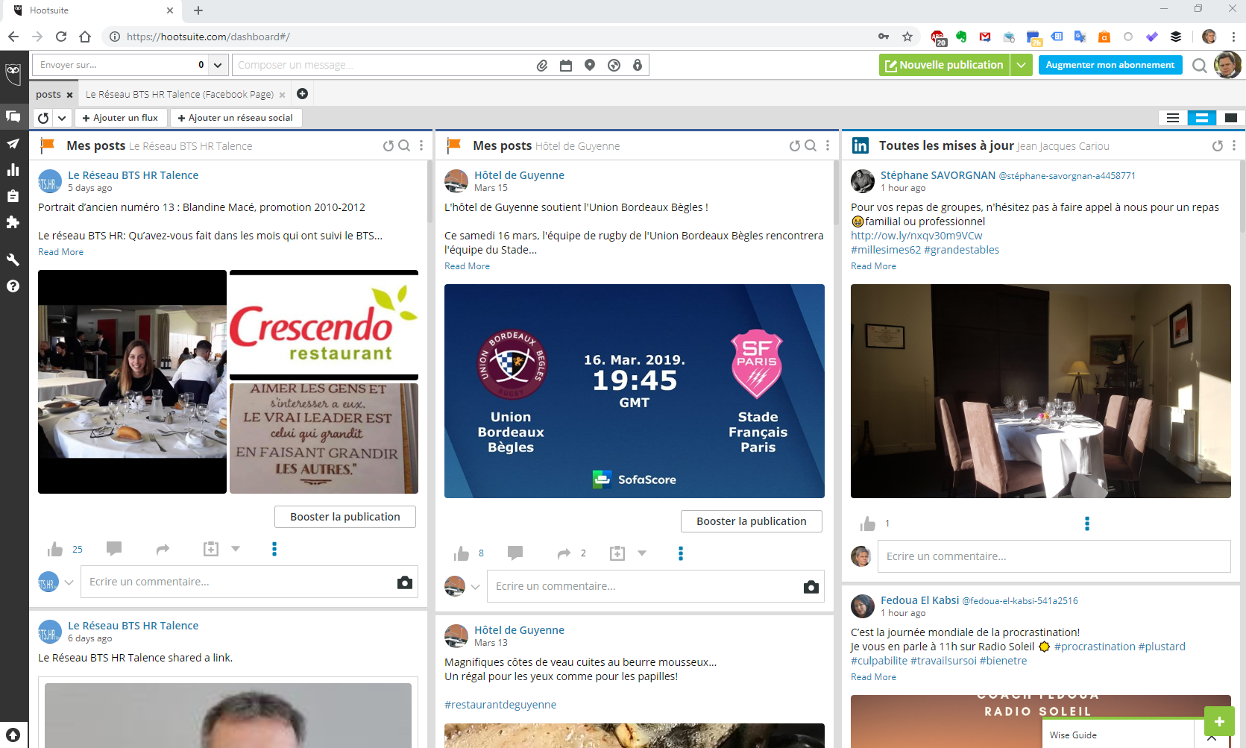
(free.fr + xxxxCxxxxx + special)
You must create an account on Hootsuite for managing your social medias (facebook, twitter…)

Slide 50
2 Web analytics, search console, dashboard
3 Online reputation management (ORM)
4 Social media optimization
5- e-commerce
6 e-mailing / news letters
E-commerce
E-shop and booking system

Slide 51
e-marketing
Direct marketing:
e-mailing («permission marketing »☺ «spam »☹)
+ control/analytics/dashboard
Mass communication:
Owned website,
ad on third party websites, SEA…
e-reputation
SMM
+ control/analytics/dashboard
Interactivité
e-communication
Interactivité
Interactivité
Distribution.
Booking systems, e-shop
+ control/analytics/dashboard
Webmarketing
e-distribution/e-commerce

Slide 52
E-commerce for goods
1
Company
Web site with an e-shop
Clients
Market place
2
Company 1
delivery
Clients
Market place (e.g: amazon)
Company 2
Clients
Company 3
Clients

Slide 53
E-commerce for goods + market place (1)
3
Company
Web site with an e-shop
Clients
Market place (e.g: amazon)
Clients
E-commerce for goods + market place (2)
4
Company
Web site with an e-shop
Clients
Market place (e.g: amazon)
Clients

Slide 54
Click and brick / Brick and click
Web to store / Store to web
Company
Web site with an e-shop
Clients
Brick and mortar property/shop
Clients
Is it important ?
How to manage that ?

Slide 55
E-commerce for visits, rooms…
5
Company
Web site with « booking system »
Clients
For hotels (Simplified)
6
Clients
Hotel
PMS
(property management system)
Channel manager+ booking engine
OTA…web site
Clients
Clients
Hotel web site
Clients
Hotel group web site
Clients

Slide 56
E-commerce for restaurants 1
7
Web site with booking system
(specialized: itable, guestable)
Restaurant TMS
(table management system)
Clients
E-commerce for restaurants 2
8
Restaurant + distributor TMS
Distributorbooking system
Distributor web site (The Fork, Open Table…)
Clients
Restaurant web site
Clients

Slide 57
We will work on cases and
1
5

Slide 58
Install the plugin woocommerce
Built your e-shop…
Minimum 10 items, 3 photos/item
(it’s better if you shoot the photos before Monday !)

Slide 59
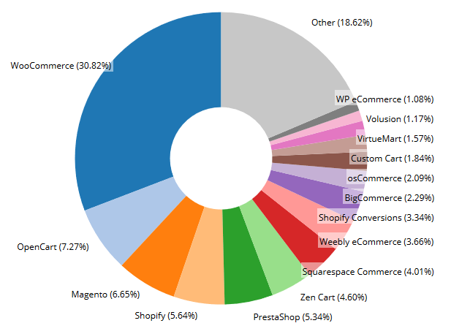
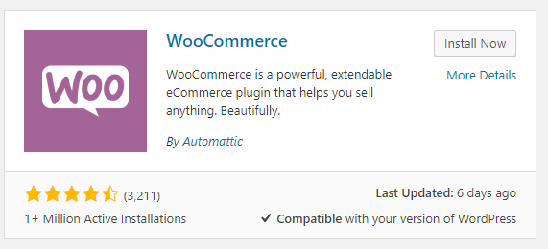
Market share wordwide
http://builtwith.com/ecommerce/
(Uninstall unused plugins !!!)
Install the plugin woocommerce

Slide 60
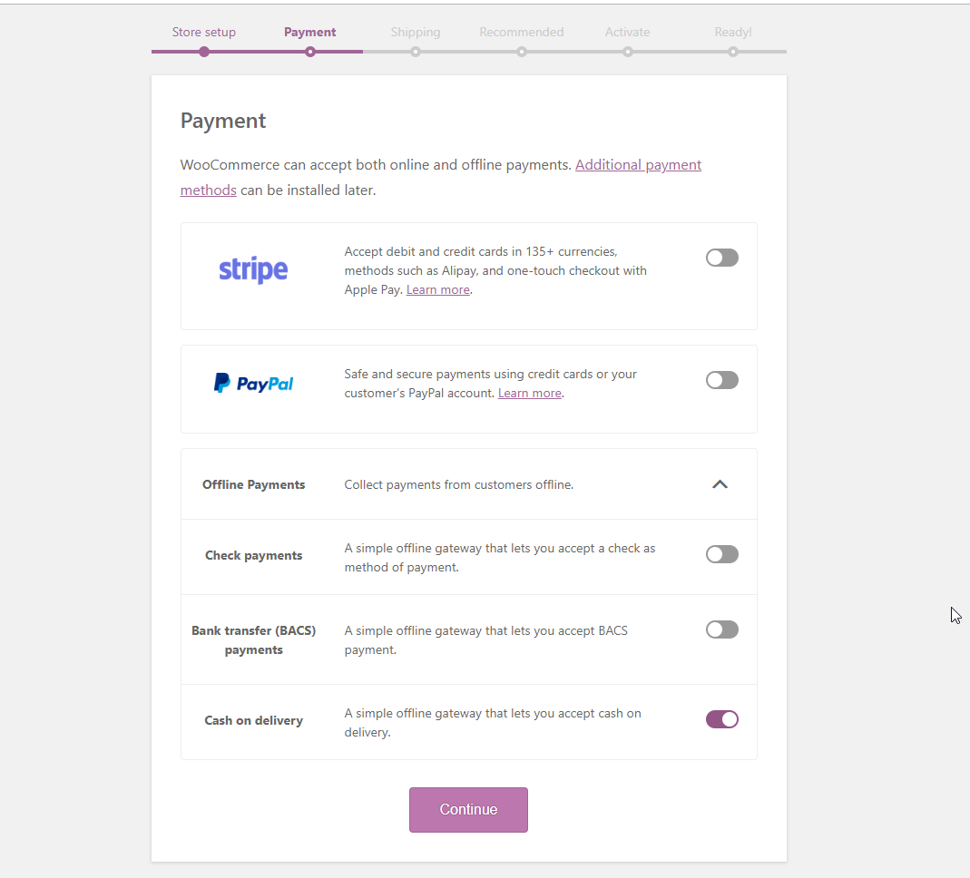

Slide 61
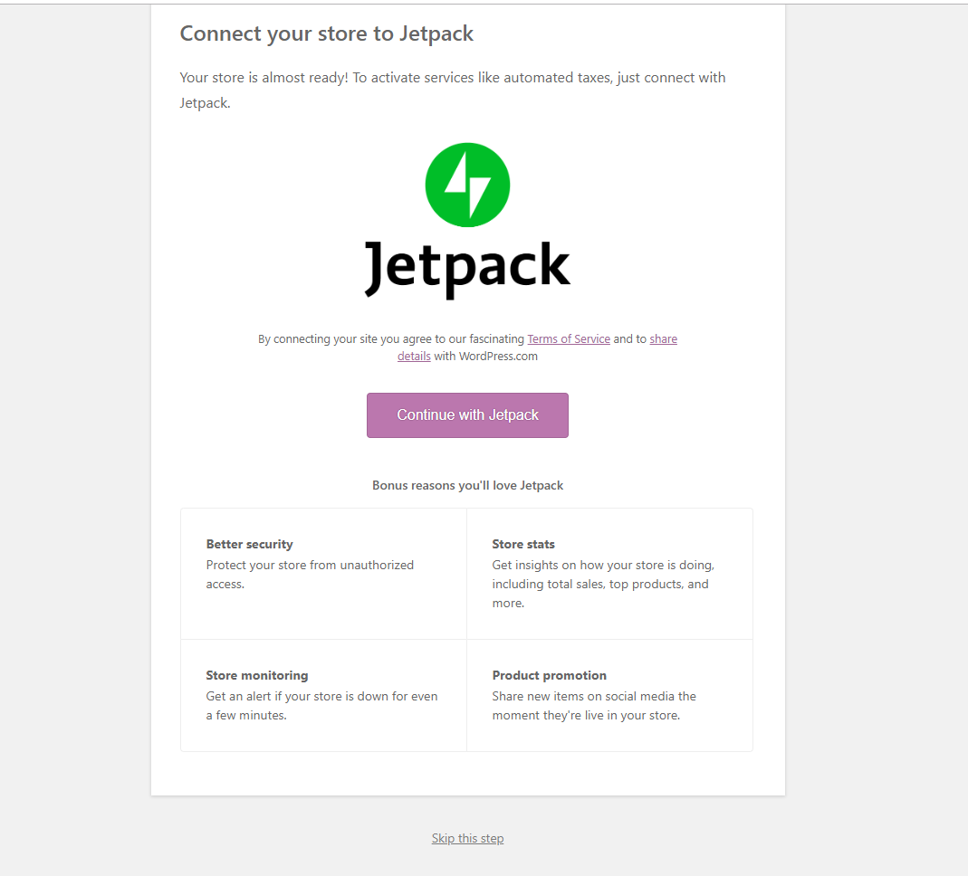

Slide 62
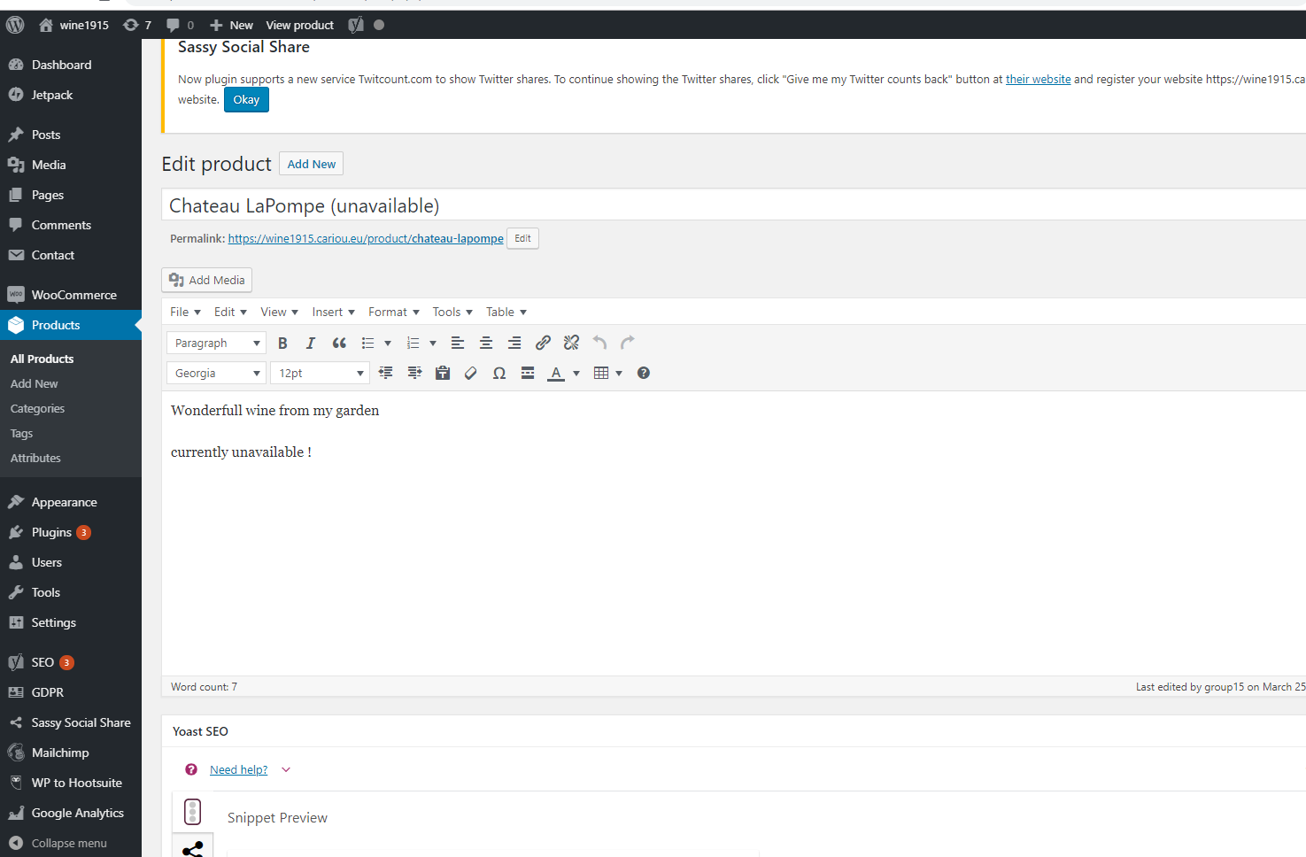
I want you to type « unavailable » on every product name

Slide 63
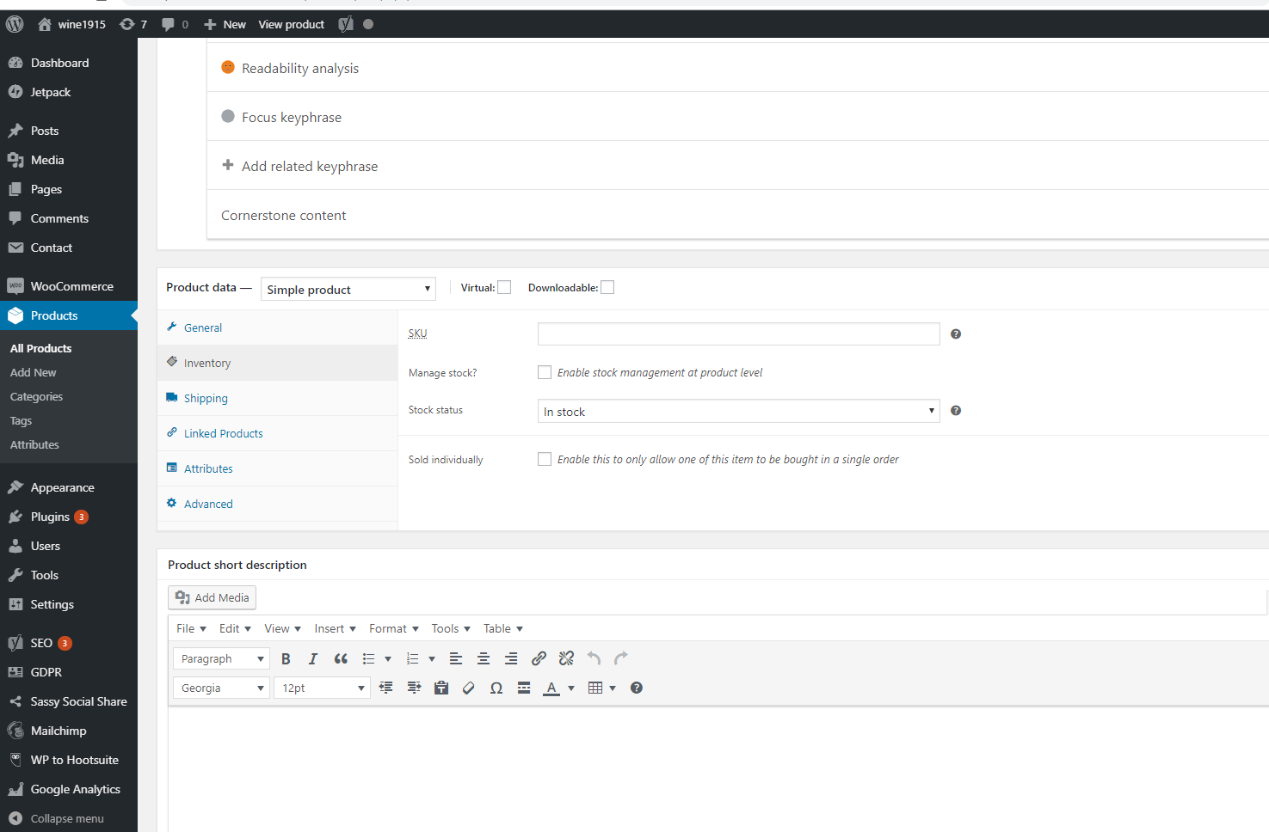
Your products need to be « in stock »

Slide 64
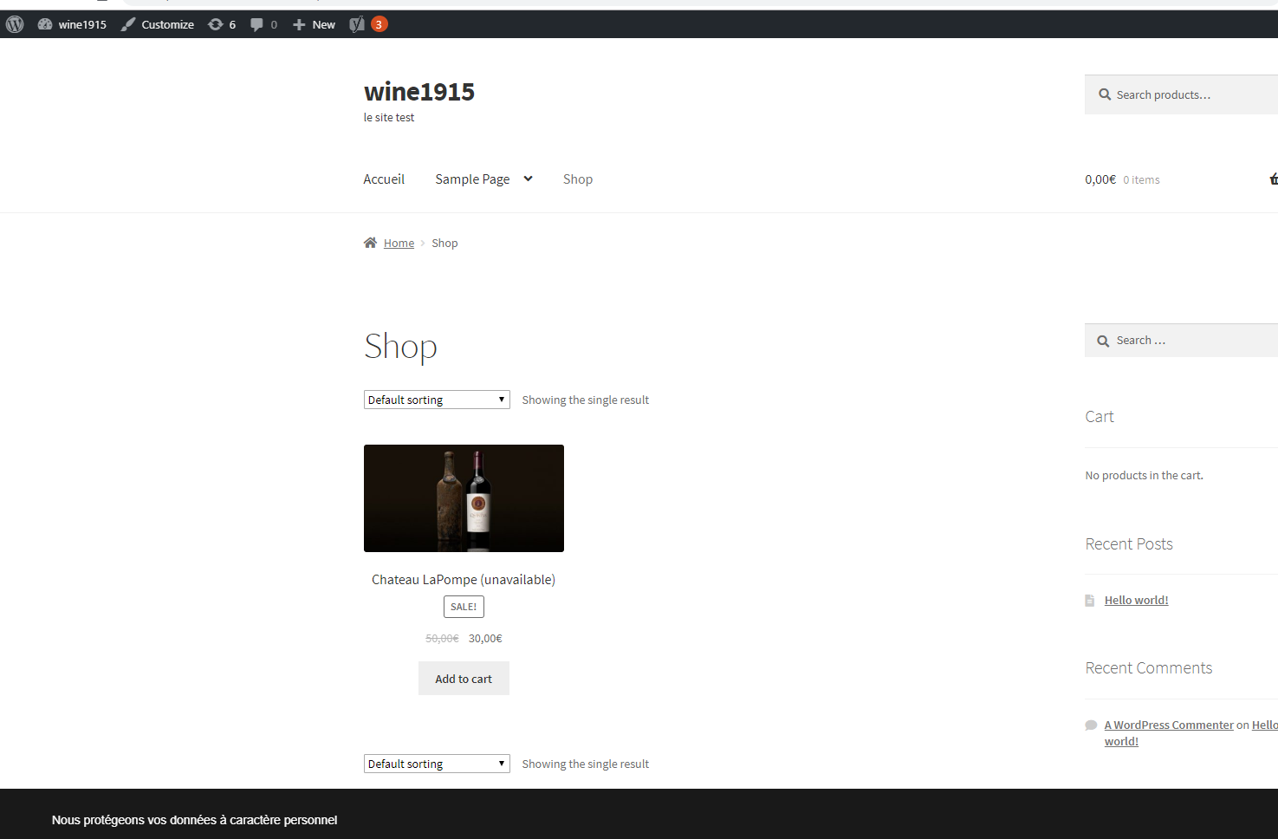
Add the shop page in your menu
Add the cart widget in the side bar or in the menu…

Slide 65
Now create products, manage your e-shop (set the emails… test …)

Slide 66
Optimize our e-shop
You can install specific extensions for woocommerce (fremium !): e.g : Quick view Woocommerce, Woocommerce Menu cart, WooCommerce Wishlist Plugin, Ajax Search for WooCommerce, WP Image Zoom…
Uninstall unused plugins !!!

Slide 67
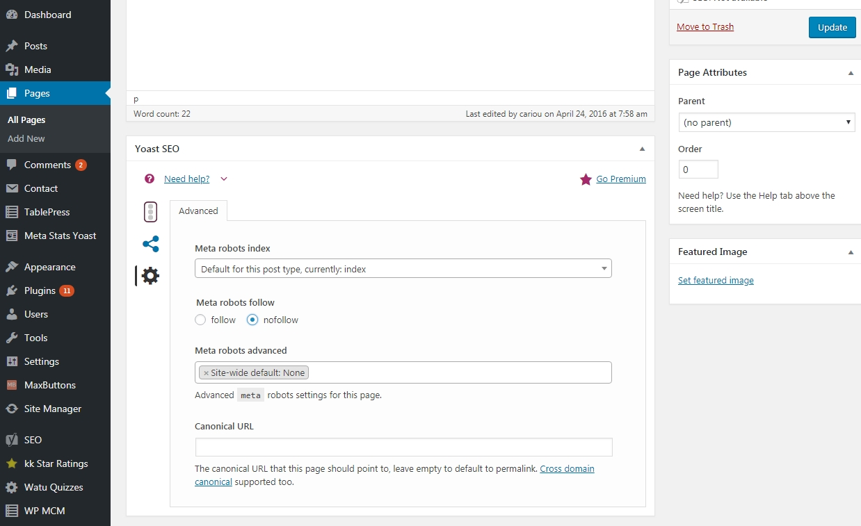
SEO and your e-shop:
1 (SEO) The pages « my account », « chart », « deconnexion »… must be « no index/follow» (also recommended for other pages of your site: « contact »…)
2 (SEO) write contend, tutos, FAQs, posts (on your social medias, blog…) about your products.

Slide 68
When the course ends today (or next week) you must have (1/2):
Ad the plugin: woocommerce
Create your product catalog…, (minimum 10 products, three different categories, tags…) Please note on each product “This item is not yet for sale”
Create a page “Shop” on your website, Adjust the main settings…
Optimize the merchandising of your e-shop (price, promotion, pictures, categories…, )
Add extras, discount, taxes…
Manage orders
Update your dash board
1

Slide 69
(When the course ends today you must have 2/2):
Pick and choose a booking system (find the best plugins and make your own choice)
(If you are not able to select yourself then add the plugin: Pinpoint Booking system)
Add a new page on your website for booking (and menu)
On your website customers will be able to:
See the availability and the prices
book a reservation (day, time , duration) for a single person or for a group (with number of people)
Get extra (sun glasses, audio guide…), discount (for children…)
Get a confirmation e-mail
payment on arrival (reservations need to be approved)
Update your dash board
5

Slide 70
End of Day 7
The tools you need to know today | Ok ?
Manage your social media with Hootsuite
E-shop
Booking System
Design your dashboard ( datas from: Website + Social médias +e-commerce)

Slide 71
2 Web analytics, search console, dashboard
3 Online reputation management (ORM)
4 Social media optimization
5- e-commerce
6 e-mailing / news letters
E-mailing / news letters

Slide 72
First of all I need you e-mail adress (1 adress/person)…
Go to my web site and complete the form

Slide 73
Emailing is nice (and not “has been”) !
Providers (Mailchimp, Sarbacane, Sendinblue…) who send millions of e-mails each month see slight increases in opening rates. A good campaign: 25% opening rate, conversion rate: 1% .
ROI is higher than working on social networks
Why does an user open an e-mail?
He knows the sender (he remembers being a customer, having subscribed to a news letter ...)
The subject interests him (the theme, the advertised promotion ...)
He is confident (because he knows the sender but also because the credibility of the object, the address ...)

Slide 74
The benefits of e-mailing:
- Speed of implementation
- Customization (You can fine tune the message to the target)
- Selectivity (You can choose precisely the people to whom you send the message. For example you can send a message only to “men under 35 who have already come to your property”)
- Powerful links with your website and social networks
Very good possibility of controlling the effectiveness of your campaigns (For example you can find out who received the message that opened the message that to click on the links…and track them on your website)
Virality (« forward » and linked to your social medias and your website)
AB tests easy to manage (ie: A = 10% discount, B = 5€ off test the best with e-mailing)
***
Usually e-mailing campaigns used to nurture relationship with customers or for promotional/special offers campaigns, to advertise events…

Slide 75
But…
Saturation of mailboxes (and / or individuals)
Low message life (trash is not far)
Risk of spam classification, "promotion" by Google
***
The main issues of e-mailing:
What files to use ? How to get good files ?
How to write good emails ? (Pleasant to read, easy to understand, consistent with your marketing objectives… and that will not be classified as spam…)
How to send mails by hundreds ?
How to check the effectiveness of the email campaign ?

Slide 76
About files
This is an essential aspect of the e-mailing campaign: No good e-mailing campaign without good file(s)
Internal file for loyalty (loyalty program), for promotion/special offers to your former customers, for reactivation
External files (purchased or rented) for prospecting new contacts ( = lead)
Read about CRM: here
Often used in
complementarity
Main issue
File quality: volume (how many client records does the file contain), richness (how much information for each person does the file contain?), update, accuracy (is the information for each person accurate ?)...

Slide 77
The worst that could happen: Be blacklisted by Internet Service Providers, ISPs, and anti-spam organizations, Google and other companies.
The blacklistage can be applied to your email address but also to your domain name, to your IP address, to your email boxes…
Avoid a lot of users clicking the "unwanted/spam" button on their mailbox: Remind the recipient that they have given you permission to send them your newsletter, put an unsubscribe button in your email.
Avoid using words as “free”, “bank”, “credit card” (or “sex”, “Viagra”… but it is far from winetourism), don’t use too many uppercase letters (capitals)…Your message will be filtered by the mailboxes and ISPs and classified in spam. If many of the messages you send are classified as spam you will be blacklisted
Do not use a personal mailbox to send hundreds of emails (Your message will be filtered by the mailboxes and ISPs and classified in spam): use an email marketing platform (mailchimp, sendinblue, campaign monitor…)

Slide 78
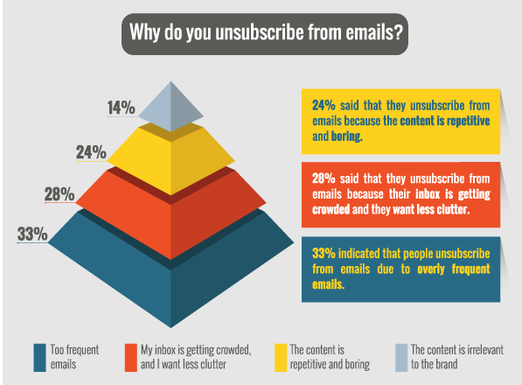

Slide 79
We will use MailChimp which is a very popular e-mailing platform.
(Sorry but for my part I am not very used to MailChimp because I use Sendinblue instead. I hope you will excuse my hesitation)
A small demo to start
For myself:
(google drive+ fichier “e-mail list”+ download cvs format (ad to www.cariou.eu),
go to mailchimp, login (for myself: JCariou+ mdp: xxxxXxxxxx! ) ,
list + createlist + add/import contacts (cvs),
create campaing, send
- Ask students to check their mailbox, ask a few students to click on an email link, ask two students to unsubscribe
reports
Notes:
For myself:
(google drive+ fichier “e-mail list”+ download cvs format (ad to www.cariou.eu),
go to mailchimp, login (for myself: JCariou+ mdp: xxxxXxxxxx! ) ,
list + createlist + add/import contacts (cvs),
create campaing, send
- Ask students to check their mailbox, ask a few students to click on an email link, ask two students to unsubscribe
reports

Slide 80
1 Create a list (mailchimp)

Slide 81
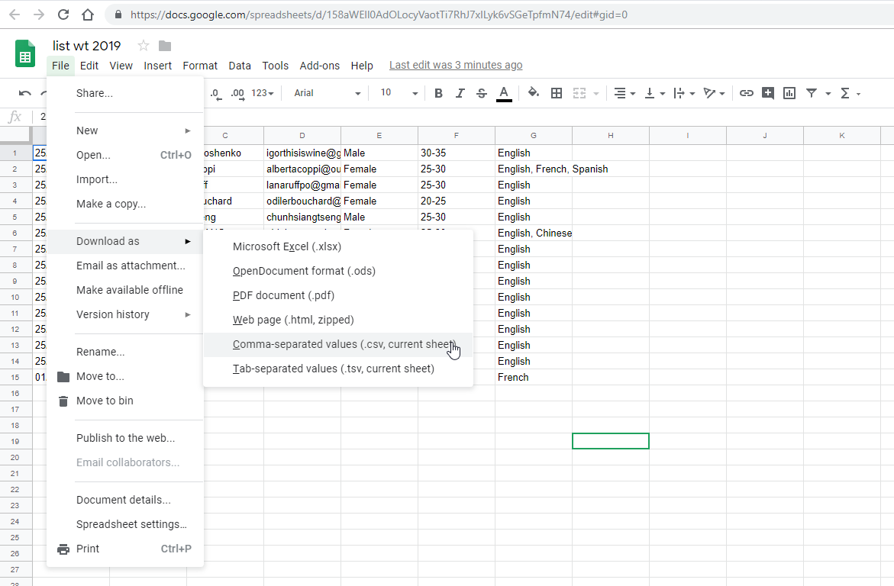

Slide 82
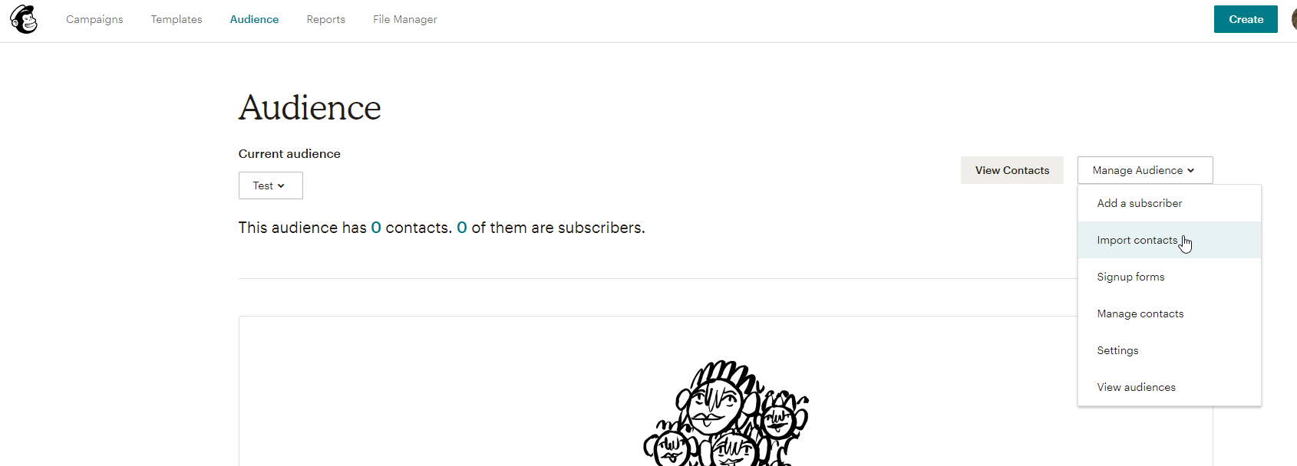

Slide 83
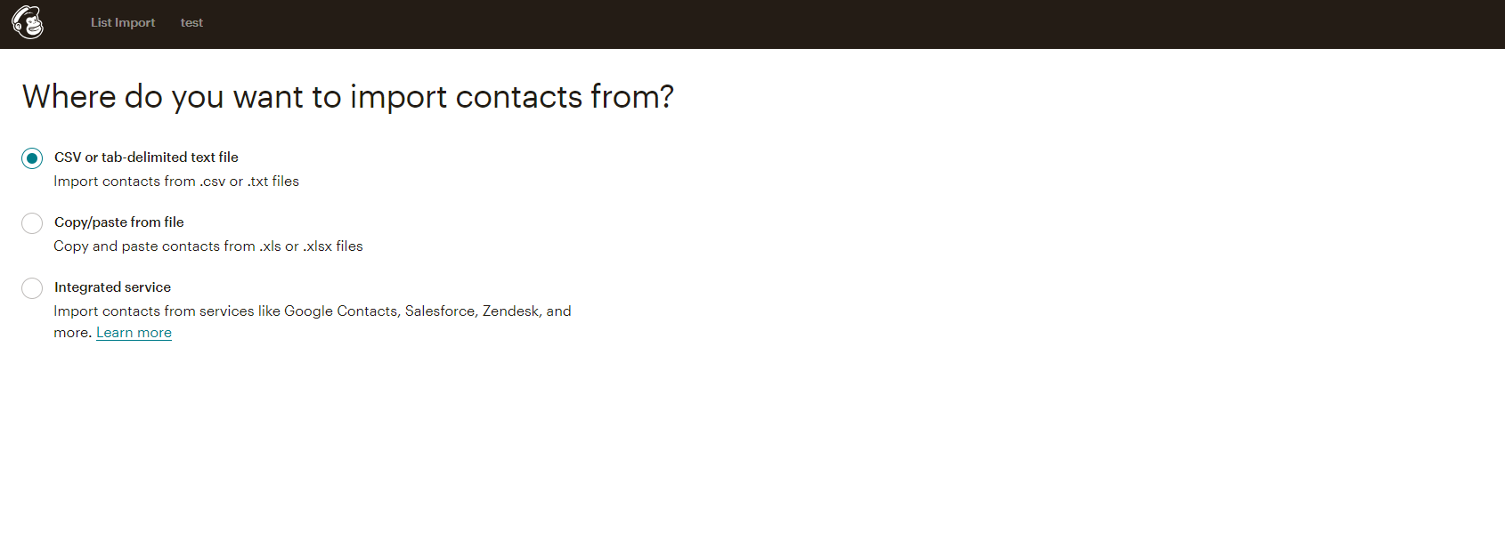

Slide 84
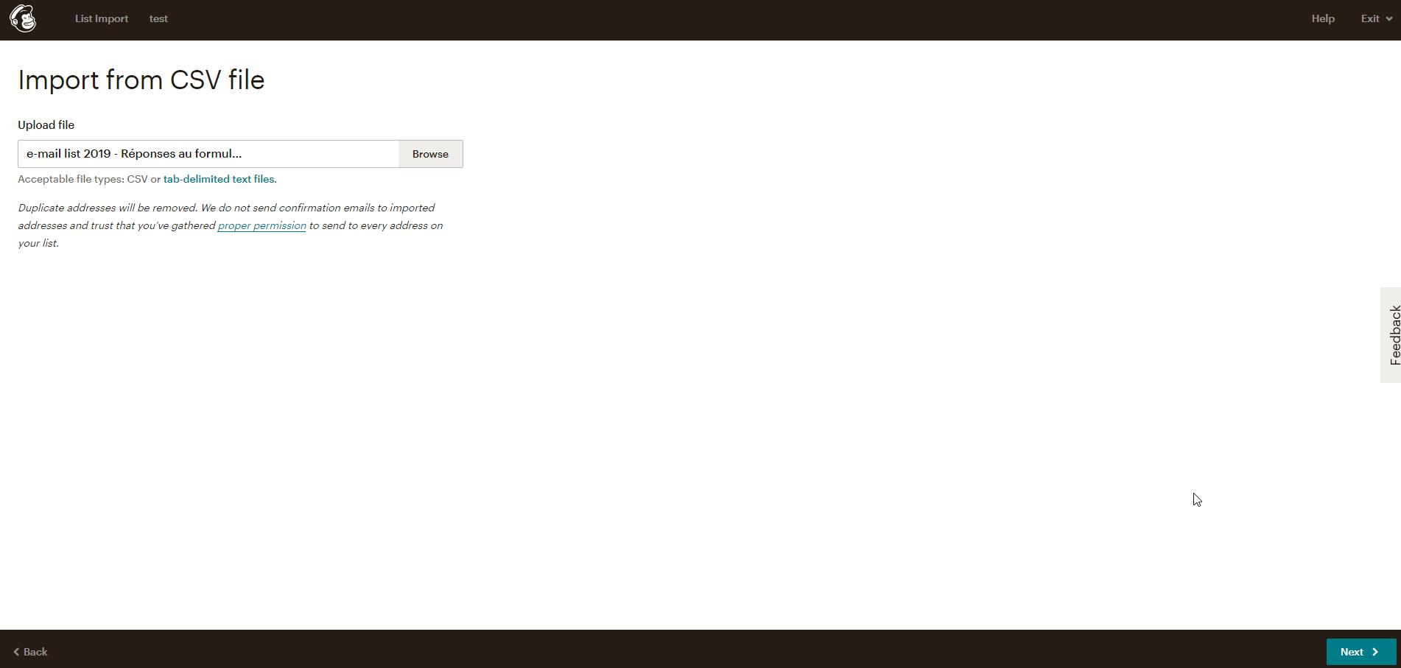

Slide 88
2 Create a campaing

Slide 91
…

Slide 92
3 Check the report

Slide 95
You also must install the plugin:
Mailchimp for woocommerce (or Easy Forms for Mail Chimp) on your web site and linked it with your Mailchimp account

Slide 99
(paste)

Slide 100
When the course ends today you must have:
Create an account on MailChimp (a single account per team)
Create a list and import the CVS file with the email addresses of the entire student group
Create a beautiful e-mail related to the subject of your website
Send the message to all students in the class
Check the dashboard in MailChimp
Ad a subscription form to your web site (richness ?)
You should also continue to develop your digital marketing dashboard (MailChimp is OK with Supermetric)
Notes:
For myself:
(google drive+ fichier “e-mail list”+ download cvs format (ad to www.cariou.eu),
go to mailchimp, login (for myself: JCariou+ mdp: xxxxXxxxxx! ) ,
list + createlist + add/import contacts (cvs),
create campaing, send
- Ask students to check their mailbox, ask a few students to click on an email link, ask two students to unsubscribe
reports

Slide 101
IMPROVE YOUR DASHBOARD !
I want you to use « supermetrics for google sheet »… but the free version is only for 14 days
… so you have to wait 14 days before the last day (« public defense » of your work ) to install Supermetrics’ add-on on googlesheet

Slide 102
To get Supermetrics: Google sheet (“add-ons” + “Get add-ons” + search: “supermetrics” + install = “+ free”)
Then:
Launch supermetrics
Pick and choose your datas

Slide 103
Build your dashboard

Slide 104
Day 9
The tools you need to know today | Ok ?
Adjustment of website details
Web desing SEO Social media E-shop: last setting (specially about login/members…. In connection with the newsletter) Booking system Newsletter, emailing…
Analytics / Dashboard
Development of the defense

Slide 105
Last setting of your website :
- Love the speed
- Be light
- Go green !

Slide 106
Analytics / dashboard
You must choose carefully your KPIs: this concerns your website (you need to study very closely Google analytics), your SEO, your newsletter, your social networks, your reservation system and your e-shop
You must prepare a dashboard: It is a summary document which presents your main KPIs and their evolution over the weeks (figures and charts).
It's better to use Google Data Studio, you can also use Excel

Slide 107
The defense
Each team has 15 minutes maximum
You will use the teacher's computer and the video projector
You must present your work: your marketing goals, the website and its various features, design, social media, newsletter (mailchimp), booking system, e-shop, SEO, your dashboard. Give some tips (your best template, plugin…). It is up to you to select the main elements that highlight your work.
The presentation strategy is free: you can do a powerpoint or a Prezi or choose another way to present your work. It is important that we do not get bored during your presentation: interest us, amaze us ! (Please send me also the elements of the presentation by email)
After the defense 5 minutes will be devoted for a peer evaluation (of course I will then also make my own evaluation)

Slide 108
The end

